Slide 1
Artificial Intelligence
Lecture 1

Slide 2
Contents
Course Outline
Introduction to AI

Slide 3
Course Outline
Text Books:
Artificial Intelligence Illuminated by Ben Coppin
Artificial Intelligence A Modern Approach by Stuart J. Russell and Peter Norvig
Topics:
Part 1: Introduction to Artificial Intelligence
Chapter 1: A Brief History of Artificial Intelligence
Chapter 2: Uses and Limitations
Chapter 3: Knowledge Representation
Part 2: Search
Chapter 4: Search Methodologies
Chapter 5: Advanced Search
Chapter 6: Game Playing

Slide 4
Course Outline…
Part 3: Logic
Chapter 7: Propositional and Predicate Logic
Chapter 8: Inference and Resolution for Problem Solving
Chapter 9: Rules and Expert Systems
Part 4: Machine Learning
Chapter 10: Introduction to Machine Learning
Chapter 11: Neural Networks
Chapter 12: Probabilistic Reasoning and Bayesian Belief Networks
Chapter 13: Artificial Life: Learning through Emergent Behavior

Slide 5
Course Outline…
Part 5: Planning
Chapter 15: Introduction to Planning
Chapter 16: Planning Methods
Part 6: Advanced Topics
Chapter 17: Advanced Knowledge Representation
Chapter 18: Fuzzy Reasoning
Chapter 19: Intelligent Agents
Chapter 20: Understanding Language
Chapter 21:Machine Vision

Slide 6
Introduction to AI
What is intelligence?
(Professor Bruce Batchelor, School of Computer Science, Cardiff University)
It is what we use when we don’t know what to do …
It is difficult to define
Its features may be:
Perform complex tasks
Recognize complex patterns
Solve unseen problems
Learn from experience
Learn from instruction
Use Natural Languages
Be aware of self (consciousness)
Use tools …

Slide 7
Introduction to AI
Many people assert that intelligence is a unique property of man and animals.
Are plants and micro-organisms intelligent?
Can a system be intelligent if it is not based on organic (i.e. carbon chain) chemistry?
Can an intelligent system (e.g. man) design another system that is more intelligent than itself?

Slide 8
Introduction to AI
Intelligent animals:
Monkeys and other primates
Dolphins, whales, horses, dogs, octopus
Rats
Ants exhibit complex behavior not as an individual but as a complete colony
Flat worms

Slide 9
Introduction to AI
Are the following intelligent?
Electrons, quarks, atoms
Molecules
DNA molecules
Viruses
Bacteria
Clouds
Plants

Slide 10
Introduction to AI
How do we judge intelligence?
System response time affects our judgment of intelligence?
Can a system is said to be intelligent if it takes a thousand years to respond to a "query"?
Can a system ever be judged to be intelligent if it cannot communicate with the outside world? (Are autistic people intelligent?)

Slide 11
Introduction to AI
Albert Einstein
Einstein had difficulty with social interactions, had tactile sensitivity, was very intelligent yet found his language difficult at times, and had difficulty learning in school. It may have been that Einstein had such a hard time with learning in school because he did not have the accommodations and different teaching styles that many autistic children need. Because of this, it makes perfect sense that someone so intelligent and full of ideas about the world could fall behind in school. It also makes sense that, because of his social interactions with others, he found it difficult to get a job despite his intelligence. Many of the individuals also have a lack of desire for food and the same disregard for timeliness of meals as Einstein. However, Einstein did not care what he ate and completed his meals with no complaints. Many other autistics were very specific about the kinds, colors, textures, and smells of foods if they had any aversion to food at all. His carelessness for the time or necessity of food rather than persistence on what the food he ate is slightly different than most autistics. However, all autistics are different, and therefore it is indeterminant whether this should be classified as an autistic trait or not. Einstein had a relationship with a woman whom he eventually married and had three children with. The marriage seemed to have quite a bit of difficulty, but the woman gave birth to three children with him. However, although Einstein showed love and concern for his children, the he could not stand for the children to touch him. This, sounds very characteristic of an autistic. It is important to realize that Einstein was very different and it was his difference that made him develop ideas that made him famous. Therefore, his differences made him the celebrated individual he is today. This should give us a second look at those who we consider different, and make us realize that being different is not a bad thing. It is instead, something to be celebrated and accepted.

Slide 12
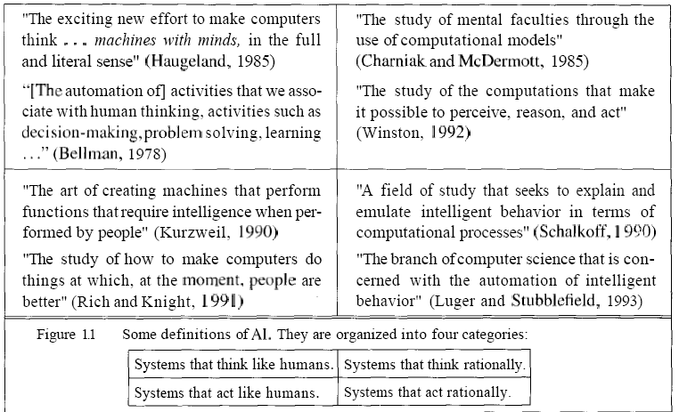
Introduction to AI Definition:

Slide 13
Intro…
What is Artificial Intelligence?
AI is the study of heuristics, rather than algorithms.
Heuristic: A rule of thumb, which usually works but may not do so in all circumstances. Example: getting to university in time for a 9.00 lecture.
Algorithm: A prescription for solving a given problem, over a defined range of input conditions. Example: solving a quadratic equation, or a set of N linear equations involving N variables.

Slide 14
Intro…
Goal of AI: Not only to understand how does mind work? but also how to build intelligent entities?.
Engineering:-solve real-world problems using knowledge and reasoning -develop concepts, theory and practice of building intelligent entities -emphasis on system building
Scientific:-use computers as a platform for studying intelligence itself -emphasis on understanding intelligent behavior.

Slide 15
Intro…
AI is one of the newest sciences which emerged after the world war II.
AI represents a big and open field.
The name Artificial Intelligence was adopted for the first time in 1956.
AI can be viewed as a universal field: How to automate intellectual tasks?

Slide 16
Intro…
AI Definitions revised:
According to thought and reasoning
Thinking humanly
«The automation of activities that we associate with human thinking, activities such as decision-making, problem solving, learning…»(bellman, 1978).
«The exciting new effort to make computers think…machines with minds, in the full and literal sense. »(Haugeland, 1985).
Thinking rationally
Rational System= system which does the «right thing» given what it knows.
«The study of mental faculties through the use of computational models. »(Charniak and Mc dermott, 1985).
«The study of the computations that make it possible to perceive, reason and act. »(Winston 1992).

Slide 17
Some AI Definitions:
According to behavior
Acting Humanly
≪ The art of creating machines that perform functions that require intelligence when performed by people. ≫ (Kurzweil, 1990)
≪ The study of how to make computers do things at which, at the moment, people are better. ≫ (Rich and Knight, 1991)
Acting rationally
≪ Computational intelligence is the study of the design of intelligent agents. ≫ (Poole et al.,1998).
≪ AI…is concerned with intelligent behavior in artifacts. ≫ (Nilsson, 1998).

Slide 18
Some other AI Definitions
Weak AI: AI develops useful, powerful applications
Strong AI: claims machines have cognitive minds comparable to humans
Debates on strong AI bring up some difficult conceptual problems in philosophy …

Slide 19
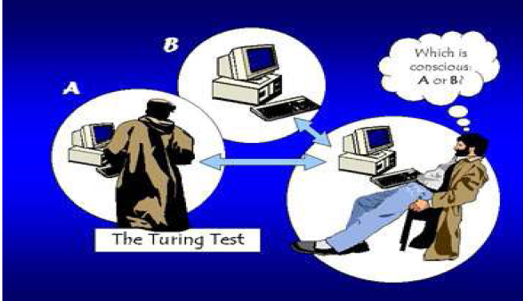
Acting Humanly
Turing Test: Alan Turing 1950 ≪ Computing Machinery and Intelligence ≫

Slide 20
Test: The computer passes the “test of intelligence” if a human, after posing some
written questions, cannot tell whether the responses were from a person or not.
Provides an operational definition of AI.
Still being used today within the AI community in annual competitions – the
Loebner Prize ($100,000 and a true 18K gold medal)
To give an answer, the computer would need to posses some capabilities:
Natural language processing: To communicate successfully.
Knowledge representation: To store what it knows or hears.
Automated reasoning: to answer questions and draw conclusions using stored
information.
Machine learning: To adapt to new circumstances and to detect and extrapolate
patterns.
Computer vision: To perceive objects.
Robotics: to manipulate objects and move.

Slide 21
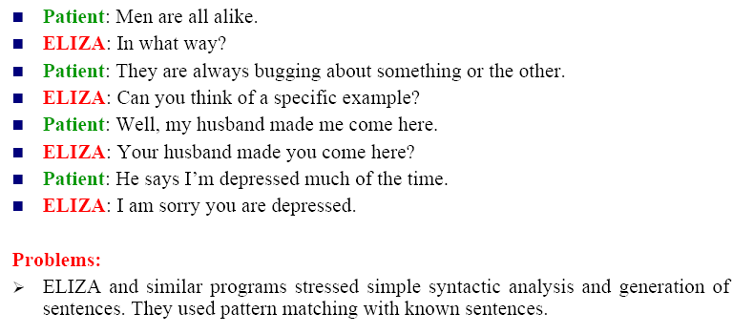
Example: ELIZA program, some extracts from the test:

Slide 22
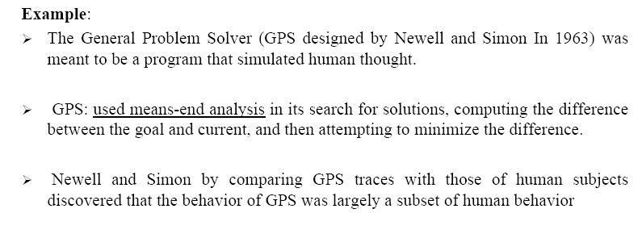
Thinking Humanly:
Programs think like human → How humans think?
Requires Scientific theories of internal activities of the brain (cognitive science and cognitive neuroscience).

Slide 23
Thinking rationally:
The Laws of Thought approach is based on pattern for argument structure arising from Aristostle’s syllogisms (a deductive form of reasoning).
Example, “Socrates is a man; all men are mortal, therefore Socrates is mortal.” The laws of thought initiated the field of logic.
The formal logic movement was advanced by Peano, Boole, Frege,, Godel and others (late 1800’s and early 1900’s)

Slide 24
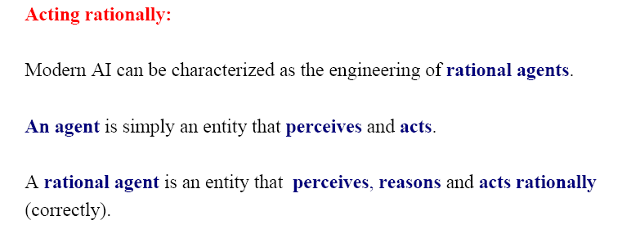

Slide 25
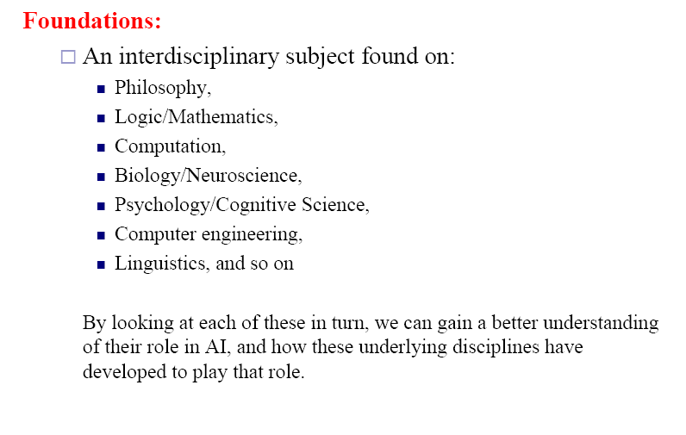

Slide 26
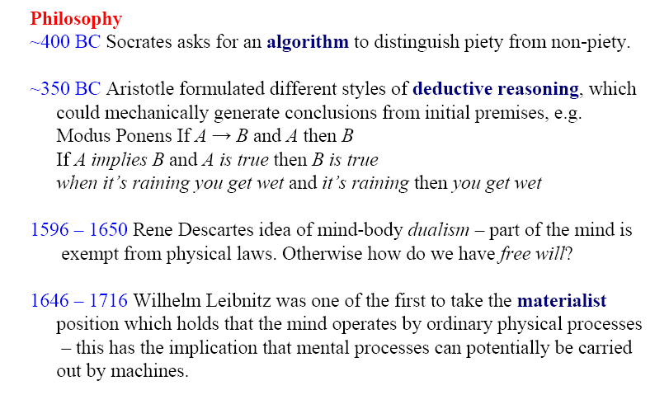

Slide 27
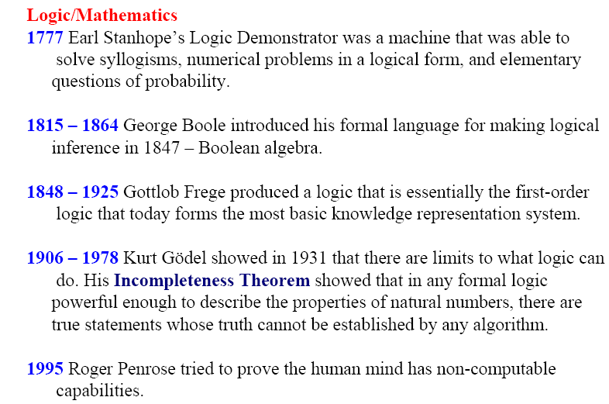

Slide 28
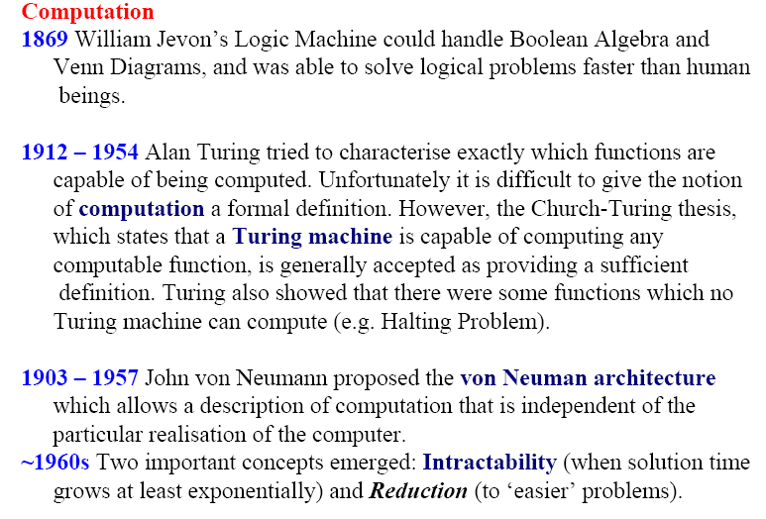

Slide 29
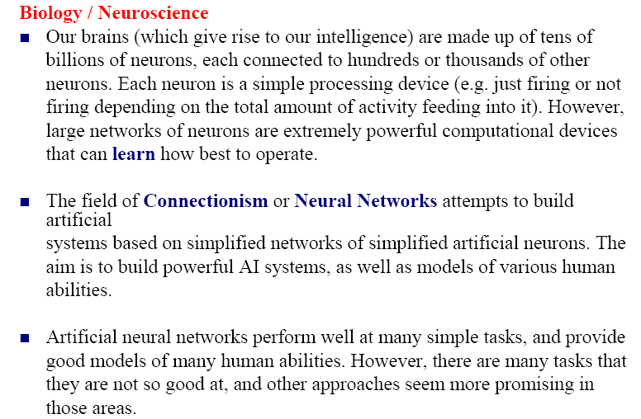

Slide 30
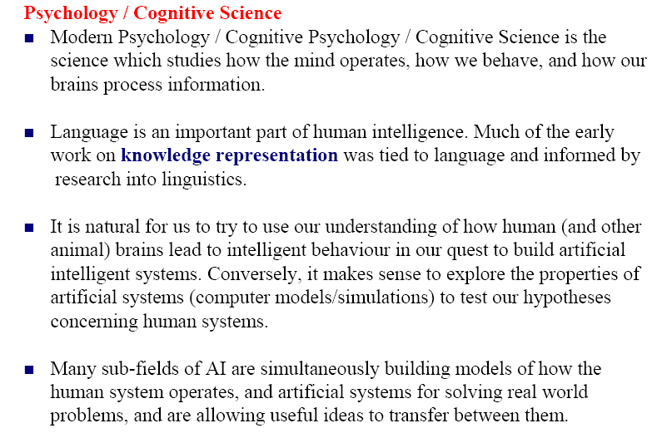

Slide 31
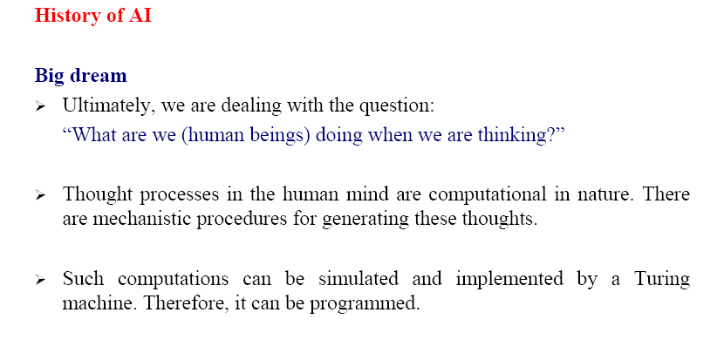

Slide 32
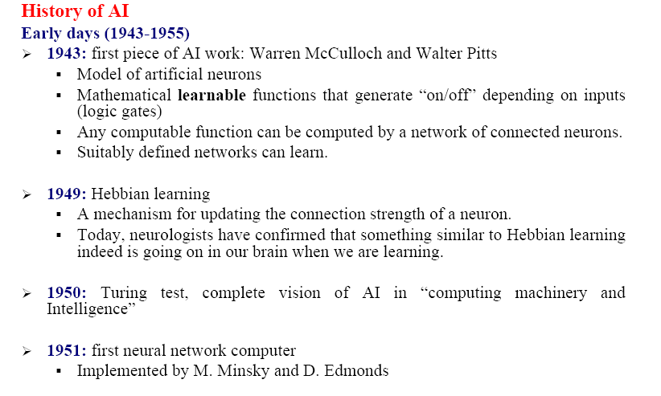

Slide 33
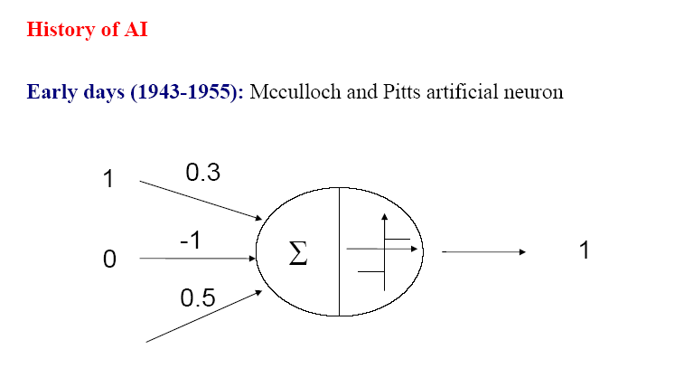

Slide 34
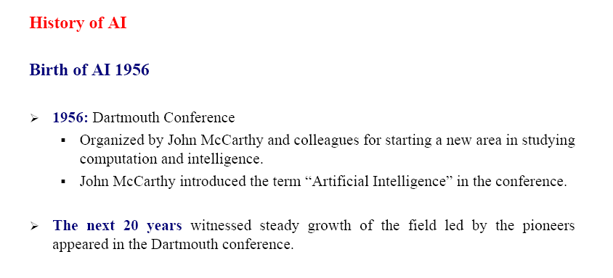

Slide 35
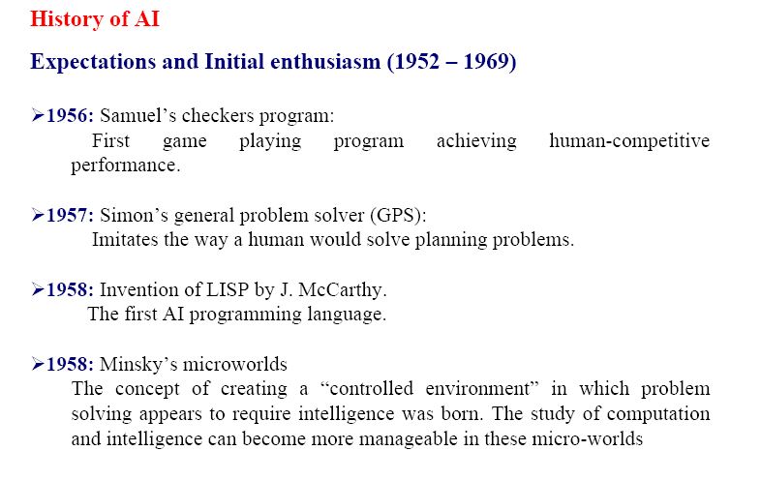

Slide 36
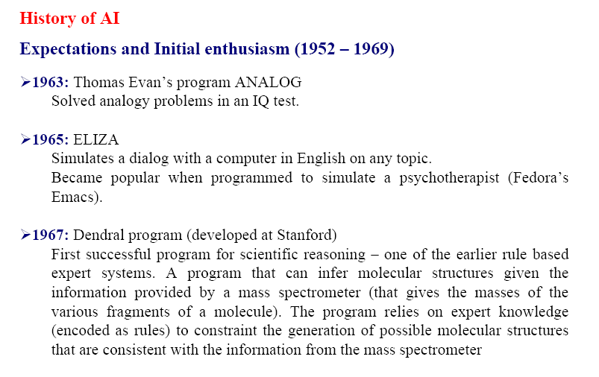

Slide 37
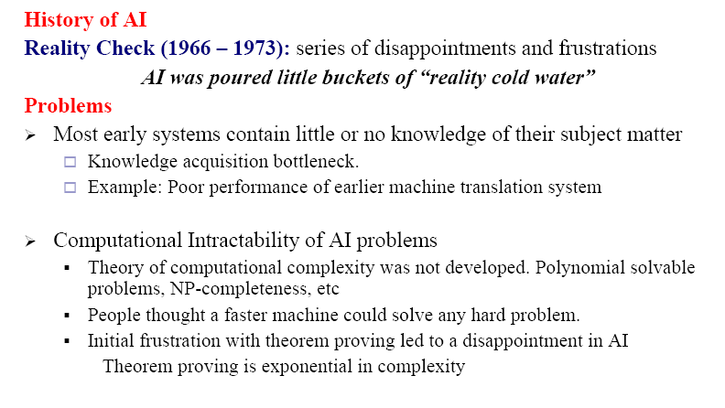

Slide 38
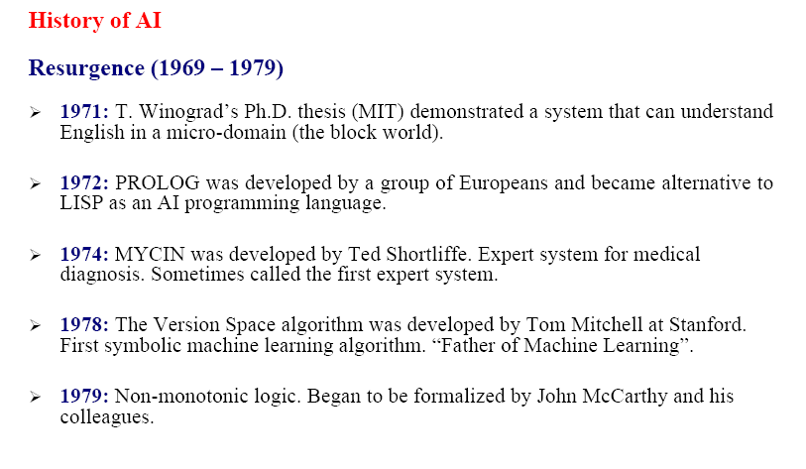

Slide 39
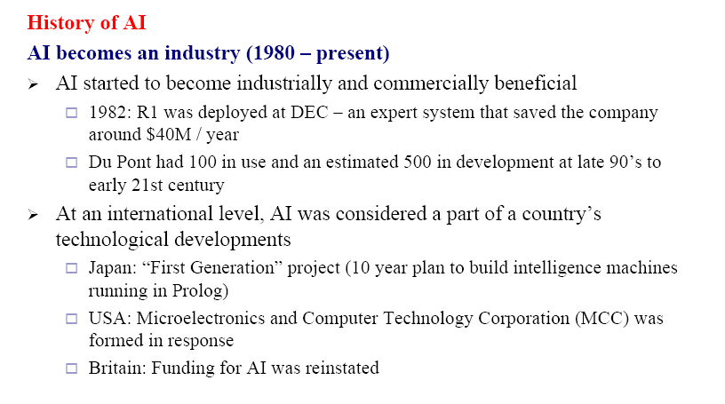

Slide 40
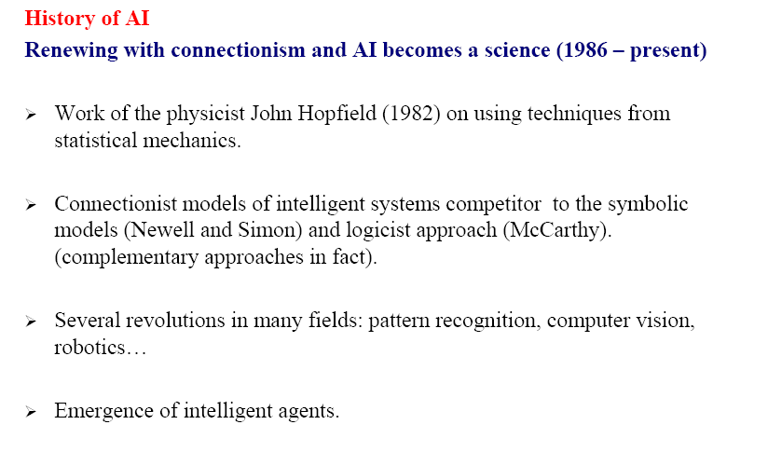

Slide 41
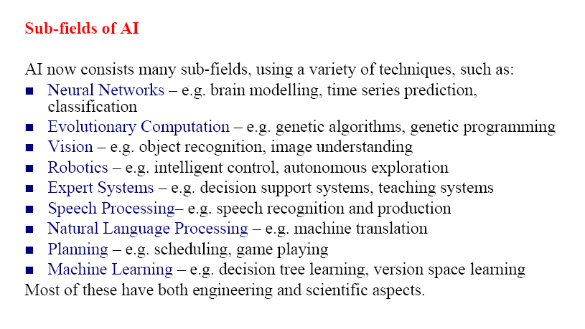

Slide 42
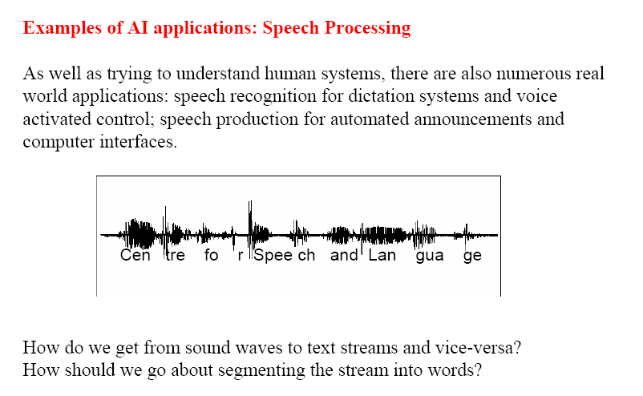

Slide 43
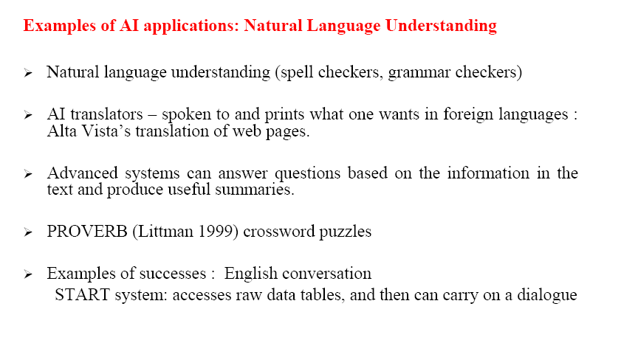

Slide 44
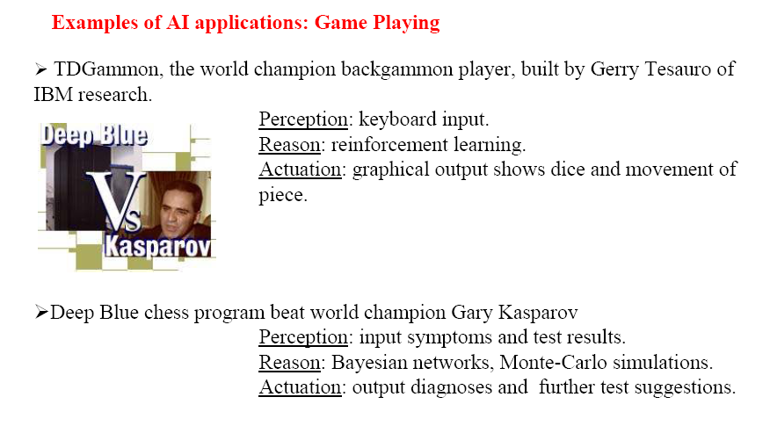

Slide 45
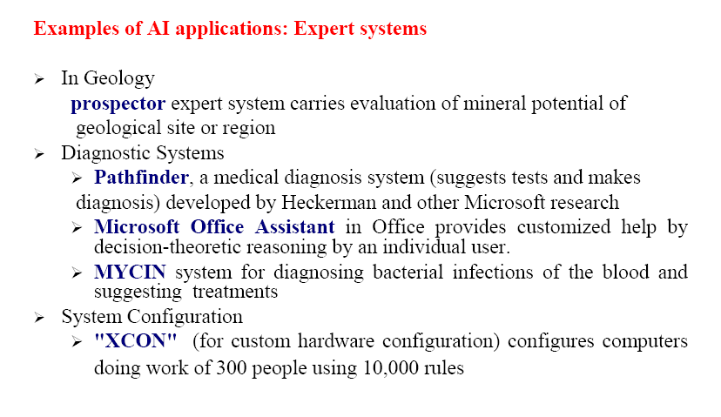

Slide 46
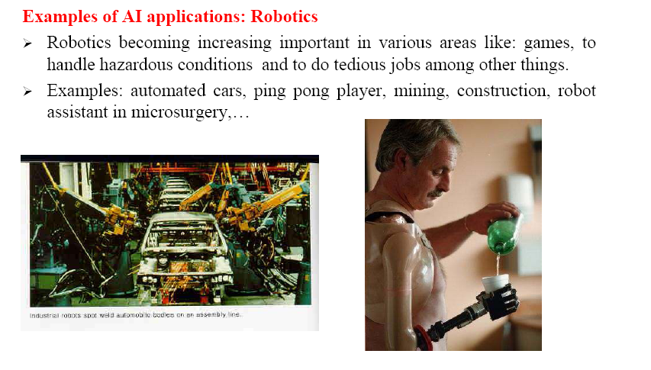

Slide 47
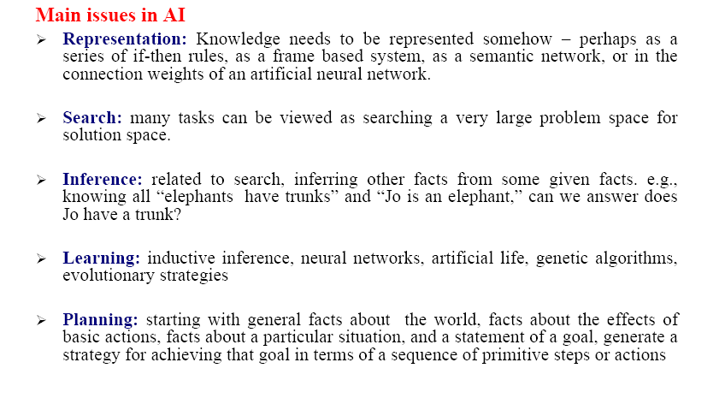
Deductive general to specific
Inductive specific to general

Slide 48
