Slide 1
Artificial Intelligence
Lecture 2

Slide 2
Contents
AI programming languages
The fight between strong and weak AI
Knowledge representation

Slide 3
AI programming languages
PROLOG
LISP

Slide 4
PROLOG
PROgramming in LOGic is a language that enables programmers to build a database of FACTS and RULES.
queries are made , the system answers to those queries based on the knowledge (rules and facts) stored in the database
Example: you store the following facts in database
fruit(mango).
fruit(apple).
fruit(orange).
juicyFruit(orange).

Slide 5
-
Then ask question from the system as
?- fruit(mango).
The prolog system will answer
true

Slide 6
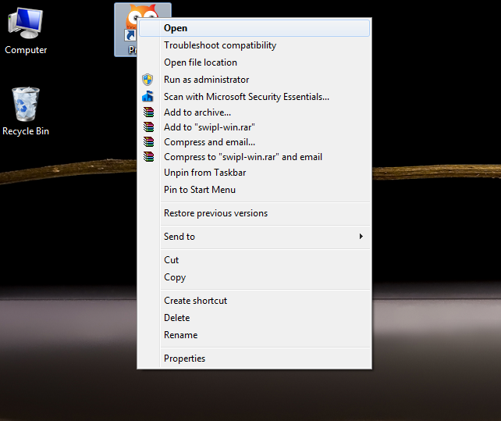
How to use PROLOG System
Step#01:
Open the prolog window by double clicking on the prolog icon (or right click on the prolog icon and then click Ok).

Slide 7
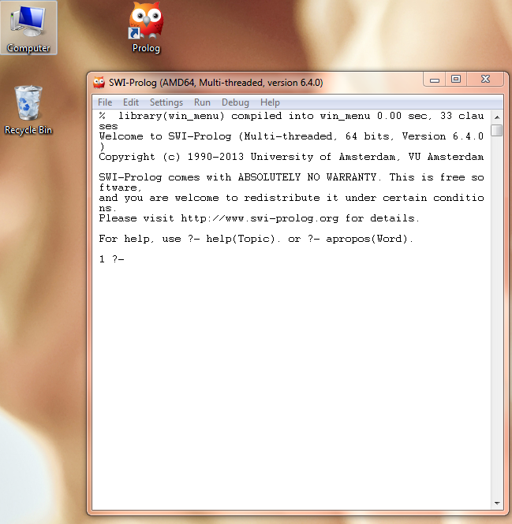
.
The following window appeares

Slide 8
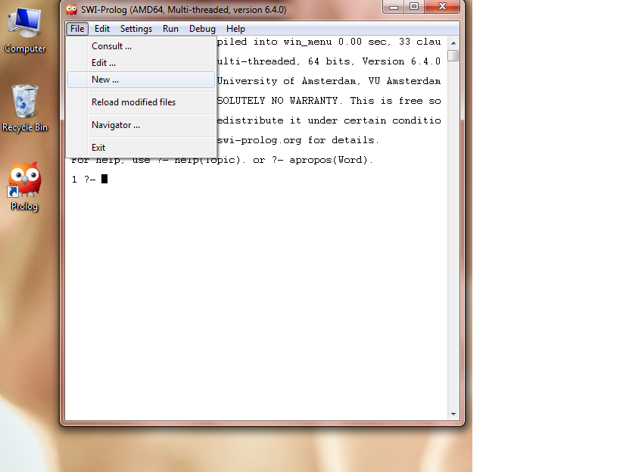
..
Step#02:
Then click on the
File => New

Slide 9
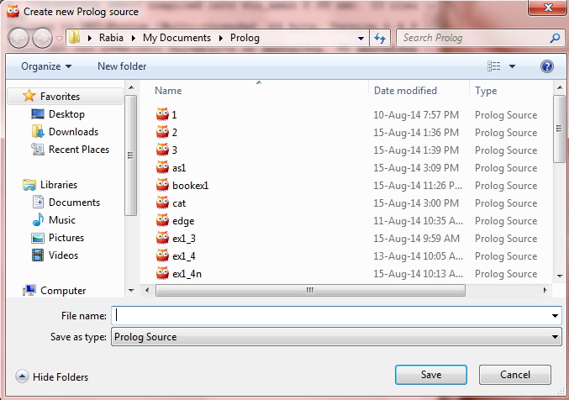
.
Write the file name with the extension “.pl”, for example “firstprogram.pl” is a valid prolog file name. A new window (as shown in below figure) will appear, the program is written in this new window.

Slide 10
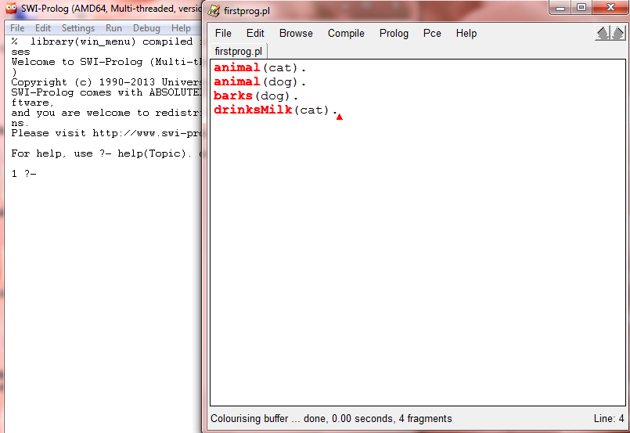
.
Then go to
File=>Save to save the program, then go to the first window and go to file=>consult and chose the program to load the program, (e.g. firstpro.pl).

Slide 11
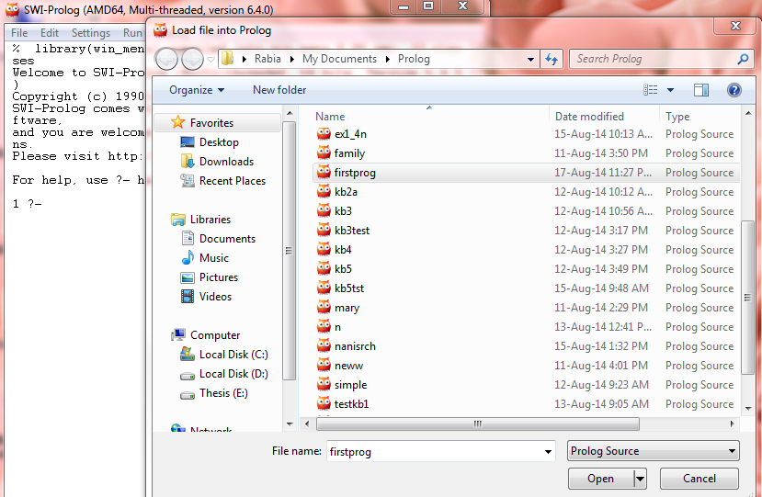
.
Now the program is loaded and you can pose queries in command window .

Slide 12
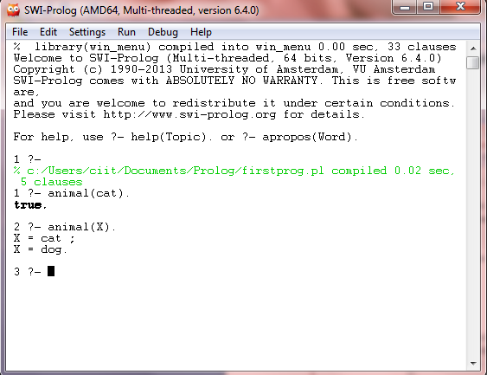

Slide 13
Operators used in RULES of prolog
ENGLISH | PROLOG
And | ,
or | ;
Only if | :-
Not | not

Slide 14
Example of RULE
Sibling(x,y) :- parent(z,x), parent(z,y).
Only if z is parent of x and y then x and y are siblings

Slide 15
LISP
The LISt Programming language resembles C++ and Pascal.
When you enter
(+ 1 1)
The lisp replies
=> 2
(/ 25 5)
=> 5
"Hello, world!“
=> "Hello, world!“
(setf x 5) ; Setf gives a value to a variable. It has a side => 5 ; effect and ALSO returns a value
(setf y (reverse '(+ a b))) ; Reverse reverses a list. => (B A +)

Slide 16
The Chinese Room- an argument to supporters of strong AI
Searle’s Chinese Room experiment was based on this idea and is described as follows:
An English-speaking human is placed inside a room. This human does not speak any language other than English and in particular has no ability to read,speak,or understand Chinese.
In other words,running a computer program that behaves in an intelligent way does not necessarily produce understanding, consciousness, or real intelligence.

Slide 17
Knowledge Representation
Semantic Nets
Inheritance
Frames
Object-oriented Programming
Search Spaces
Semantic Trees
Combinatorial Explosion
Problem Reduction
Goal Trees

Slide 18
Semantic Nets
The semantic net is a commonly used representation in Artificial Intelligence.
A semantic net is a graph consisting of nodes that are connected by edges.
The nodes represent objects, and the links between nodes represent relationships between those objects.
The links are usually labeled to indicate the nature of the relationship.

Slide 19
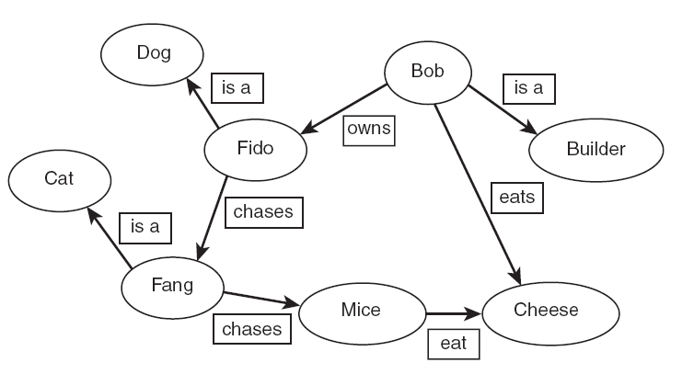
Semantic net example

Slide 20
Semantic nets have limitations, such as the inability to represent negations: “Fido is not a cat.”
The specific objects are generally referred to as instances of a particular class. Fido is an instance of the class dog. Bob is an instance of the class Builder.

Slide 21
In-efficiency
A simple representation for searching for a word in a dictionary would be to have the nodes arranged in a chain with one connection from the first node to the second, and then from the second to the third, and so on.

Slide 22
Inheritance
C++/ Java support this
As has been shown, although inheritance is a useful way to express generalities about a class of objects, in some cases we need to express exceptions to those generalities (such as, “Male animals do not give birth” or “Female dogs below the age of six months do not give birth”). In such cases, we say that the default value has been overridden in the subclass.

Slide 23
Frames
Frame-based representation is a development of semantic nets and allows us to express the idea of inheritance.

Slide 24
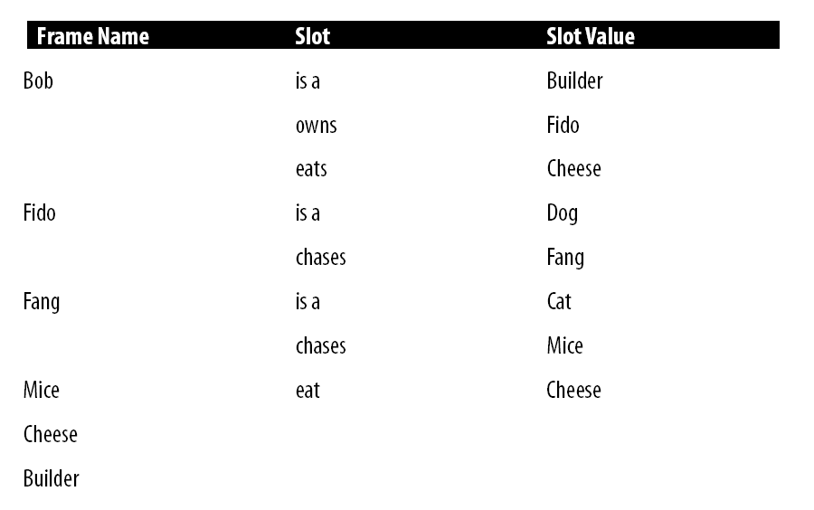
Example

Slide 25
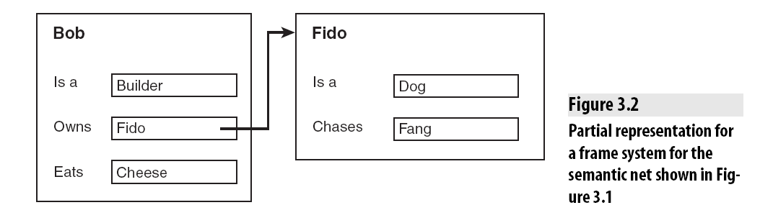

Slide 26
The main advantage of using frame-based systems for expert systems over the rule-based approach is that all the information about a particular object is stored in one place.
In a rule-based system, information about Fido might be stored in a number of otherwise unrelated rules, and so if Fido changes, or a deduction needs to be made about Fido, time may be wasted examining irrelevant rules and facts in the system, whereas with the frame system, the Fido frame could be quickly examined.

Slide 27
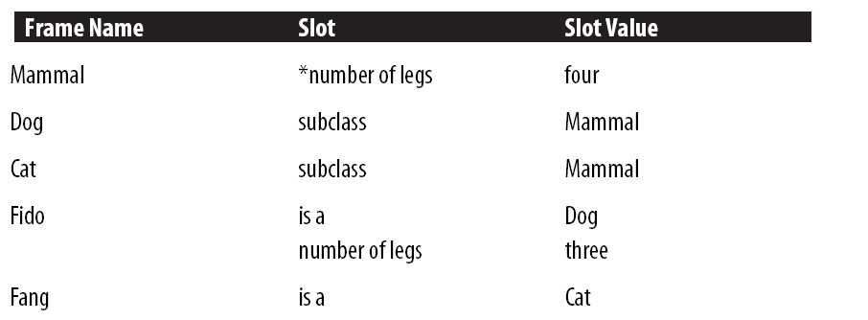
Example 2

Slide 28
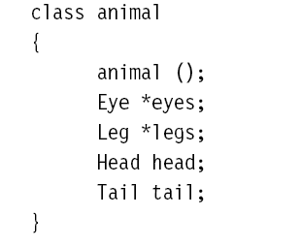
Object-Oriented Programming
C++
JAVA
C#

Slide 29

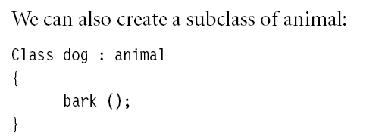

Slide 30
Search Space
In simple terms, a search space is a representation of the set of possible choices in a given problem, one or more of which are the solution to the problem.

Slide 31
Search Spaces
For example, attempting to find a particular word in a dictionary with 100 pages, a search space will consist of each of the 100 pages.
The page that is being searched for is called a goal, and it can be identified by seeing whether the word we are looking for is on the page or not.

Slide 32
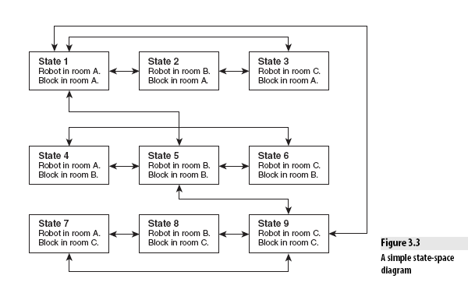
example

