Slide 1
Artificial Intelligence
Lecture 3

Slide 2
Knowledge Representation
Semantic Tree
Search Trees
Example 1:Missionaries and Cannibals
Improving the Representation
Example 2: The Traveling Salesman
Example 3: The Towers of Hanoi
Example 4: Describe and Match

Slide 3
Combinatorial Explosion
Problem Reduction
Goal Trees
Top Down or Bottom Up Approach
Uses of Goal Trees
Example 1:Map Coloring
Example 2: Proving Theorems
Example 3: Parsing Sentences 63
Example 4: Games

Slide 4
Semantic Tree
A semantic tree is a kind of semantic net that has the following properties:
Each node (except root node) has exactly one predecessor (parent), and has zero, one or more successors.
A node having no predecessor is called Root node, and having no successor is a leaf node
One or more leaf nodes may be Goal nodes

Slide 5
Semantic Tree…
A path is a route through the semantic tree, which may consist of just one node (a path of length 0).
A path of length 1 consists of a node, a branch that leads from that node, and the successor node to which that branch leads.
A path that leads from the root node to a goal node is called a complete path.
A path that leads from the root node to a leaf node that is not a goal node is called a partial path.

Slide 6
Semantic tree…
In semantic trees, an edge that connects two nodes is called a branch.
If a node has n successors, that node is said to have a branching factor of n.
A tree is often said to have a branching factor of n if the average branching factor of all the nodes in the tree is n.
The root node of a tree is said to be at level 0, and the successors of the root node are at level 1. Successors of nodes at level n are at level n + 1.

Slide 7
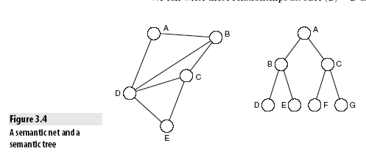

Slide 8
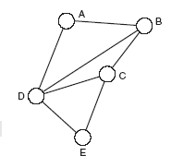
Search Trees
Search tree is a type of semantic tree.
Consider the following semantic net that has several cyclic paths, we can represent this net in form of a Tree, that is called Search Tree

Slide 9
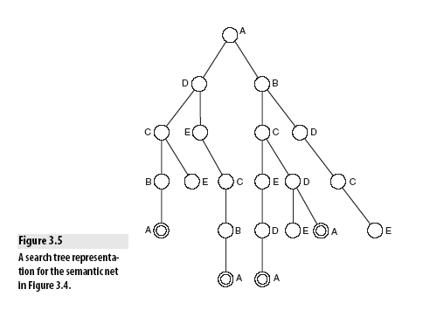
Search tree

Slide 10
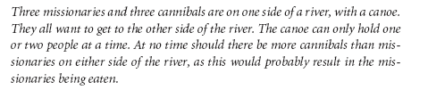
Example 1: Missionaries and Cannibals
3, 3, 1 0, 0, 0

Slide 11
We apply operators
1. Move one cannibal to the other side
2. Move two cannibals to the other side
3. Move one missionary to the other side
4. Move two missionaries to the other side
5. Move one cannibal and one missionary to the other side

Slide 12
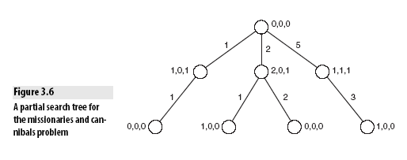
Search tree formation

Slide 13
By applying operator 1 (moving one cannibal to the other side) as the first action, and then applying the same operator again, we return to the start state.
This is a perfectly valid way to try to solve the problem, but not a very efficient one.

Slide 14
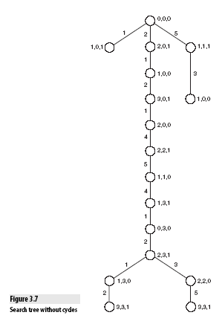

Slide 15
Example 2: The Traveling Salesman
The Traveling Salesman problem is defined as follows:
A salesman must visit each of a set of cities and then return home.
The aim of the problem is to find the shortest path that lets the salesman visit each city.

Slide 16
Let us imagine that our salesman is touring the following American cities:
A : Atlanta
B : Boston
C : Chicago
D : Dallas
E : El Paso

Slide 17
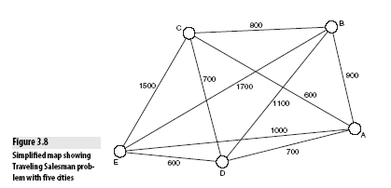

Slide 18
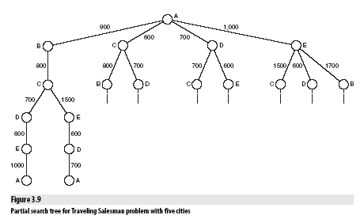

Slide 19
Example 3: The Towers of Hanoi
1
3
2

Slide 20
Example 3: The Towers of Hanoi
Op1 Move disk from peg 1 to peg 2
Op2 Move disk from peg 1 to peg 3
Op3 Move disk from peg 2 to peg 1
Op4 Move disk from peg 2 to peg 3
Op5 Move disk from peg 3 to peg 1
Op6 Move disk from peg 3 to peg 2

Slide 21
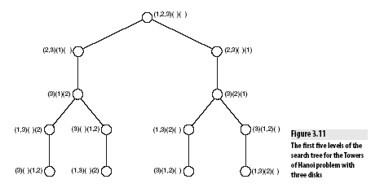

Slide 22
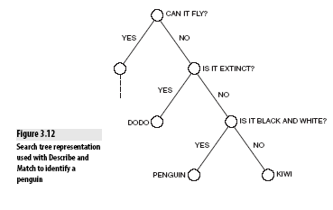
Example 4: Describe and Match
No longer exist

Slide 23
Combinatorial Explosion
The search tree for a Traveling Salesman problem becomes unmanageably large as the number of cities increases.
Many problems have the property that as the number of individual items being considered increases, the number of possible paths in the search tree increases exponentially, meaning that as the problem gets larger, it becomes more and more unreasonable to expect a computer program to be able to solve it.
This problem is known as combinatorial explosion because the amount of work that a program needs to do to solve the problem seems to grow at an explosive rate, due to the possible combinations it must consider.

Slide 24
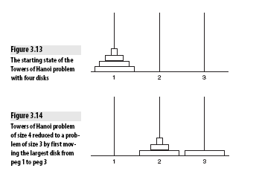
Problem Reduction
To divide the complex problem into simple problems and then solve it.

Slide 25
Goal Trees
A goal tree (also called an and-or tree) is a form of semantic tree used to represent problems that can be broken down in this way.
We say that the solution to the problem is the goal, and each individual step along the way is a sub-goal.
In the case of the Towers of Hanoi, moving the largest disk to peg 3 is a sub-goal.

Slide 26
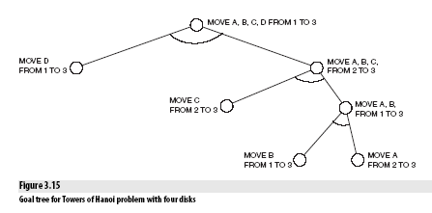

Slide 27
Top Down or Bottom Up?
There are two main approaches to breaking down a problem into subgoals—top down and bottom up.

Slide 28
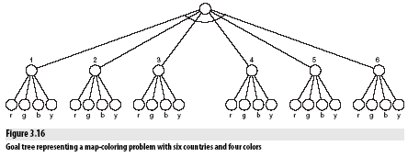
Example 1: Map Coloring

Slide 29
Assignment # 1 last date of submission: 16th sept, 2014
Answer the following questions (in detail )
Describe time complexity.
What are Common time complexities
What is meant by Non-deterministic Polynomial problem
What is meant by polynomial time?
What are the Types of Complexity ?
How to find complexity of an algorithm ?

Slide 30
Search Methodologies
Introduction
Problem Solving as Search
Data-Driven or Goal-Driven Search
Generate and Test
Depth-First Search
Breadth-First Search
Properties of Search Methods
Complexity
Completeness
Optimality
Irrevocability

Slide 31
Introduction

Slide 32
Problem Solving as Search
A problem can be considered to consist of a goal and a set of actions that can be taken to lead to the goal.
At any given time, we consider the state of the search space to represent where we have reached as a result of the actions we have applied so far.
problem of looking for a contact lens

Slide 33
Data-Driven or Goal-Driven Search
Data-driven search starts from an initial state and uses actions that are allowed to move forward until a goal is reached. This approach is also known as forward chaining.
search can start at the goal and work back toward a start state,by seeing what moves could have led to the goal state. This is goal-driven search, also known as backward chaining.

Slide 34
examples
Goal Driven:
1. A theorem that is to be proved or
Finding an exit from a maze
3. It is also clearly the best choice in situations such as medical diagnosis where the goal (the condition to be diagnosed) is known, but the rest of the data (in this case, the causes of the condition) need to be found.

Slide 35
Data driven:
1. A system that analyzes astronomical data and thus makes deductions about the nature of stars and planets would receive a great deal of data, but it would not necessarily be given any direct goals. Rather, it would be expected to analyze the data and determine conclusions of its own. This kind of system has a huge number of possible goals that it might locate. In this case, data-driven search is most appropriate.

Slide 36
Generate and Test
The simplest approach to search is called Generate and Test.
This simply involves generating each node in the search space and testing it to see if it is a goal node. If it is, the search has succeeded and need not carry on. Otherwise, the procedure moves on to the next node.

Slide 37
..
This is the simplest form of brute-force search (also called exhaustive search), so called because it assumes no additional knowledge other than how to traverse the search tree and how to identify leaf nodes and goal nodes, and it will ultimately examine every node in the tree until it finds a goal.

Slide 38
To successfully operate, Generate and Test needs to have a suitable Generator, which should satisfy three properties:
1. It must be complete: In other words, it must generate every possible solution; otherwise it might miss a suitable solution.
2. It must be non redundant: This means that it should not generate the same solution twice.
3. It must be well informed: This means that it should only propose suitable solutions and should not examine possible solutions that do not match the search space.

Slide 39
blind search technique
Generate and Test is also sometimes referred to as a blind search technique because of the way in which the search tree is searched without using any information about the search space.

Slide 40
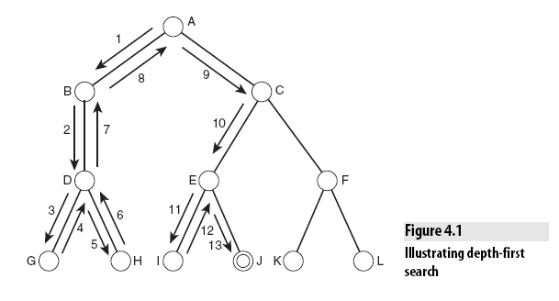
Depth-First Search

Slide 41
Depth-first search is often used by computers for search problems such as locating files on a disk, or by search engines for spidering the Internet.
Problems occur when starting braches are deep and don’t have goals or solutions over there.

Slide 42
The problem of infinite paths can be avoided in depth-first search by applying a depth threshold. This means that paths will be considered to have terminated when they reach a specified depth.

Slide 43
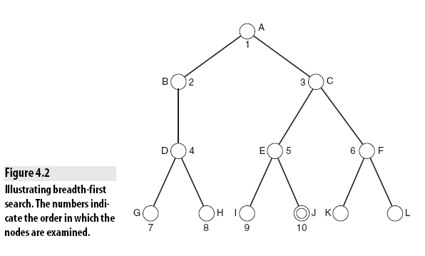
Breadth-First Search

Slide 44
Breadth-first search is a far better method to use in situations where the tree may have very deep paths, and particularly where the goal node is in a shallower part of the tree.
Unfortunately, it does not perform so well where the branching factor of the tree is extremely high, such as when examining game trees for games like Go or Chess

Slide 45
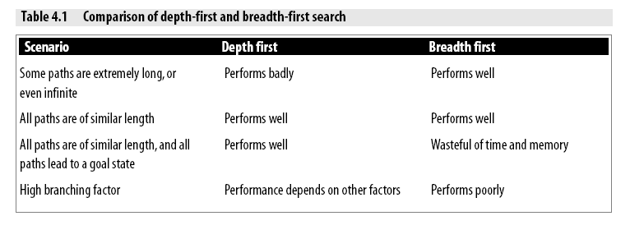

Slide 46
Breadth-first search is a poor idea in trees where all paths lead to a goal node with similar length paths. In situations such as this, depth-first search would perform far better because it would identify a goal node when it reached the bottom of the first path it examined.

Slide 47
Properties of Search Methods
■ complexity
■ completeness
■ optimality
■ admissibility
■ irrevocability

Slide 48
Complexity
In discussing a search method, it is useful to describe how efficient that method is, over time and space. The time complexity of a method is related to the length of time that the method would take to find a goal state.
The space complexity is related to the amount of memory that the method needs to use.

Slide 49
It is normal to use Big-O notation to describe the complexity of a method.
For example, breadth-first search has a time complexity of
where b is the branching factor of the tree, and d is the depth of the goal node in the tree.

Slide 50
Completeness
A search method is described as being complete if it is guaranteed to find a goal state if one exists.
Breadth-first search is complete, but depth-first search is not because it may explore a path of infinite length and never find a goal node that exists on another path.

Slide 51
Optimality
A search method is optimal if it is guaranteed to find the best solution that exists. In other words, it will find the path to a goal state that involves taking the least number of steps.
Alternative word used for optimality:
An algorithm is then defined as admissible if it is guaranteed to find the best solution.

Slide 52
Irrevocability
Methods that do not use backtracking, and which therefore examine just one path, are described as irrevocable.
Example:
Hill-climbing

Slide 53
Search Methodologies

Slide 54
Search…
Why Humans Use Depth-First Search?
Example 1: Traversing a Maze
Example 2: Searching for a Gift
Implementing Depth-First and Breadth-First Search
Example:Web Spidering
Depth-First Iterative Deepening
Using Heuristics for Search
Informed and Uninformed Methods
Choosing a Good Heuristic
The 8-Puzzle

Slide 55
Search…
Monotonicity
Example: The Modified Traveling Salesman
Hill Climbing
Steepest Ascent Hill Climbing
Foothills, Plateaus, and Ridges
Best-First Search
Beam Search
Identifying Optimal Paths
A* Algorithms
Uniform Cost Search
Greedy Search
Example: The Knapsack Problem

