Slide 1
Artificial Intelligence
Lecture 4

Slide 2
Search Methodologies

Slide 3
Topics
Why Humans Use Depth-First Search?
Example 1: Traversing a Maze
Example 2: Searching for a Gift
Implementing Depth-First and Breadth-First Search
Example:Web Spidering
Depth-First Iterative Deepening
Using Heuristics for Search
Informed and Uninformed Methods
Choosing a Good Heuristic
The 8-Puzzle

Slide 4
Traversing a MAZE

Slide 5
DFS and Maze Traversal
The DFS algorithm is similar to a classic strategy for exploring a maze
We mark each intersection, corner and dead end (vertex) visited
We mark each corridor (edge ) traversed
We keep track of the path back to the entrance (start vertex) by means of a rope (recursion stack)

Slide 6
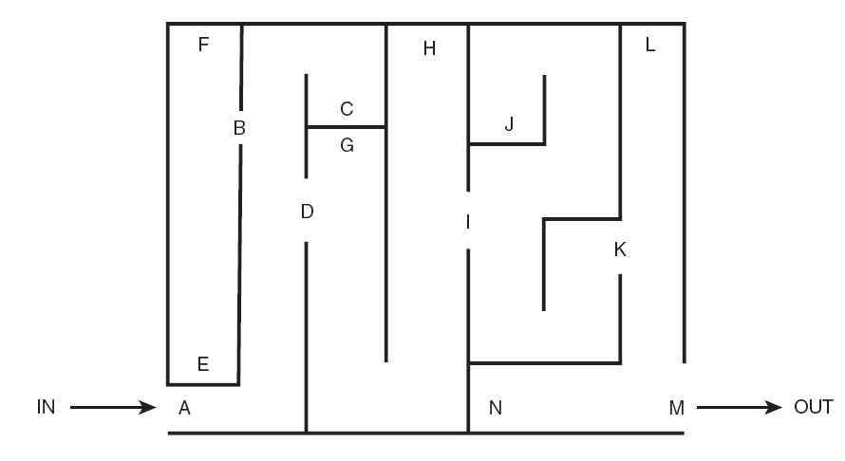

Slide 7
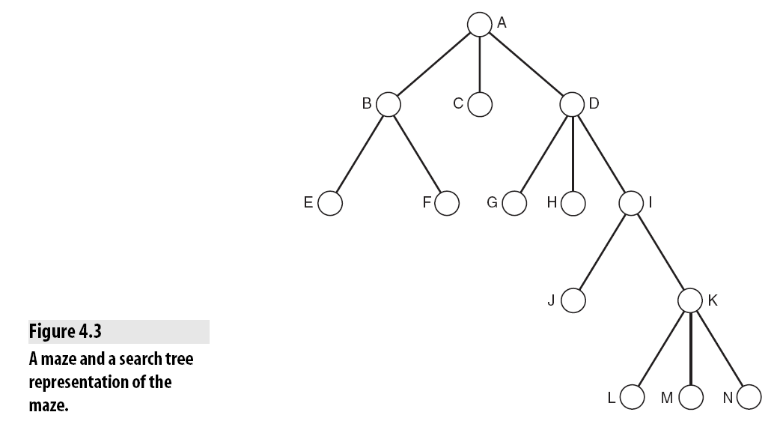

Slide 8
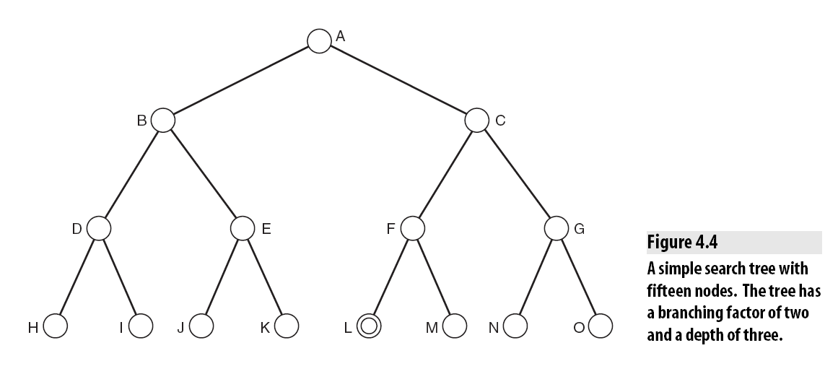
Simple tree

Slide 9
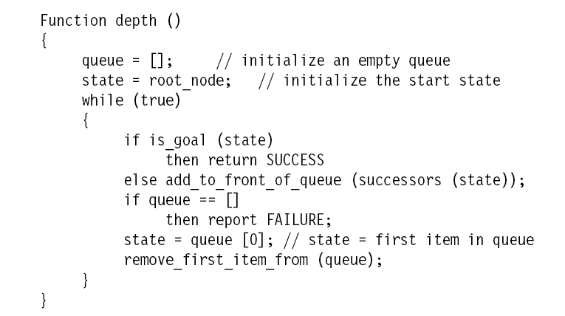
Implementation DFS

Slide 10
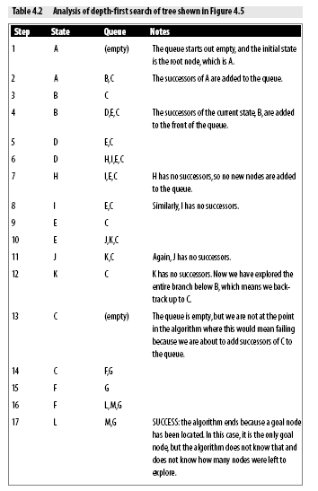

Slide 11
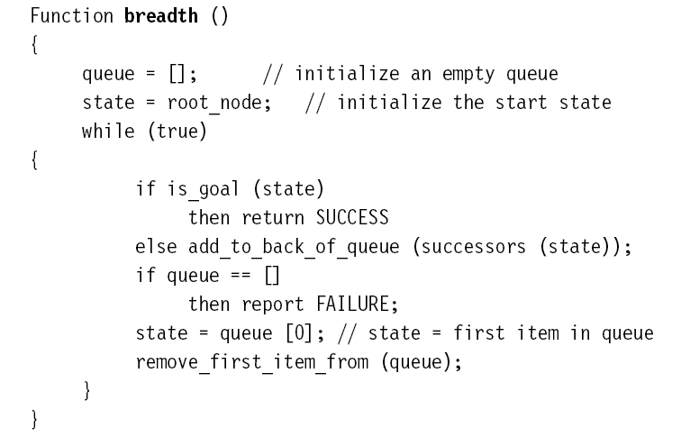
Imple.. BFS

Slide 12
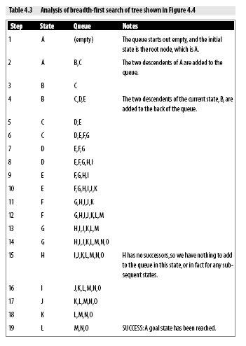

Slide 13
Depth-First Iterative Deepening
Depth-First Iterative Deepening, or DFID (also called Iterative Deepening Search or IDS), is an exhaustive search technique that combines depth-first with breadth-first search.
The DFID algorithm involves repeatedly carrying out depth-first searches on the tree, starting with a depth-first search limited to a depth of one, then a depth-first search of depth two, and so on, until a goal node is found.

Slide 14
For a tree of depth d and with a branching factor of b, the total number
of nodes is
1 root node
b nodes in the first layer
b^2 nodes in the second layer
...
b^n nodes in the nth layer
Hence, the total number of nodes is
1 + b+b^2 +b^3 + . . . + b^d
which is a geometric progression equal to
For example, for a tree of depth 2 with a branching factor of 2, there are
= 7 nodes

Slide 15
Using depth-first or breadth-first search, this means that the total number of nodes to be examined is seven.
Using DFID, nodes must be examined more than once, resulting in the following progression:
Error in text book (2+1)+ 2x2+4x1=11

Slide 18
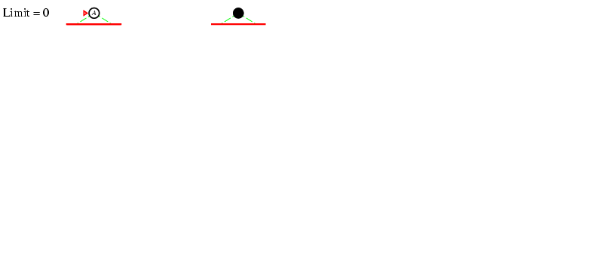
Iterative deepening search L=0

Slide 19
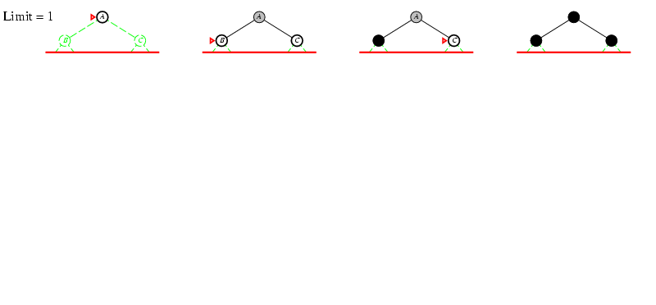
Iterative deepening search L=1

Slide 20
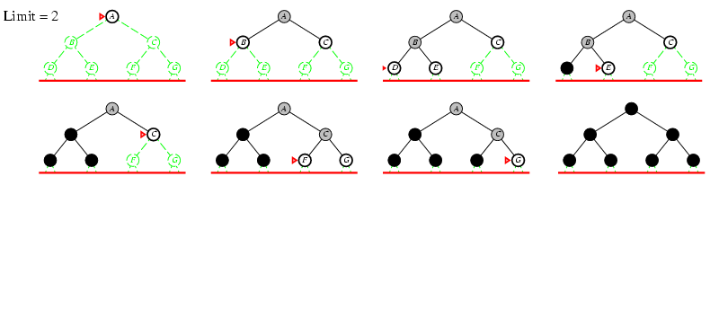
Iterative deepening search lL=2

Slide 21
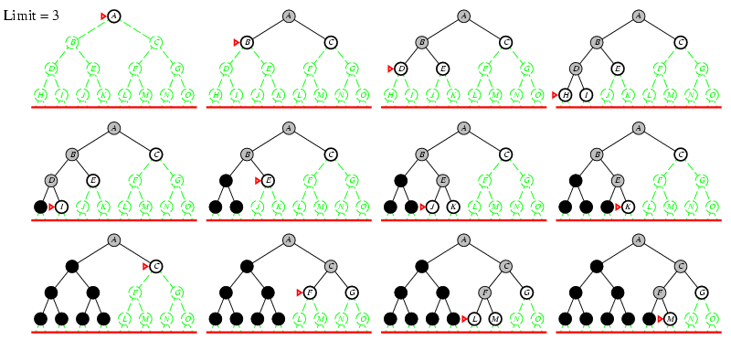
Iterative deepening search lL=3

Slide 22
Properties of iterative deepening search
Complete? Yes
Time? (d+1)b⁰ + d b¹ + (d-1)b² + … + b^{d} = O(b^{d})
Space? O(bd)
Optimal? Yes, if step cost = 1 or increasing function of depth.

Slide 23
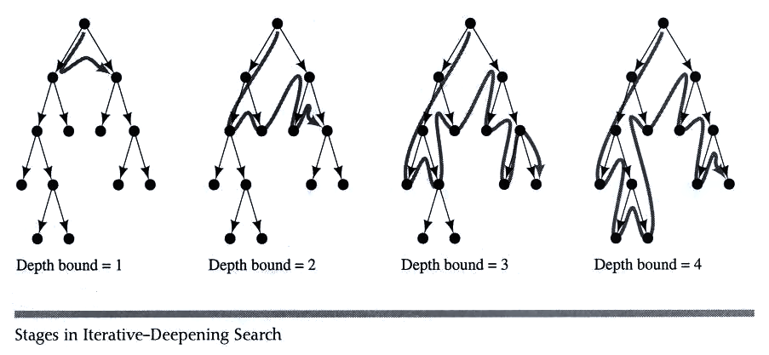
Example IDS

Slide 24
Heuristic Search
The search techniques we have seen so far...
Breadth first search
Uniform cost search
Depth first search
Depth limited search
Iterative Deepening
...are all too slow for most real world problems
uninformed search
blind search

Slide 25
Sometimes we can tell that some states appear better that others...
7
8
4
1
2
3
3
5
1
4
5
6
6
2
7
8

Slide 26
...we can use this knowledge of the relative merit of states to guide search
Heuristic Search (informed search)
A Heuristic is a function that, when applied to a state, returns a number that is an estimate of the merit of the state, with respect to the goal.
In other words, the heuristic tells us approximately how far the state is from the goal state*.
Note we said “approximately”. Heuristics might underestimate or overestimate the merit of a state. But for reasons which we will see, heuristics that only underestimate are very desirable, and are called admissible.
*I.e Smaller numbers are better

Slide 27
Heuristics for 8-puzzle I
1
2
3
Current State
4
5
6
7
8
1
2
3
The number of misplaced tiles (not including the blank)
1
2
3
4
5
6
4
5
6
1
2
3
7
8
Goal State
7
8
4
5
6
7
8
N
N
N
In this case, only “8” is misplaced, so the heuristic function evaluates to 1.
In other words, the heuristic is telling us, that it thinks a solution might be available in just 1 more move.
N
N
N
N
Y
Notation: h(n) h(current state) = 1

Slide 28
Heuristics for 8-puzzle II
3
2
8
3
3
Current State
4
5
6
2 spaces
7
1
The Manhattan Distance (not including the blank)
8
1
2
3
Goal State
3 spaces
4
5
6
8
7
8
1
In this case, only the “3”, “8” and “1” tiles are misplaced, by 2, 3, and 3 squares respectively, so the heuristic function evaluates to 8.
In other words, the heuristic is telling us, that it thinks a solution is available in just 8 more moves.
3 spaces
1
Total 8
Notation: h(n) h(current state) = 8

Slide 29
h(n)
5
We can use heuristics to guide “hill climbing” search.
In this example, the Manhattan Distance heuristic helps us quickly find a solution to the 8-puzzle.
6
4
3
4
2
But “hill climbing has a problem...”
1
3
3
0
2

Slide 30
1
2
3
h(n)
In this example, hill climbing does not work!
All the nodes on the fringe are taking a step “backwards”
(local minima)
Note that this puzzle is solvable in just 12 more steps.
4
5
8
6
6
7
1
2
3
1
2
3
4
5
8
7
4
5
5
6
7
6
7
8
1
2
3
1
2
4
5
6
4
5
3
6
6
7
8
6
7
8

Slide 31
Hill Climbing
Hill climbing is an example of an informed search method because it uses
information about the search space to search in a reasonably efficient manner.
If you try to climb a mountain in fog with an altimeter but no map,
you might use the hill climbing Generate and Test approach:

Slide 32
Function hill ()
{
queue = []; // initialize an empty queue
state = root_node; // initialize the start state
while (true)
{
if is_goal (state)
then return SUCCESS
else
{
sort (successors (state));
add_to_front_of_queue (successors (state));
}
if queue == []
then report FAILURE;
state = queue [0]; // state = first item in queue
remove_first_item_from (queue);
}

Slide 33
This algorithm thus searches the tree in a depth-first manner, at each step
choosing paths that appear to be most likely to lead to the goal.

Slide 37
Best first search

Slide 40
Beam search
Beam search is a form of breadth-first search that employs a heuristic, as seen with hill climbing and best-first search.
Beam search works using a threshold so that only the best few paths are followed downward at each level.
This method is very efficient in memory usage and would be particularly useful for exploring a search space that had a very high branching factor (such as in game trees for games, such as Go or Chess).
It has the disadvantage of not exhaustively searching the entire tree and so may fail to ever find a goal node.

Slide 44
Uniform Cost Search
Uniform cost search (or Branch and Bound) is a variation on best-first search that uses the evaluation function g(node), which for a given node evaluates to the cost of the path leading to that node.
This was invented by Dijkstra in 1959 also known as Dijkstra’s algorithm.

Slide 66
Uniform Cost
Measures the cost to each node.
Is optimal and complete!
Can be very slow.
Hill Climbing
Estimates how far away the goal is.
Is neither optimal nor complete.
Can be very fast.
Can we combine them to create an optimal and complete algorithm that is also very fast?

Slide 67
Uniform Cost Search Enqueue nodes in order of cost
5
2
5
2
5
2
1
7
1
7
Intuition: Expand the cheapest node. Where the cost is the path cost g(n)
4
5
Hill Climbing Search Enqueue nodes in order of estimated distance to goal
17
19
17
19
17
19
16
14
16
14
13
15
Intuition: Expand the node you think is nearest to goal. Where the estimate of distance to goal is h(n)

Slide 68
The A* Algorithm (“A-Star”) Enqueue nodes in order of estimate cost to goal, f(n)
g(n) is the cost to get to a node.
h(n) is the estimated distance to the goal.
f(n) = g(n) + h(n)
We can think of f(n) as the estimated cost of the cheapest solution that goes through node n
Note that we can use the general search algorithm we used before. All that we have changed is the queuing strategy.
If the heuristic is optimistic, that is to say, it never overestimates the distance to the goal, then…
A* is optimal and complete!

Slide 69
Informal proof outline of A* completeness
Assume that every operator has some minimum positive cost, epsilon .
Assume that a goal state exists, therefore some finite set of operators lead to it.
Expanding nodes produces paths whose actual costs increase by at least epsilon each time. Since the algorithm will not terminate until it finds a goal state, it must expand a goal state in finite time.
Informal proof outline of A* optimality
When A* terminates, it has found a goal state
All remaining nodes have an estimate cost to goal (f(n)) greater than or equal to that of goal we have found.
Since the heuristic function was optimistic, the actual cost to goal for these other paths can be no better than the cost of the one we have already found.

Slide 70
How fast is A*?
A* is the fastest search algorithm. That is, for any given heuristic, no algorithm can expand fewer nodes than A*.
How fast is it? Depends of the quality of the heuristic.
If the heuristic is useless (ie h(n) is hardcoded to equal 0 ), the algorithm degenerates to uniform cost.
If the heuristic is perfect, there is no real search, we just march down the tree to the goal.
Generally we are somewhere in between the two situations above. The time taken depends on the quality of the heuristic.

Slide 71
What is A*’s space complexity?
A* has worst case O(b^{d}) space complexity, but an iterative deepening version is possible ( IDA* )

Slide 72
A Worked Example: Maze Traversal
A
B
Problem: To get from square A3 to square E2, one step at a time, avoiding obstacles (black squares).
Operators: (in order)
go_left(n)
go_down(n)
go_right(n)
each operator costs 1.
Heuristic: Manhattan distance
C
D
E
1
2
3
4
5

Slide 73
A3
A
A2
A4
g(A2) = 1
h(A2) = 4
g(B3) = 1
h(B3) = 4
g(A4) = 1
h(A4) = 6
B
B3
A2
B3
A4
C
g(c3) = 2
h(c3) = 3
D
A1
g(A1) = 2
h(A1) = 5
c3
B4
g(B4) = 2
h(B4) = 5
E
1
2
3
4
5
Operators: (in order)
go_left(n)
go_down(n)
go_right(n)
each operator costs 1.

Slide 74
A3
A
A4
A1
A2
g(A2) = 1
h(A2) = 4
g(B3) = 1
h(B3) = 4
g(A4) = 1
h(A4) = 6
B
B3
A2
B3
A4
C
D
A1
g(A1) = 2
h(A1) = 5
E
1
2
3
4
5
Operators: (in order)
go_left(n)
go_down(n)
go_right(n)
each operator costs 1.

Slide 75
A3
A
A1
A2
A4
g(A2) = 1
h(A2) = 4
g(B3) = 1
h(B3) = 4
g(A4) = 1
h(A4) = 6
B
B3
B4
A2
B3
A4
C
C3
D
A1
g(A1) = 2
h(A1) = 5
E
C3
g(C3) = 2
h(C3) = 3
B4
g(B4) = 2
h(B4) = 5
1
2
3
4
5
Operators: (in order)
go_left(n)
go_down(n)
go_right(n)
each operator costs 1.

Slide 76
A3
A
A1
A2
A4
g(A2) = 1
h(A2) = 4
g(B3) = 1
h(B3) = 4
g(A4) = 1
h(A4) = 6
B
B1
B3
B4
A2
B3
A4
C
C3
D
A1
g(A1) = 2
h(A1) = 5
E
C3
g(C3) = 2
h(C3) = 3
B4
g(B4) = 2
h(B4) = 5
1
2
3
4
5
B1
g(B1) = 3
h(B1) = 4
Operators: (in order)
go_left(n)
go_down(n)
go_right(n)
each operator costs 1.

Slide 77
A3
A
A1
A2
A4
g(A2) = 1
h(A2) = 4
g(B3) = 1
h(B3) = 4
g(A4) = 1
h(A4) = 6
B
B1
B3
B4
B5
A2
B3
A4
C
C3
D
A1
g(A1) = 2
h(A1) = 5
E
C3
g(C3) = 2
h(C3) = 3
B4
g(B4) = 2
h(B4) = 5
1
2
3
4
5
B1
g(B1) = 3
h(B1) = 4
Operators: (in order)
go_left(n)
go_down(n)
go_right(n)
each operator costs 1.
B5
g(B5) = 3
h(B5) = 6

Slide 78
A3
A
A1
A2
A4
g(A2) = 1
h(A2) = 4
g(B3) = 1
h(B3) = 4
g(A4) = 1
h(A4) = 6
B
B1
B3
B4
B5
A2
B3
A4
C
C3
C5
D
A1
g(A1) = 2
h(A1) = 5
E
C3
g(C3) = 2
h(C3) = 3
B4
g(B4) = 2
h(B4) = 5
1
2
3
4
5
B1
g(B1) = 3
h(B1) = 4
Operators: (in order)
go_left(n)
go_down(n)
go_right(n)
each operator costs 1.
B5
g(B5) = 3
h(B5) = 6
g(C5) = 4
h(C5) = 5
C5

Slide 79
A3
A
A1
A2
A4
g(A2) = 1
h(A2) = 4
g(B3) = 1
h(B3) = 4
g(A4) = 1
h(A4) = 6
B
B1
B3
B4
B5
A2
B3
A4
C
C3
C5
D
A1
g(A1) = 2
h(A1) = 5
E
C3
g(C3) = 2
h(C3) = 3
B4
g(B4) = 2
h(B4) = 5
1
2
3
4
5
B1
g(B1) = 3
h(B1) = 4
Operators: (in order)
go_left(n)
go_down(n)
go_right(n)
each operator costs 1.
B5
g(B5) = 3
h(B5) = 6
g(C5) = 4
h(C5) = 5
C5
D5
g(D5) = 5
h(D5) = 4

Slide 80
A3
A
A1
A2
A4
g(A2) = 1
h(A2) = 4
g(B3) = 1
h(B3) = 4
g(A4) = 1
h(A4) = 6
B
B1
B3
B4
B5
A2
B3
A4
C
C3
C5
D
D4
D5
A1
g(A1) = 2
h(A1) = 5
E
C3
g(C3) = 2
h(C3) = 3
B4
g(B4) = 2
h(B4) = 5
1
2
3
4
5
B1
g(B1) = 3
h(B1) = 4
Operators: (in order)
go_left(n)
go_down(n)
go_right(n)
each operator costs 1.
B5
g(B5) = 3
h(B5) = 6
C5
g(C5) = 4
h(C5) = 5
D5
g(D5) = 5
h(D5) = 4
D4
g(D4) = 4
h(D4) = 3

Slide 81
A3
A
A1
A2
A4
g(A2) = 1
h(A2) = 4
g(B3) = 1
h(B3) = 4
g(A4) = 1
h(A4) = 6
B
B1
B3
B4
B5
A2
B3
A4
C
C3
C5
D
D4
D5
A1
g(A1) = 2
h(A1) = 5
E
E3
E4
C3
g(C3) = 2
h(C3) = 3
B4
g(B4) = 2
h(B4) = 5
1
2
3
4
5
B1
g(B1) = 3
h(B1) = 4
Operators: (in order)
go_left(n)
go_down(n)
go_right(n)
each operator costs 1.
B5
g(B5) = 3
h(B5) = 6
C5
g(C5) = 4
h(C5) = 5
D5
g(D5) = 5
h(D5) = 4
D4
g(D4) = 4
h(D4) = 3
E4
g(E4) = 5
h(E4) = 2

Slide 82
A3
A
A1
A2
A4
g(A2) = 1
h(A2) = 4
g(B3) = 1
h(B3) = 4
g(A4) = 1
h(A4) = 6
B
B1
B3
B4
B5
A2
B3
A4
C
C3
C5
D
D4
D5
A1
g(A1) = 2
h(A1) = 5
E
E3
E4
C3
g(C3) = 2
h(C3) = 3
B4
g(B4) = 2
h(B4) = 5
1
2
3
4
5
Operators: (in order)
go_left(n)
go_down(n)
go_right(n)
each operator costs 1.
B1
g(B1) = 3
h(B1) = 4
B5
g(B5) = 3
h(B5) = 6
C5
g(C5) = 4
h(C5) = 5
D5
g(D5) = 5
h(D5) = 4
D4
g(D4) = 4
h(D4) = 3
E2
g(E3) = 4
h(E3) = 1
E4
g(E4) = 5
h(E4) = 2
E3

Slide 86
Search…
Monotonicity
Example: The Modified Traveling Salesman
Hill Climbing
Steepest Ascent Hill Climbing
Foothills, Plateaus, and Ridges
Best-First Search
Beam Search
Identifying Optimal Paths
A* Algorithms
Uniform Cost Search
Greedy Search
Example: The Knapsack Problem

Slide 88
Searching for a Gift

Slide 89
Artificial Intelligence
Lecture 5

Slide 90
Topics
Monotonicity
Example: The Modified Traveling Salesman
Hill Climbing
Steepest Ascent Hill Climbing
Foothills, Plateaus, and Ridges
Best-First Search
Beam Search
Identifying Optimal Paths
A* Algorithms
Uniform Cost Search
Greedy Search
Example: The Knapsack Problem

