Slide 1
Artificial Intelligence
Lecture 4

Slide 2
Search Methodologies

Slide 3
Topics
Why Humans Use Depth-First Search?
Example 1: Traversing a Maze
Example 2: Searching for a Gift
Implementing Depth-First and Breadth-First Search
Example:Web Spidering
Depth-First Iterative Deepening
Using Heuristics for Search
Informed and Uninformed Methods
Choosing a Good Heuristic
The 8-Puzzle

Slide 4
Traversing a MAZE

Slide 5
DFS and Maze Traversal
The DFS algorithm is similar to a classic strategy for exploring a maze
  We mark each intersection, corner and dead end (vertex) visited
  We mark each corridor (edge ) traversed
  We keep track of the path back to the entrance (start vertex) by means of a rope (recursion stack)

Slide 6
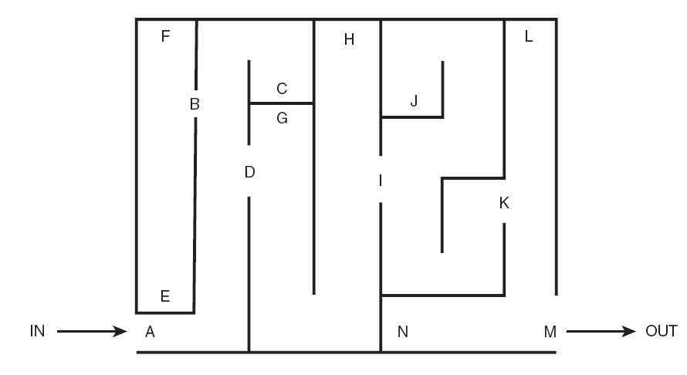

Slide 7
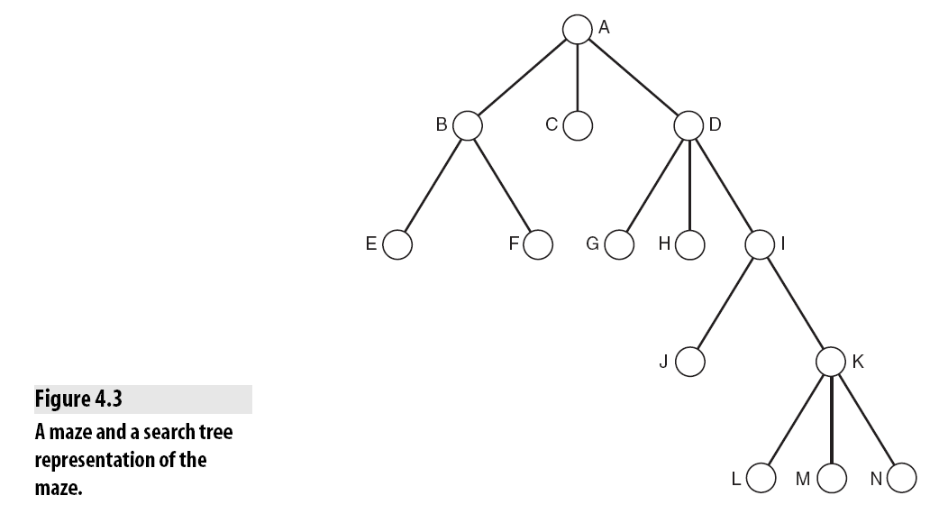

Slide 8
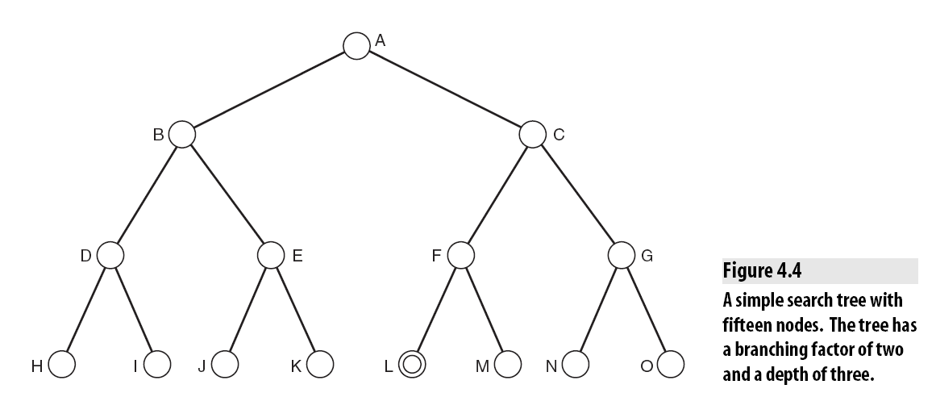
Simple tree

Slide 9
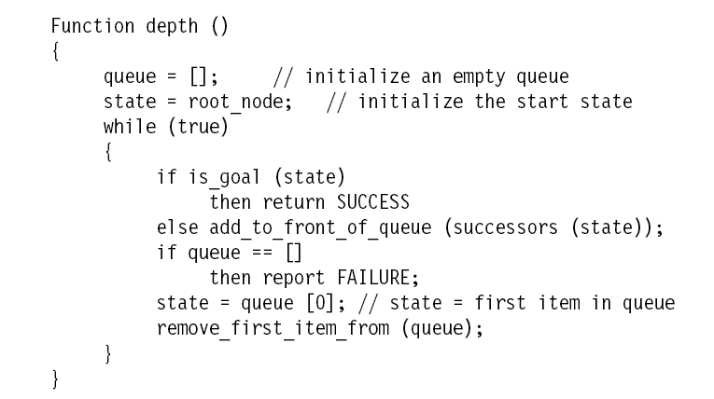
Implementation DFS

Slide 10
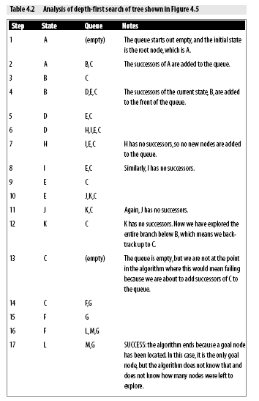

Slide 11
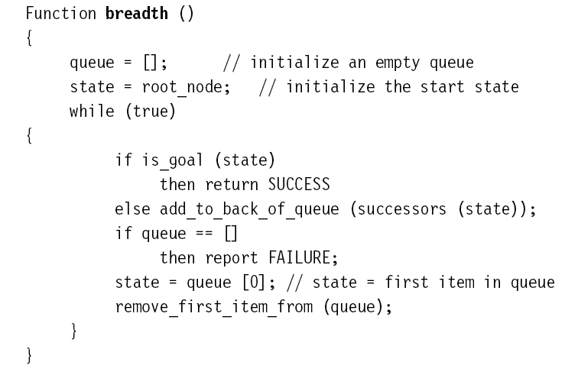
Imple.. BFS

Slide 12
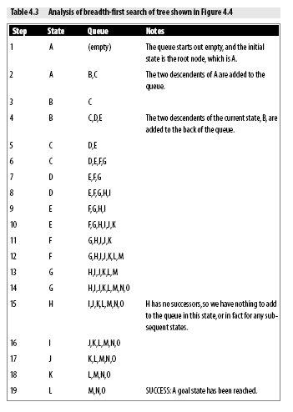

Slide 13
Depth-First Iterative Deepening
Depth-First Iterative Deepening, or DFID (also called Iterative Deepening Search or IDS), is an exhaustive search technique that combines depth-first with breadth-first search.
The DFID algorithm involves repeatedly carrying out depth-first searches on the tree, starting with a depth-first search limited to a depth of one, then a depth-first search of depth two, and so on, until a goal node is found.

Slide 15
Search…
Monotonicity
Example: The Modified Traveling Salesman
Hill Climbing
Steepest Ascent Hill Climbing
Foothills, Plateaus, and Ridges
Best-First Search
Beam Search
Identifying Optimal Paths
A* Algorithms
Uniform Cost Search
Greedy Search
Example: The Knapsack Problem

Slide 17
Searching for a Gift

Slide 18
Artificial Intelligence
Lecture 5

Slide 19
Topics
Monotonicity
Example: The Modified Traveling Salesman
Hill Climbing
Steepest Ascent Hill Climbing
Foothills, Plateaus, and Ridges
Best-First Search
Beam Search
Identifying Optimal Paths
A* Algorithms
Uniform Cost Search
Greedy Search
Example: The Knapsack Problem

