Slide 1
Artificial Intelligence
Lecture 8
Game Playing

Slide 2
Game Trees

Slide 3

Evaluation Function
q = number of queens
r = number of rooks
n = number of knights
b = number of bishops
p = number of pawns
score = 9q + 5r + 3b + 3n + p

Slide 4
Searching Game Tree

Slide 7
MinMax Algorithm
Result 10
A
Now Min will select C1
7
B1
B2
10
C1
20
C3
10
C4
7
11
C2
Now Max will have two choices of 7 and 3 , max is 7 so 7 is selected
3
11
5
20
4
6
10
7

Slide 8
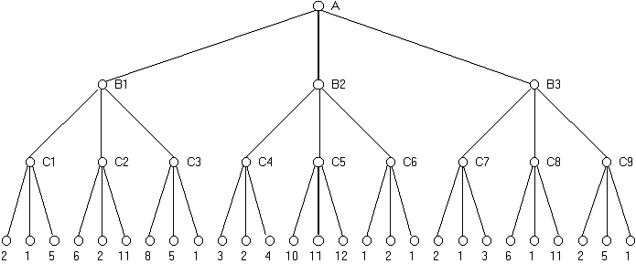
Traversing a game tree using MinMax

