Slide 1
Strong Method Problem Solving
Expert System

Slide 2
Contents
Introduction
Overview of Expert System Technology
Rule-Based Expert Systems
Model-Based, Case Based, and Hybrid Systems

Slide 3
What is an expert system?
Human/AI-Oriented Approach
“An expert system is a computer system which uses a representation of human expertise in a specialist domain to perform functions similar to those normally performed by a human expert in that domain”
Key concepts
“Expert” performance
Representation of “human” expertise as knowledge

Slide 4
What is an expert system?
Technology-Oriented Approach
“An expert system is a computer system, which operates by applying an inference mechanism to a body of specialist expertise represented in the form of knowledge and which manipulates this knowledge to perform efficient and effective problem solving in a narrow problem domain.”
Key concepts
Use of an inference mechanism
Efficiency and effectiveness
Narrow domain

Slide 5
Why use expert systems?
Human Expertise
Perishable
people leave
people forget
Difficult to transfer
requires training
Difficult to document
hard to get at knowledge
time consuming
Artificial Expertise
Permanent
always there
once in, always in
Easy to transfer
just copy it
Easy to document
knowledge is in a form that is almost self-documenting

Slide 6
Why use expert systems?
Human Expertise
Unpredictable
emotional factors
stress
Expensive
very scarce...
...therefore very expensive
Artificial Expertise
Consistent
no change
unemotional
Affordable
maybe costly to develop...
...but inexpensive to operate

Slide 7
Why might humans be better?
Human Expertise
Creative
can reorganise or synthesise knowledge
can use imaginative approaches
can draw analogies
Adaptive
can adjust approach
continually learning
Artificial Expertise
Uninspired
very routine
no imagination
little (if any) use of analogy
Hard to make adaptive
machine learning for ES very hard

Slide 8
Why might humans be better?
Human Expertise
Sensory experience
can use all senses: visual, tactile, olfactory
“picture is worth 1000 words”
Broad focus
can look at “big picture”
common sense knowledge
Artificial Expertise
Symbolic input
can only manipulate ideas and concepts
Narrow focus
very focussed
acquiring knowledge expensive

Slide 9
What problems can be solved by expert systems ?
Nature
can be solved naturally through symbol manipulation
is heuristic in nature
Complexity
must not be too easy
area should require years of study to become expert
Scope
should be narrow in technical scope yet have broad possibilites for application
must be of practical value

Slide 10
Types of problems solved by expert systems

Slide 11
What makes for a good expert system ?
Genuine experts exist
Experts must generally agree about choices
Experts must be able to articulate and explain their method
Problem must require cognitive not physical skills
Task cannot be too difficult
Problems should not require common sense

Slide 12
Expert systems (ESs) - motivations
Experts usually have a lot of knowledge, why not build a system that incorporates a lot of knowledge in a specific area.
Will attempt to solve a problem that is
non-trivial
complex
poorly understood
The resulting system will be
fast
reliable
cheap
transportable
usable in remote sites

Slide 13
What is in an expert system?
lots of knowledge
a production system architecture
inference techniques
advanced features for the user
should make their job easier
explanations

Slide 14
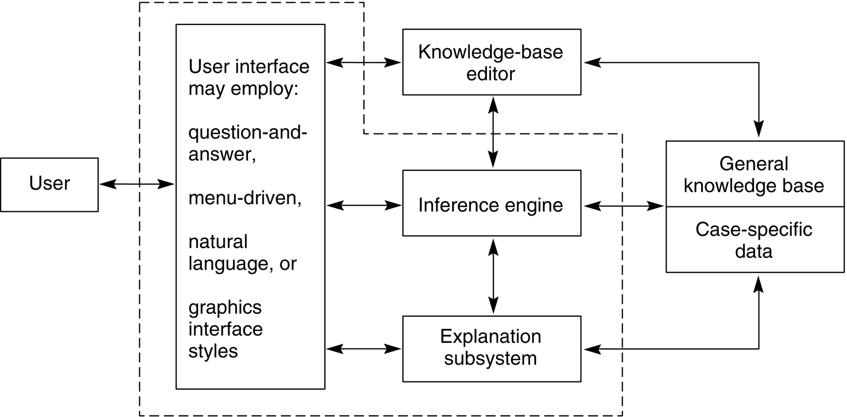
Architecture of a typical expert system

Slide 15
Knowledge seperated from methods
Note the formal division between
the rule base (knowledge in machine-readable form)
the inference engine (the machinery for manipulating the knowledge, i.e. methods)
The seperation gives two big advantages:
the inference engine can be used for many projects, with saving of programming effort
the person developing the expert system can usually concentrate on the knowlege
”knowledge engineers” program with data

Slide 16
Is an Expert System the right solution?
The need for the solution justifies the cost and effort of building an expert system.
Human expertise is not available in all situations where it is needed.
The problem may be solved using symbolic reasoning.
The problem domain is well structured and does not require commonsense reasoning.
The problem may not be solved using traditional computing methods.
Cooperative and articulate experts exist.
The problem is of proper size and scope.

Slide 17
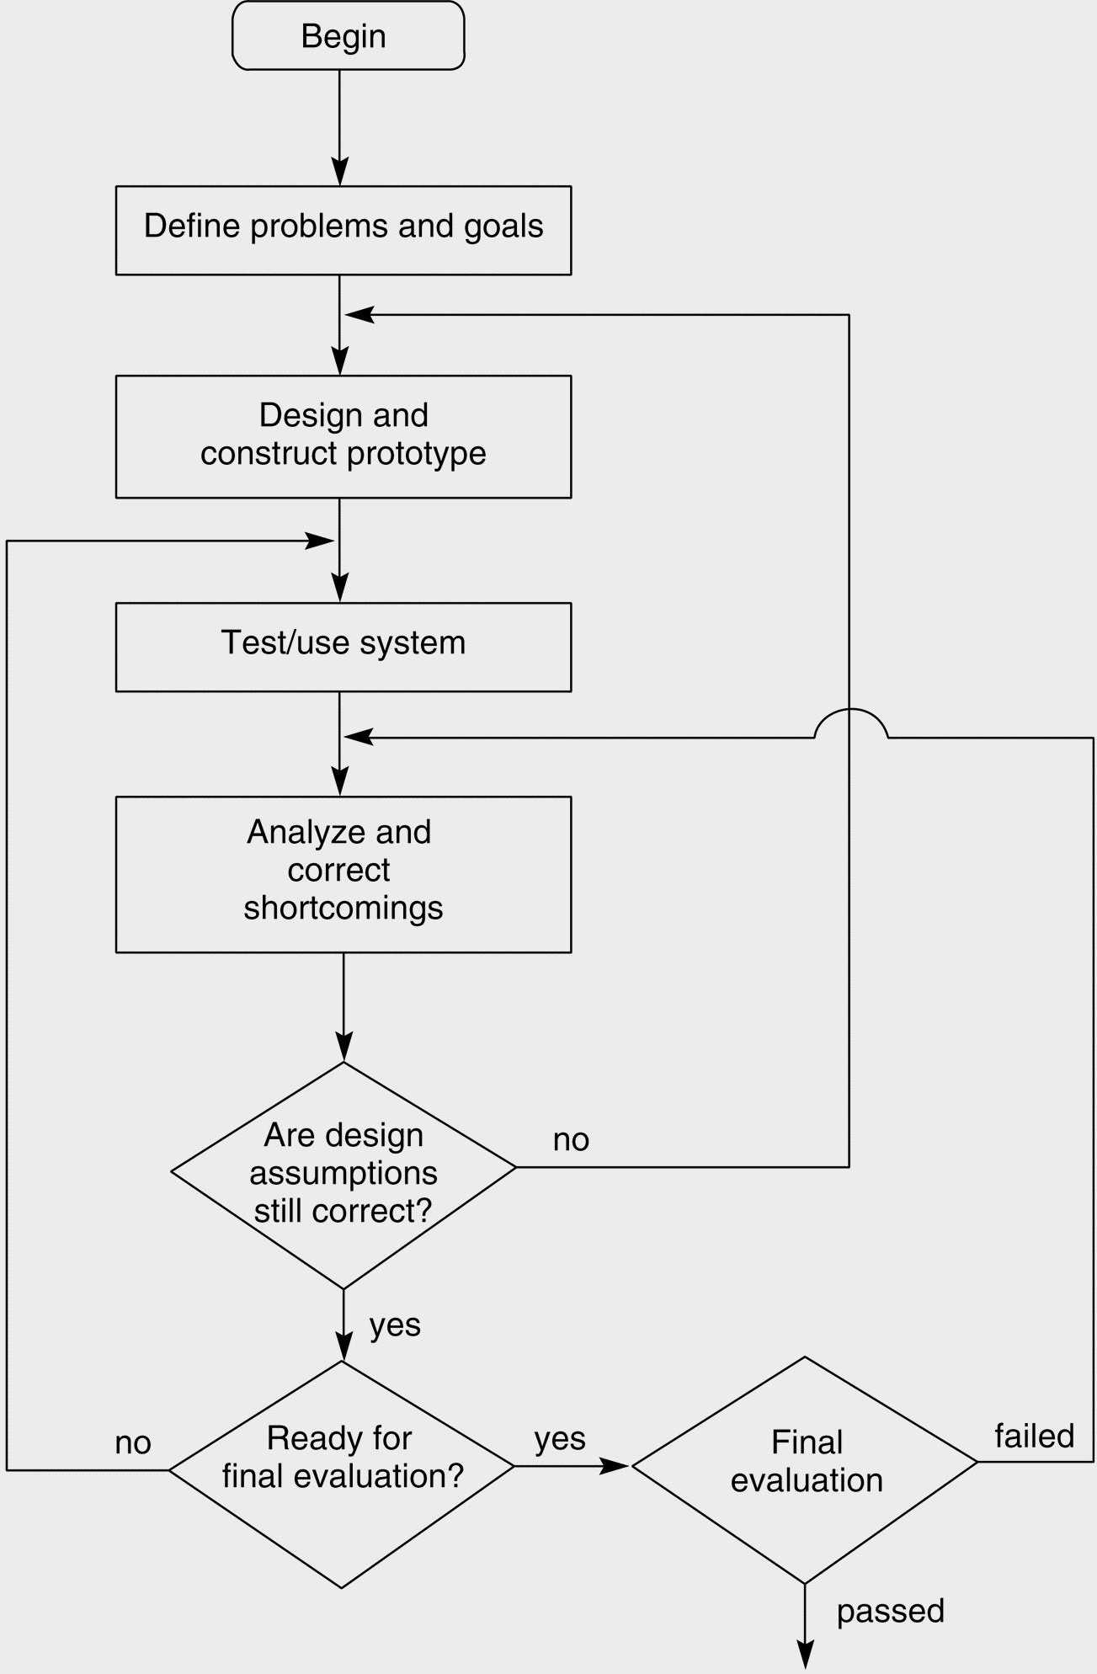
Exploratory development cycle

Slide 18
Knowledge elicitation
Mainly three stages can be identified:
Knowledge acquisition
Knowledge analysis and knowledge representation
Knowledge validation
These are not stages that have to follow each other.
Some of them will run as one

Slide 19
Who is involved?
Users &
managers
Domain experts
who have years of experience working in the application domain
Knowledge engineers
who possess technical skills in eliciting, representing knowledge and implementing the expert systems

Slide 20
Knowledge acquisition
Knowledge acquisition is the process of gathering the knowledge to stock the expert system knowledge base.
This is the most difficult component of the knowledge engineering process and it also called for “knowledge acquisition bottleneck”
This is the principle reason why expert systems have not become more widespread.

Slide 21
Knowledge acquisition
Sources of Knowledge
Documents, textbooks, journal, etc
This will almost never be enough to provide the knowledge base for real-world expert systems
The range of problems which the textbook examines and solves is always smaller than the range that a human expert is master of
Sources of Knowledge
Humans experts
Notes:
21
Source of knowledge by using documents, textbooks, journals will almost never be enough to provide the knowledge base for real words expert systems. The source of knowledge is by using humans experts because the range of problems which the textbook examinees and solves is always smaller that the range that a human expert have in the area.

Slide 22
Knowledge Elicitation
Knowledge elicitation is the process by which the knowledge engineer aquires knowledge from domain experts.
Key ideas are:
knowledge organisation
problem representation
problem solving strategies
An underlying theme is that experts think very differently about problems than non-experts

Slide 23
Problem with knowledge elicitation
One major problem with knowledge elicitation is that experts cannot easily describe all they know about the subject
They do not necessary have much insight into the methods they use to solve problems
Their knowledge is like a “compiled program”
Fast and efficient but unreadable

Slide 24
Knowledge elicitation techniques
Interviews
Unstructured interview (A general discussion of the domain, designed to provide a list of topics and concepts)
Structured Interview (Concerned with a particular concept within the domain. A particular problem-solving skill or small group of skills)
Problem solving interview (The domain expert is provided with real-life problem, of a kind that they deal with during their working life, and asked to solve it)
Think aloud interview (The domain expert merely imagines that they are solving the problem that have been presented to them rather then actually doing it)
Critical incident analysis
The Domain Expert is asked to provide details of cases which were particular difficulty or of special interest for some other reason.
He/she describes how they were solved and the lessons that were learnt.

Slide 25
One expert or many?
One human expert
Interviews: question-answer sessions
Structured interviews: goal-oriented sessions)
Observations
Comments
difficulty in allocating time
personal bias
single line of reasoning
incomplete domain of expertise
A panel of experts
more complete domain of expertise
increasing quality, relevance
encourage discussions, interactions
better understanding
Comments
experts don’t agree
hard for experts to communicate across discipline boundaries
more work to synthesize the knowledge

Slide 26
Knowledge representation
How do humans arrange knowledge?
Humans organise and structure knowledge in ways to overcome the problems:
association
hierarchy
meta-knowledge

Slide 27
Semantic Networks
Semantic networks consider knowledge as a graph
Nodes of the graph are objects and properties
Links of the graph are relationships
This representation allows association and prioritises knowledge
neighbouring relationships in the graph are more likely to be useful when solving a problem

Slide 28

Example semantic net
Move
ANIMAL
Skin
CAN
HAS
Fly
BIRD
Feathers
CAN
HAS
Small
CANARY
Yellow
IS
IS
TWEETY
Missing toe
HAS

Slide 29
Justification of semantic nets
Psychological experiments show that humans store knowledge in this kind of network arrangement
e.g. word association games
bird → fly → insect → bee → honey
bird → eagle → king → government

Slide 30
Conceptual Graphs
concept
relation
Conceptual graphs are similar to semantic networks, but:
links have no semantic meaning
instead, we have a seperate class of objects which represent relationships
The main advantage is that we can easily represent relationships of arbitrary arity

Slide 31
Modelling Arity
bird
flies
A 1-ary relation (unary)
dog
color
brown
A 2-ary relation (binary)
mother
A 3-ary relation (tertiary)
child
parents
father

Slide 32
Example conceptual graph
Move
ANIMAL
Has
Skin
Is a
Flies
BIRD
Has
Feathers
Is a
Small
Size
CANARY
Colour
Yellow
Is a
TWEETY
Has
Missing toe

Slide 33
Frames
A frame is a data structure for representing a stereotyped situation or things
Attached to each frame are several kinds of information
Some is about what one can expect to happen/find
What to do if these expectations are not confirmed
Some of the information is about how to use the frame

Slide 34
Example of frames
Animal
Canary
Skin : Yes
Move: Yes
Super Class: Bird
Size : small
Colour: yellow
Song: high twitter
Bird
Tweety
Super Class: Animal
Type of : feathers
Type of motion: fly
Reproduces: sexually via eggs
Communcates via: song
Super Class: Canary
Enemy: Sylvester
Toe: one missing
Song: talks

Slide 35
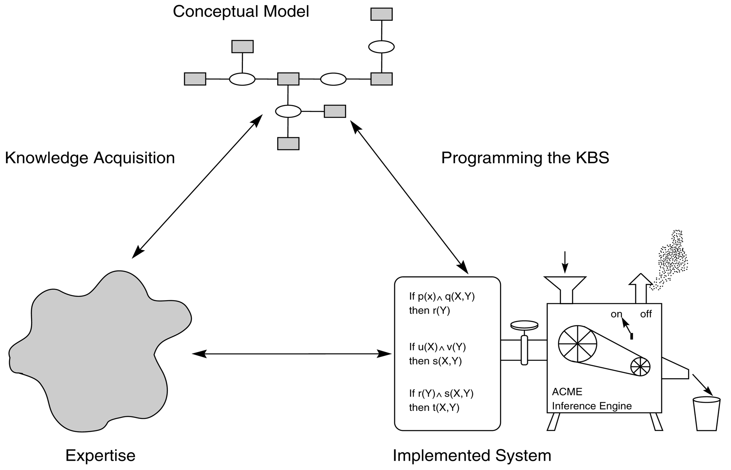
The role of conceptual models in problem solving

Slide 36
Rule based Expert System
How does a system based on production rules differ from an ordinary program?
We have a large collection of rules....
....but no explicit control structures
We also have facts - items which we know are true
The inference engine deduces conclusions from the given collection of rules
maintains an internal database in working memory to manipulate the rules and keep track of which rules have been used

Slide 37
Typical production rule
}
left hand side
}
right hand side
if
engine is getting gas and
engine will turn over
then
problem is ignition system
in predicate calculus:
∀X engine(X) ∧ gets(gas, X) ∧ turnsover(X) ⇒ has_problem(X, ignition)

Slide 38
Ways to handle production rules
Data-driven or Forward-chaining (left → right)
Start with existing information and perform inference to derive all new information
Applies well to design and planning problems
Goal-driven or Backward-chaining (right → left)
Start with goals, then try to find out what must be true for the goals to be achieved
Applies well to diagnostic and prescription problems
Mixed-chaining
data-driven + goal-driven chaining

Slide 39
Forward vs backward chaining
Forward-chaining
match the FACTS contained in the knowledge base to left hand sides of rules
apply the rules and instatiate new (temporary) facts
repeat until the goal is achieved or until no more rules fire
Backward-chaining
match the GOAL to right hand side of rules
set up left side of rule as sub-goals
repeat until
all sub-goals match directly with known facts (goal is true)
some sub-goals fail to match (goal is false)

Slide 40
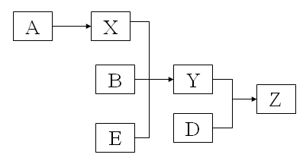
Inference chain – example
Production rules
Inference chain representation
Rule 1: IF Y is true AND D is true THEN Z is true
Rule 2: IF X is true
AND B is true
AND E is true
THEN Y is true
Rule 3: IF A is true THEN X is true

Slide 41
Forward Chaining
With forward chaining, we usually make all possible derivations of new facts with each iterations, i.e. we fire all rules which apply
Thus forward chaining operates as a Breadth First Search.

Slide 42
Backward Chaining
Note that there may be more than one rule which matches the goal (a conflict)
A simple strategy is to choose the first rule we find which matches and search on its LHS
If this fails, we backtrack up one or more levels of rule and try again
Thus backward chaining is usually implemented as Depth First Search

Slide 43
Example
Rule 1: If Y & D then Z
Rule 2: IF X & B & E then Y
Rule 3: If A then X
Rule 4: If C then L
Rule 5: If L &M then N
Forward Chaining
Cycle 1:First Rule 3 and then Rule 4 are fired. New facts that are added to the database: X and L
Cycle 2: Rule 2 New facts that are added to the database: Y
Cycle 3: Rule 1 New facts that are added to the database: Z
Totally 4 rules were used
Backward Chaining
Cycle 1:Rule 3 is fired New facts that are added to the database: X
Cycle 2: Rule 2 is fired New facts that are added to the database: Y
Cycle 3: Rule 1 is fired New facts that are added to the database: Z
Totally 3 rules were used

Slide 44
A small ES for diagnosing automotive problems
If
the engine is getting gas, and
the engine will turn over,
then
the problem is spark plugs
If
the engine does not turn over, and
the lights do not come on
then
the problem is battery or cables
If
the engine does not turn over, and
the lights do come on,
then
the problem is the starter motor
If
there is gas in the fuel tank, and
there is gas in the carburetor
then
the engine is getting gas
1
3
2
4

Slide 45
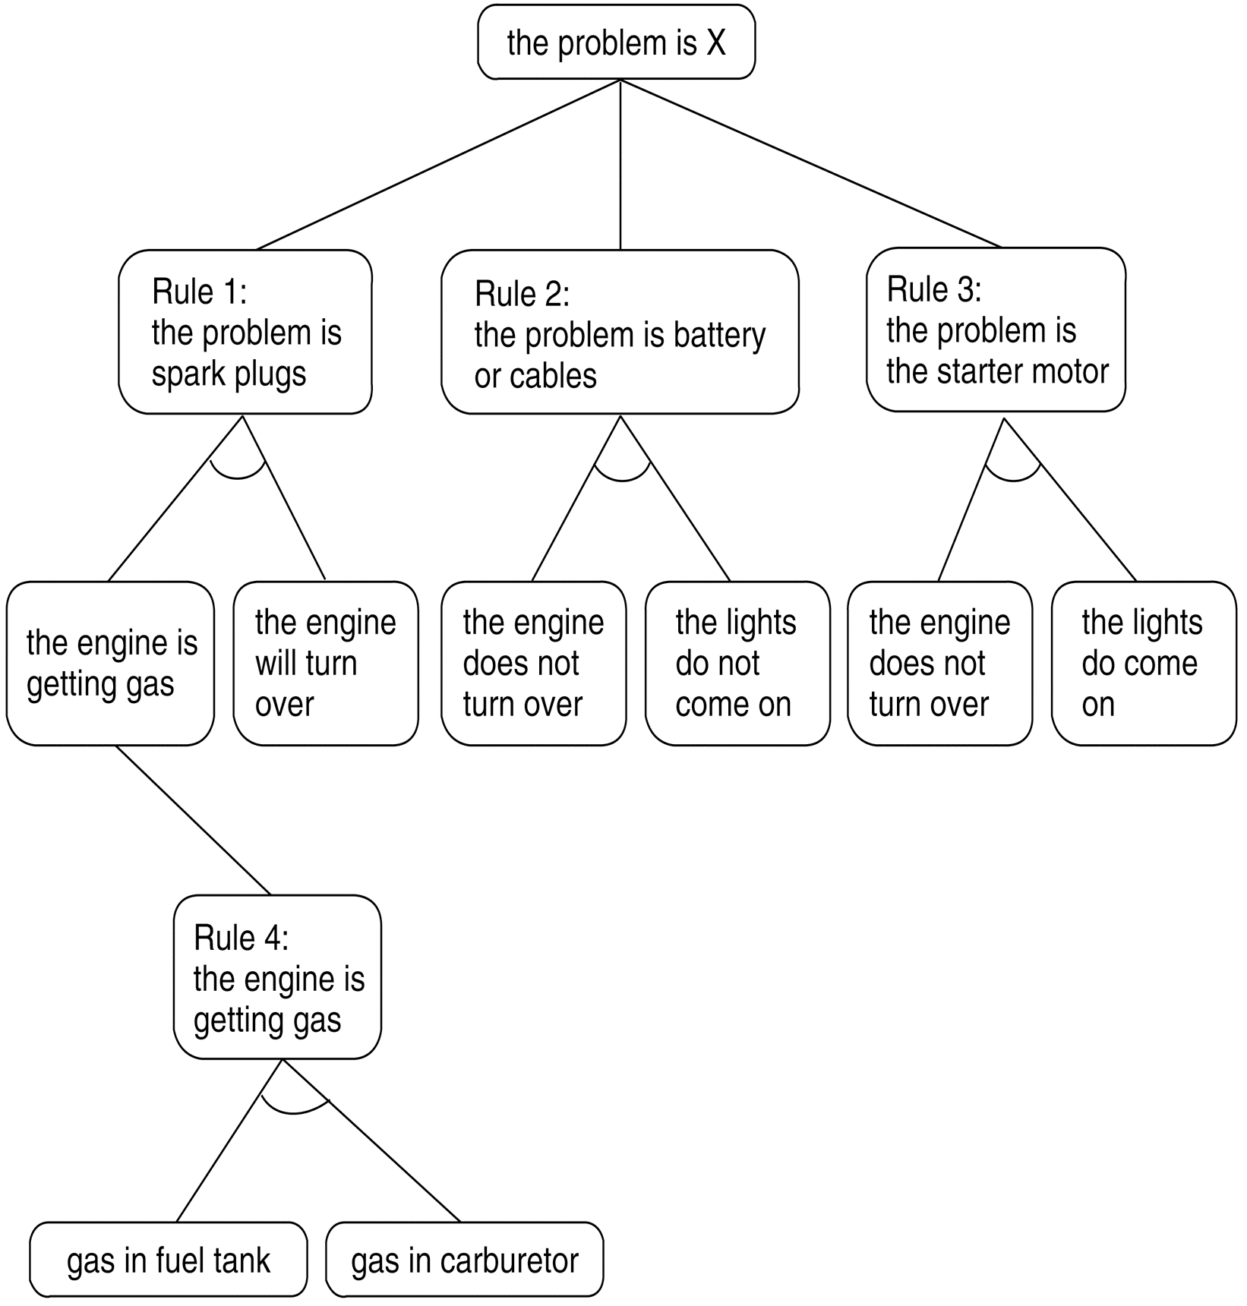
The and/or graph searched in the car diagnosis example

Slide 46
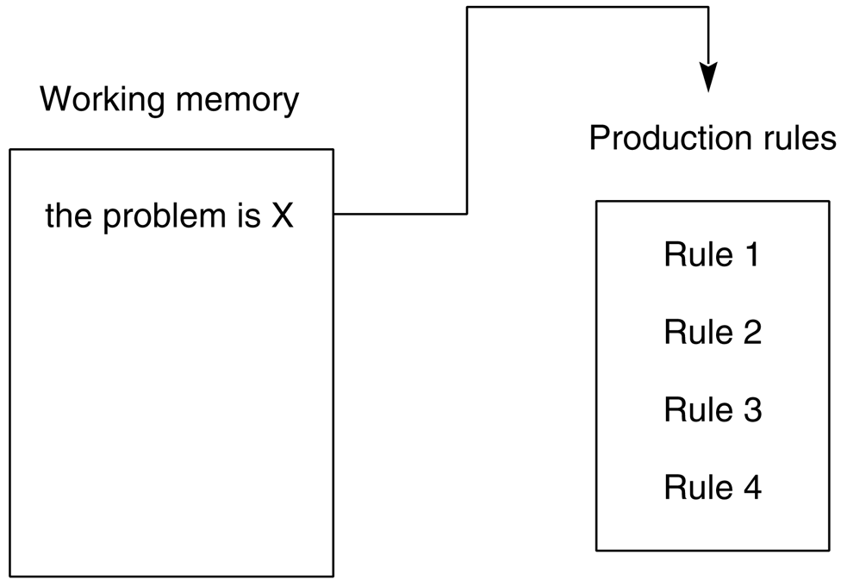
The production system at the start of a consultation (it will be DFS)

Slide 47
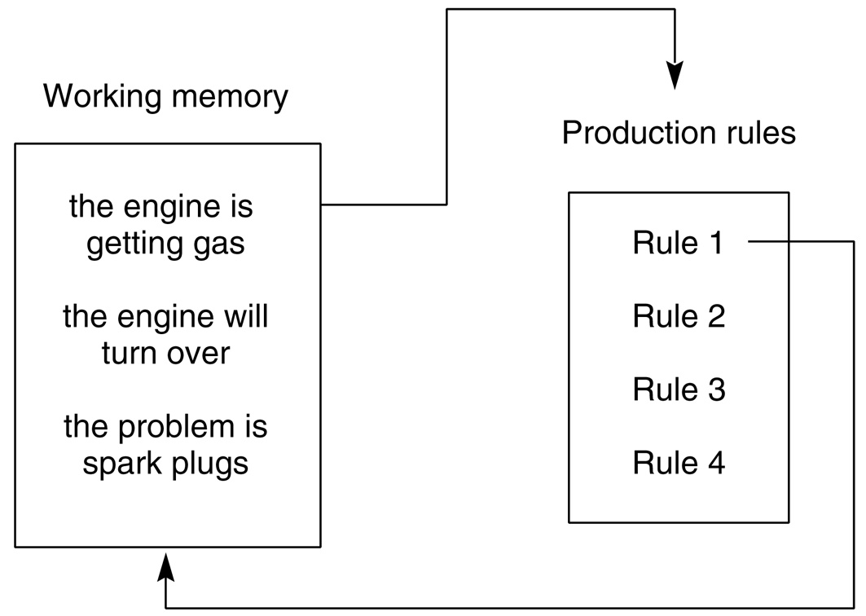
The production system after Rule 1 has fired

Slide 48
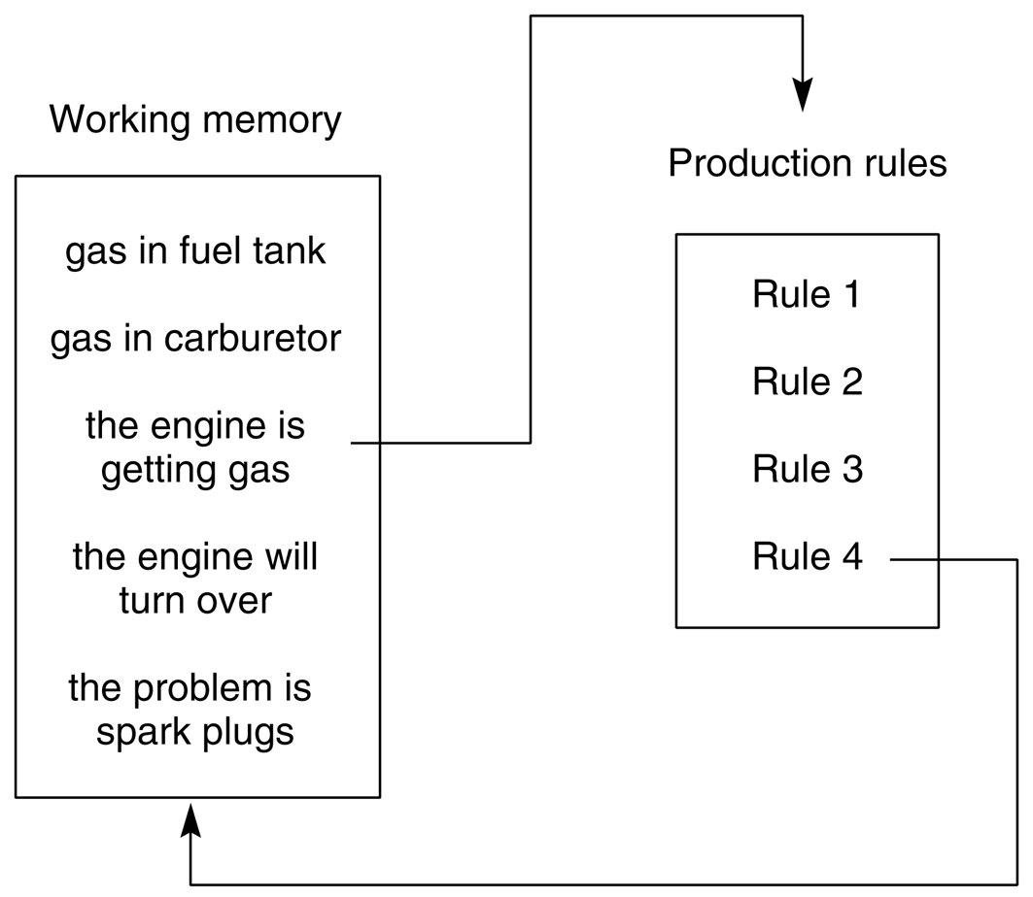
The system after Rule 4 has fired. Note the stack-based approach to goal reduction

Slide 49
Explanation: Answering “why” questions
ES - Gas in fuel tank? U- yes ES- Gas in carburetor? U- yes ES- Engine will turn over? U- why
ES- It has been established that 1. The engine is getting gas, therefore if 2. The engine will turn over, then the problem is spark plugs.
The user is asking “why is this information important?”

Slide 50
Explanation: Answering “how” questions
U- how the engine is getting gas
ES- This follows from rule 4: if gas in fuel tank, and there is gas in the carburetor then the engine is getting gas gas in fuel tank was given by the user gas in the carburetor was given by the user
The user is asking “How did the system come up with this conclusion?”

Slide 51
Data-driven reasoning in ESs
Use breadth-first search
Algorithm:
Do the next step until the working memory does not change anymore
For each rule:
Compare the contents of the working memory with the conditions of each rule in the rule base using the ordering of the rule base.
If the data in working memory supports a rule’s firing place the result in working memory

Slide 52
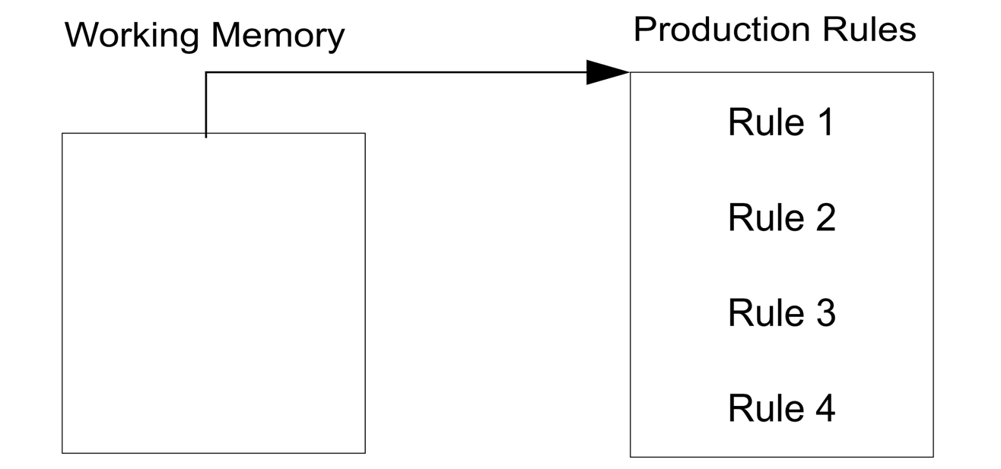
At the start of a consultation for data-driven reasoning

Slide 53
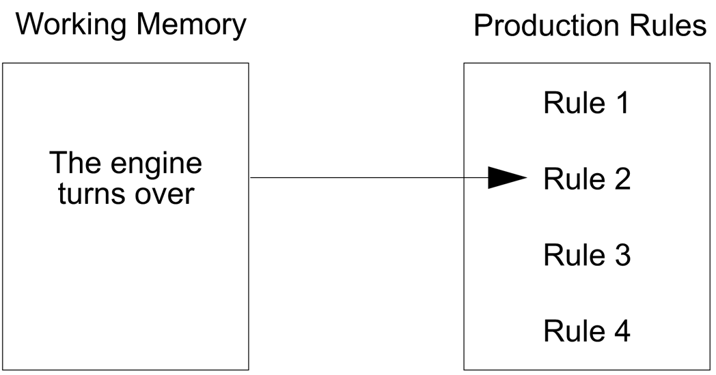
After evaluating the first premise of Rule 2, which then fails

Slide 54
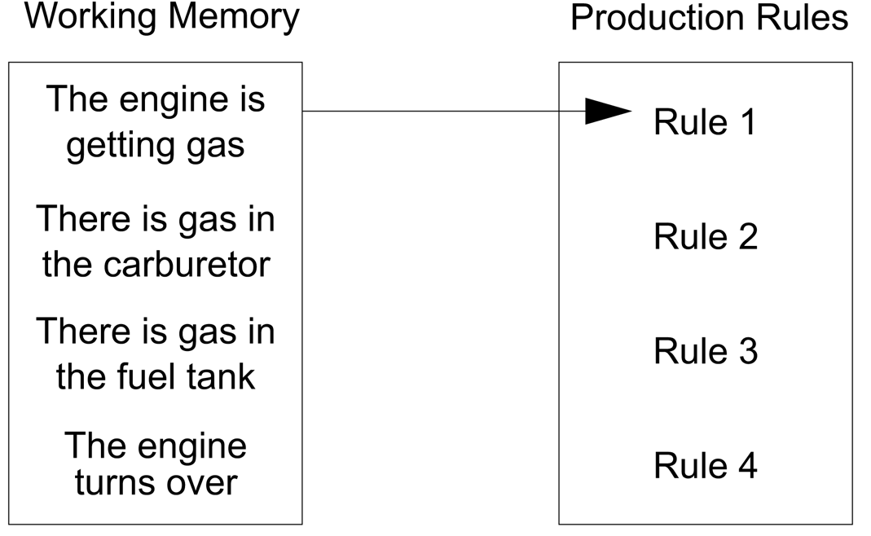
After considering Rule 4, beginning its second pass through the rules

Slide 55
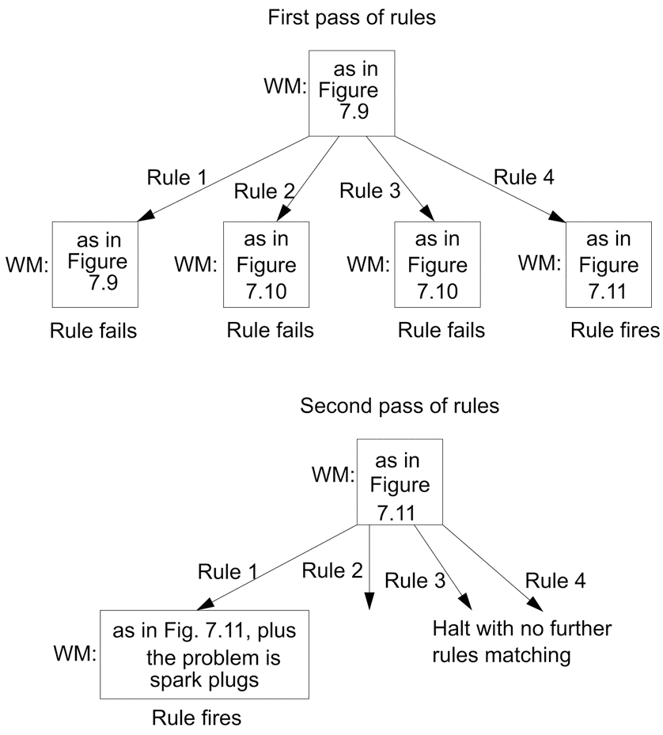
The search graph as described by the contents of WM data-driven BFS

Slide 56
ES examples - MYCIN
MYCIN is a well known ES.
Developed at Stanford by Ed Feigenbaum, Bruce Buchanan, Dr. Edward Shortliffe.
Problem solved: diagnose blood infections. This is an important problem because physicians usually must begin antibiotic treatment without knowing what the organism is (laboratory cultures take time). They have two choices: (1) prescribe a broad spectrum drug (2) prescribe a disease-specific drug (better)

Slide 57
ES examples - MYCIN (cont’d)
Differences from DENDRAL:
No general theoretical model existed from which MYCIN rules could be deduced. They had to be acquired from extensive interviewing of experts, who in turn acquired them from textbooks, other experts, and direct experience of cases.
The rules reflected uncertainty associated with medical knowledge: certainty factors (not a sound theory)

Slide 58
ES examples - MYCIN (cont’d)
About 450 rules. One example is:
If the site of the culture is blood the gram of the organism is neg the morphology of the organism is rod the burn of the patient is serious then there is weakly suggestive evidence (0.4) that the identity of the organism is pseudomonas.

Slide 59
ES examples - MYCIN (cont’d)
If the infection which requires therapy is meningitis only circumstantial evidence is available for this case the type of the infection is bacterial the patient is receiving corticosteroids then there is evidence that the organisms which might be causing the infection are e.coli(0.4), klebsiella- pneumonia(0.2), or pseudomonas-aeruginosa(0.1).

Slide 60
ES examples - MYCIN (cont’d)
Starting rule: “If there is an organism requiring therapy, then, compute the possible therapies and pick the best one.”
It first tries to see if the disease is known. Otherwise, tries to find it out.

Slide 61
ES examples - MYCIN (cont’d)
Can ask questions during the process:
> What is the patient’s name? John Doe. > Male or female? Male. > Age? He is 55. > Have you obtained positive cultures indicating general type? Yes. > What type of infection is it? Primary bacteremia.

Slide 62
ES examples - MYCIN (cont’d)
> Let’s call the first significant organism from this culture U1. Do you know the identity of U1? No. > Is U1 a rod or a coccus or something else? Rod. > What is the gram stain of U1? Gram-negative.
In the last two questions, it is trying to ask the most general question possible, so that repeated questions of the same type do not annoy the user. The format of the KB should make the questions reasonable.

Slide 63
ES examples - MYCIN (cont’d)
Studies about its performance showed its recommendations were as well as some experts, and considerably better than junior doctors.
Could calculate drug dosages very precisely.
Dealt well with drug interactions.
Had good explanation features and rule acquisition systems.
Was narrow in scope (not a large set of diseases). Another expert system, INTERNIST, knows about internal medicine.
Issues in doctors’ egos, legal aspects.

Slide 64
Asking questions to the user
Which questions should be asked and in what order?
Try to ask questions to make facilitate a more comfortable dialogue. For instance, ask related questions rather than bouncing between unrelated topics (e.g., zipcode as part of an address or to relate the evidence to the area the patient lives).

Slide 65
Heuristics and control in expert systems
Organization of a rule’s premises
Rule order
Costs of different tests
Which rules to select:
Refraction
Recency
Specificity
Restrict potentially usable rules

Slide 66
Model based reasoning
Adds ”deeper” knowledge of the system under consideration using constructs other than the form of explicit rules:
simulations
complex mathematical equations
game theory
some other AI modelling tools (e.g. neural networks) to creat a hybrid system

Slide 67
Model-based reasoning
Attempt to describe the “inner details” of the system.
Include a description of:
each component of the device,
device’s internal structure,
observations of the device’s actual performance

Slide 68
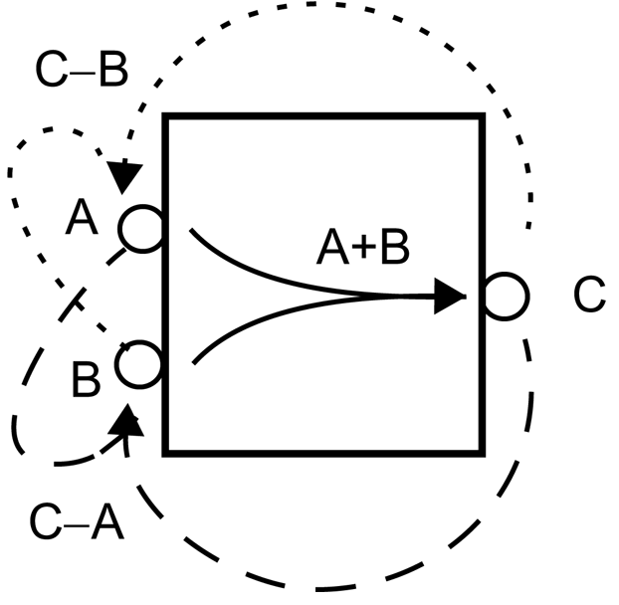
The behavioral description of an adder (Davis and Hamscher,1988)
Behaviour at the terminals of the device: e.g., C is A+B.

Slide 69
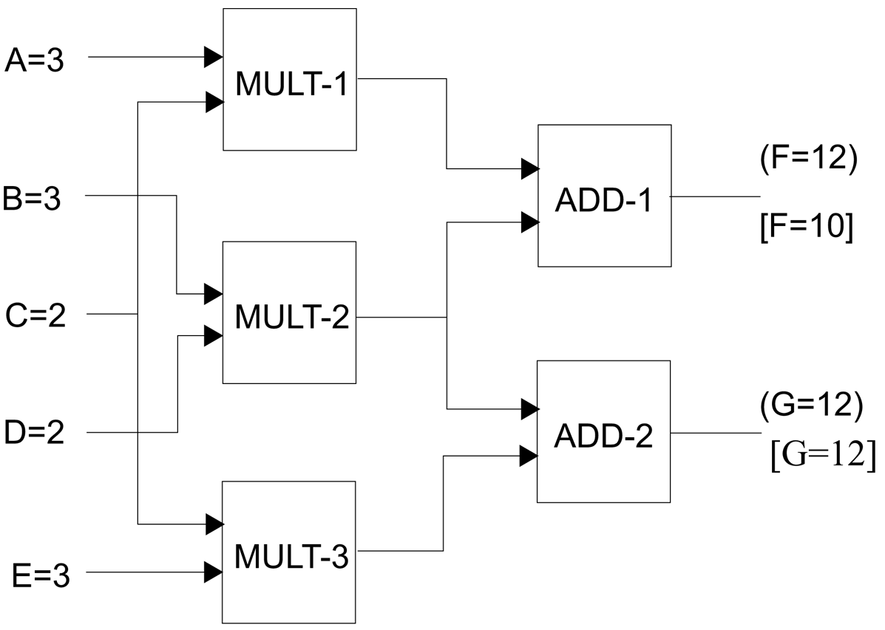
Taking advantage of direction of information flow (Davis and Hamscher, 1988)
Either ADD-1
is bad, or the
inputs are
incorrect
(MULT-1 or
MULT-2 is bad)

Slide 70
Fault diagnosis procedure
Generate hypotheses: identify the faulty component(s) , e.g., ADD-1 is not faulty
Test hypotheses: Can they explain the observed behavior?
Discriminate between hypotheses: What additional information is necessary to resolve conflicts?

Slide 71
Case-based reasoning (CBR)
Allows reference to past “cases” to solve new situations.
Operates at a more shallow level. Rather than attempt to derive explict rules or relationships, we rely on a historical database of previous examples
Both successes and failures
We then try to match the current problem to similar historical examples and find likely successful actions or correct diagnoses
The nice thing about case based reasoning is that we can add in our current problem, once we know whether our solution was successful or not.
Medicine, law, programming, car repairs, …

Slide 72
Common steps performed by a case-based reasoner
Retrieve appropriate cases from memory
Modify a retrieved case so that it will apply to the current situation
Apply the transformed case
Save the solution, with a record of success or failure, for future use

Slide 73
Preference heuristics to help organize the storage and retrieval cases
Goal directed preference: Retrieve cases that have the same goal as the current situation
Salient-feature preference: Prefer cases that match the most important features or those matching the largest number of important features
Specify preference: Look for as exact as possible matches of features before considering more general matches
Recency preference: Prefer cases used most recently
Ease of adaptation preference: Use first cases most easily adapted to the current situation

Slide 74
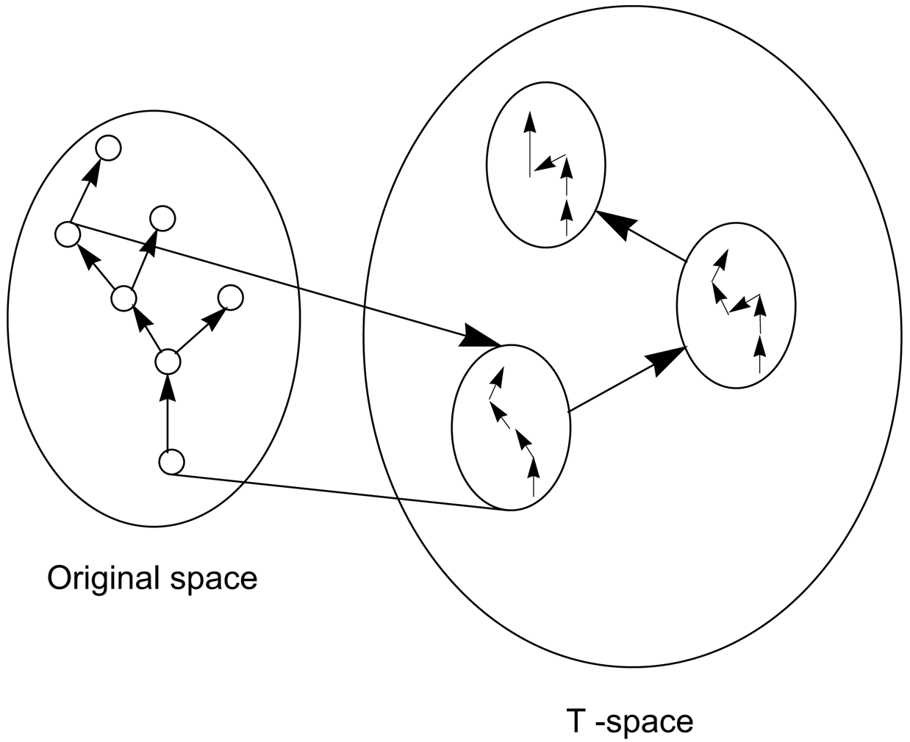
Transformational analogy

Slide 75
Advantages of a rule-based approach
Ability to directly use experiential knowledge acquired from human experts
Mapping of rules to state space search
Separation of knowledge from control
Possibility of good performance in limited domains
Good explanation facilities

Slide 76
Disadvantages of a rule-based approach
Highly heuristic nature of rules not capturing the functional (or model-based) knowledge of the domain
Brittle nature of heuristic rules
Rapid degradation of heuristic rules
Descriptive (rather than theoretical) nature of explanation rules
Highly task dependent knowledge

Slide 77
Advantages of model-based reasoning
Ability to use functional/structure of the domain
Robustness due to ability to resort to first principles
Transferable knowledge
Ability to provide causal explanations

Slide 78
Advantages of model-based reasoning
Lack of experimental (descriptive) knowledge of the domain
Requirement for an explicit domain model
High complexity
Unability to deal with exceptional situations

Slide 79
Advantages of case-based reasoning
Ability to encode historical knowledge directly
Achieving speed-up in reasoning using shortcuts
Avoiding past errors and exploiting past successes
No (strong) requirement for an extensive analysis of domain knowledge
Added problems solving power via appropriate indexing strategies

Slide 80
Disadvantages of case-based reasoning
No deeper knowledge of the domain
Large storage requirements
Requirement for good indexing and matching criteria

Slide 81
How about combining those approaches?
Complex!! But nevertheless useful.
rule-based + case-based can
first check among previous cases, then engage in rule-based reasoning
provide a record of examples and exceptions
provide a record of searches done

Slide 82
How about combining those approaches?
rule-based + model-based can
enhance explanations with functional knowledge
improve robustness when rules fail
add heuristic search to model-based search
model-based + case-based can
give more mature explanations to the situations recorded in cases
first check against stored cases before proceeding with model-based reasoning
provide a record of examples and exceptions
record results of model-based inference
Opportunities are endless!

Slide 83
Summary
Rule based | Model Based | Case based
maps easily from experts (experts don’t always agree!) | stronger theoretical basis | can take a lot of time to code the cases....
modularity - lots of simple rules | extrapolates outside specified domain better | ...if data is already available, coding is much easier
explanatory facilities | explanation can be very good, but needs more effort | explanation poor
can use simple search methods | deeper knowledge more transferrable | easy for experts and system designer to communicate
explicit separation of knowledge and methods | difficult to build models of many complex systems | hard to decide how to index the cases
specific system produced | costly to build | can update itself and learn
degrades at edge of specified domain | hard to debug and update | cases may be misapplied due to lack of deep knowledge
no deep foundation - often rules highly heuristic |  | data base of examples can get very large

Slide 84
Expert Systems: then and now
The AI industry boomed from a few million dollars in 1980 to billions of dollars in 1988.
Nearly every major U.S. corporation had its own AI group and was either using or investigating expert systems.
For instance, Du Pont had 100 ESs in use and 500 in development, saving an estimated $10 million per year.
AAAI had 15,000 members during the “expert systems craze.”
Soon a period called the “AI Winter” came …BIRRR...

Slide 85
Expert Systems: then and now (cont’d)
The AI industry has shifted focus and stabilized (AAAI members 5500- 7000)
Expert systems continue to save companies money
IBM’s San Jose facility has an ES that diagnoses problems on disk drives
Pac Bell’s diagnoses computer network problems
Boeing’s tells workers how to assemble electrical connectors
American Express Co’s helps in card application approvals
Met Life’s processes mortgage applications
Expert Sytem Shells: abstract away the details to produce an inference engine that might be useful for other tasks. Many are available.

