Slide 1
Constraint Satisfaction Problem

Slide 2
Constraint Satisfaction Problem
CSP: A problem that require some constraints to be satisfied while finding its solution
A CSP consists of three components Variables (V), Domain (D), and Constraints (C)
V={v1,v2, … , vn)
D={d1, d2, … , dn}
C={c1,c2, …, cm} a constraint ci is composed of (scope, relation)
Scope: the set of variables that participate in the constraint
Relation: The relation of variable/variables e.g. v1>v2, v2==2x v3 etc.
Unary Constraints: It is the simplest type of constraints that restricts the value of a single variable.
Binary Constraints: It is the constraint type which relates two variables.
Global Constraints: It is the constraint type which involves an arbitrary number of variables.

Slide 3
Solving CSP using Back-Tracking
Let consider a problem with variables A,B and C
Domain of each variable is {1, 2, 3}
With Constraints
A > B
B != C
And
A != C
Let solve this CSP with Backtracking: that is start from empty assignment, place value for each variable then subject to constraints if satisfy then move to another variable otherwise Change the value (back-track).

Slide 4
Solution
Step | Assignment | Backtrack (Yes/No)
1 | A=1 | No
2 | A=1, B=1 | Yes
3 | A=1, B=2 | Yes
4 | A=1, B=3 | Yes/move back to A
5 | A=2, B=1 | No
6 | A=2, B=1, C=1 | Yes
7 | A=2, B=1, C=2 | Yes
8 | A=2, B=1, C=3 | No, Stop a Constraints Satisfactory Solution is found
Given :
A= {1, 2, 3}
B= {1, 2, 3}
C= {1, 2, 3}
A > B
B != C
And
A != C

Slide 5
Consistency
Consistency is an inference mechanism to rule out certain variable assignments, which in turn enhances the search.
The simplest consistency check tests a current assignment against the set of constraints.
Domain Consistent Variable: A variable is DC if no value of its domain is ruled impossible by any unary constraints.
  Example: domain(v1)={1,2,4}, C=v1 !=2 then v1 is domain inconsistent.
  We can make it domain consistent if we remove 2 from its domain.

Slide 6
Constraint Network
A constraint network is defined by a graph,
  One node for every variable (drawn as circle)
  One node for every constraint (drwn as rectangle)
  Edges/arcs running between variable nodes and constraint nodes whenever a given variable is involved in a given constraint.
Example: draw a constraint network with variables A,B,C with constraints A<B, B<C, A+3=C
B
B<C
A
A<B
C
A+3=C

Slide 7
Arc Consistency
An arc <x, r(x,y)> is arc consistent if for each value x in domain(X) there is some value y in domain(Y) such that r(x,y) is satisfied
A network is arc consistent if all its arcs are arc consistent.
Not arc consistent bcz no value in domain of Y that satisfies X<Y if X=3
X
Y
1,2,3
2,3
X<Y
Is arc consistent?
Arc consistent bcz both 2 and 3 of Y have respective X values that satisfies X<Y
X
Y
2,5,7
2,3,13
X<Y/2

Slide 8
How to enforce Arc Consistency?
If an arc <x, r(x,y)> is not arc consistent
Delete all values x in domain(X)
For which there is no corresponding value in domain(Y)
This deletion makes the arc <x, r(x,y)> arc consistent.
X
X
Y
Y
1,2,3
2
1,2,3
2,3,4
X<Y
X<Y
1!>2, 2!>2, remove 2 and 3
X
Y
2,3,4
1,2,3
X<Y
X
Y
3
2
X<Y
2<3, 3!<3, 4!<3 remove 3 and 4

Slide 9
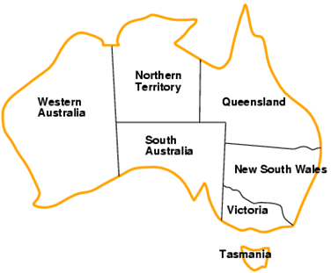
Map Coloring Problem
To model the problem as a CSP, we need to define the variables, domains, and constraints. The variables are the seven regions of Australia (at least the seven that we’ll restrict ourselves to): Western Australia; Northern Territory; South Australia; Queensland; New South Wales; Victoria; and Tasmania.
Variables Encoding:
Western Australia= WS;
Northern Territory=NT;
South Australia=SA;
Queensland=Q;
New South Wales=NSW;
Victoria=V; and
Tasmania =T

Slide 10
Problem Formulation
Variables WA, NT, Q, NSW, V , SA, T
Domains Di = {red, green, blue}
Constraints: adjacent regions must have different colors
e.g., WA != NT or
(WA, NT) ∈ {(red, green), (red, blue), (green, red), (green, blue), . . .}

Slide 11
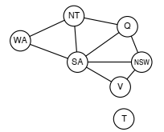
Constraint Graph: where an edge represents constraint and nodes represent states/regions

Slide 12
Solution
Step | Assignment | Backtrack (Yes/No)
1 | WA=R | No
2 | WA=R, NT=R | Yes
3 | WA=R, NT=B | No
4 | WA=R, NT=B, SA=R | Yes
5 | WA=R, NT=B, SA=B | Yes
6 | WA=R, NT=B, SA=G | No
7 | WA=R, NT=B, SA=G, Q=R | No
8 | WA=R, NT=B, SA=G, Q=R, NSW=R | Yes
9 | WA=R, NT=B, SA=G, Q=R, NSW=B | No
10 | WA=R, NT=B, SA=G, Q=R, NSW=B, V=R | No
11 | WA=R, NT=B, SA=G, Q=R, NSW=B, V=R, T=R
Given :
WA= {R, B, G},NT= {R, B, G}
SA= {R, B, G},Q= {R, B, G}
NSW= {R, B, G},V= {R, B, G}
T= {R, B, G}
WA != NT, WA != SA,
NT!=SA, NT!=Q
SA!=Q, SA!=NSW, SA!=V
Q!=NSW, NSW!=V

Slide 13
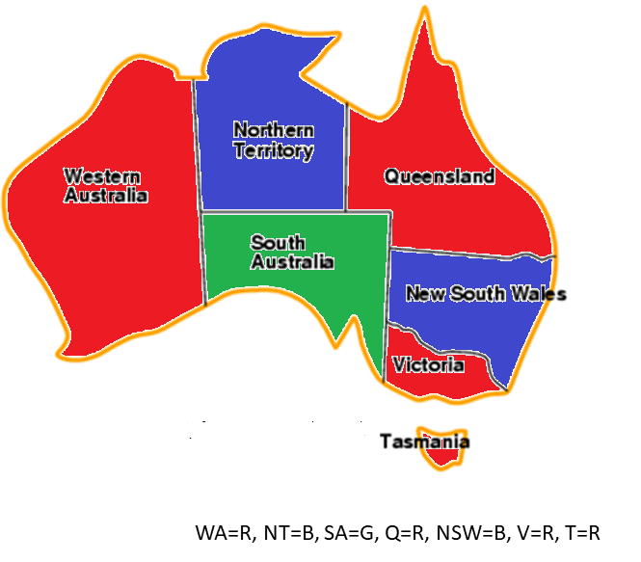
Solution
Assignments satisfy all constraints, e.g.,
WA=R, NT=B, SA=G, Q=R, NSW=B, V=R, T=R

