Slide 1
Goals
Basic understanding of machine learning/deep learning
Zero to Hero!!
Basic algebra + probability
Basic Python

Slide 2
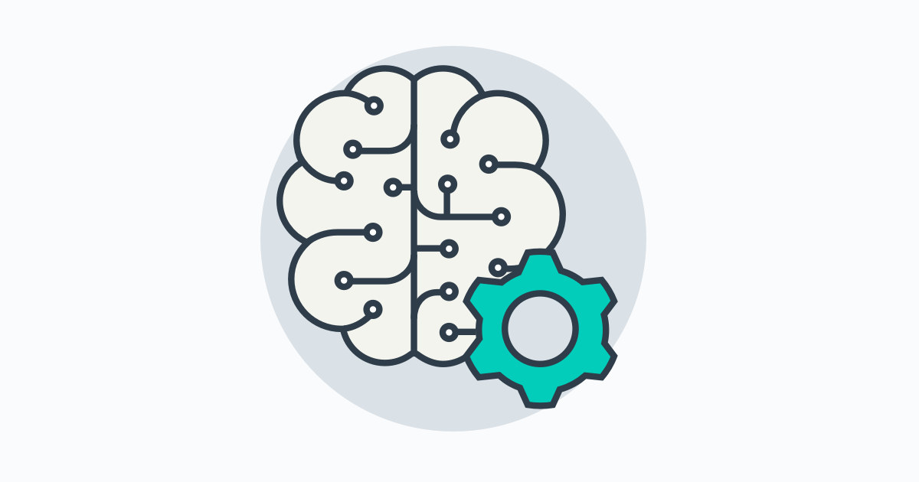
What is ML?
Before we talk about ML let us define human intelligence

Slide 3
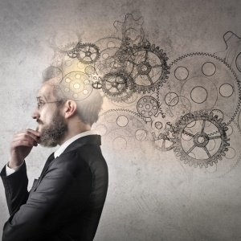
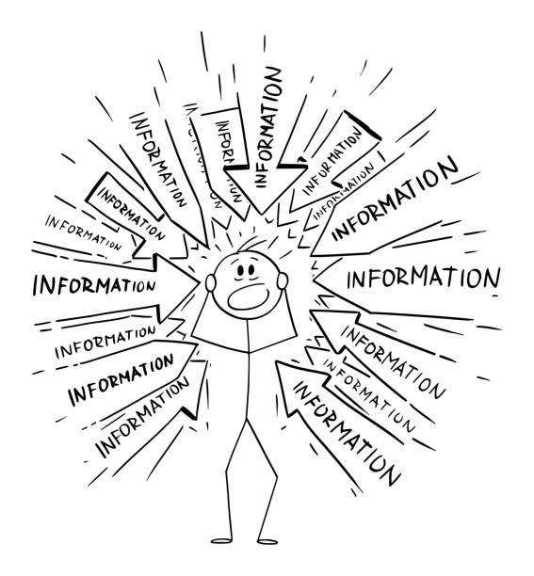
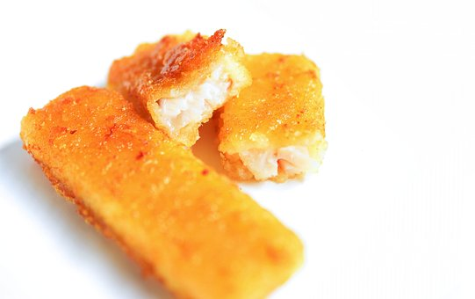
What is human intelligence?
We make a lot of decisions
For example What to eat for lunch
How we make this decision?
Infer

Slide 4

What is human intelligence?
We make a lot of decisions
What to dress?
Infer

Slide 5

What is human intelligence?
What is in this picture?
CAT
Image information
Prediction

Slide 6
What is human intelligence?
What will be the grade if I study 4 hours daily?
?
Grade points
4
Hours
information
Prediction

Slide 7
Machine Learning
Is the same thing that answers
What to dress?
But decisions are made by machine
Infer

Slide 8
Machine Learning
Is the same thing that answers
What is in this picture?
But decisions are made by machine
CAT
Prediction
Image information

Slide 9
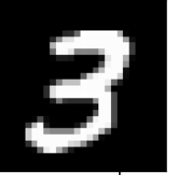
Machine Learning
Is the same thing that answers
What is this number?
But decisions are made by machine
3
Prediction
Image information

Slide 10
Machine Learning
Is the same thing that answers
What will be the grade if I study 4 hours daily?
But decisions are made by machine
4
Hours
?
Grade points
information
Prediction

Slide 11
Machine Learning
Machine needs a lot of Training to be capable to answer
What is this number?
3
Prediction
Image information

Slide 12
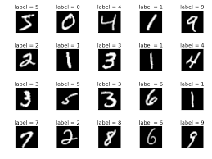
Machine Learning
Machine needs a lot of Training to be capable to answer
What is this number?
Model
Training
Labelled Dataset

Slide 13
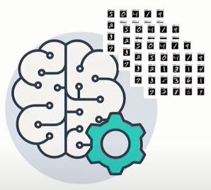
Machine Learning
Predict (test) with Trained Model
3
Prediction
Test Dataset
Trained Model

Slide 14
Machine Learning
What will be the grade if I study 4 hours daily?
4
Hours
?
Grade points
Prediction
Hours(x) | Points(y)
1 | 2
2 | 4
3 | 6
4 | ?
Training dataset
Test dataset

Slide 15
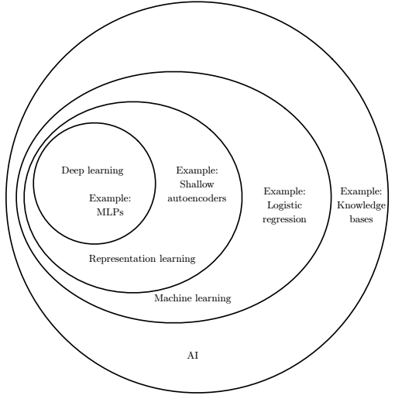
What is Deep Learning?
A Venn diagram showing how deep learning is a kind of representation learning,
which is in turn a kind of machine learning, which is used for many but not all approaches
to AI. Each section of the Venn diagram includes an example of an AI technology.

Slide 16
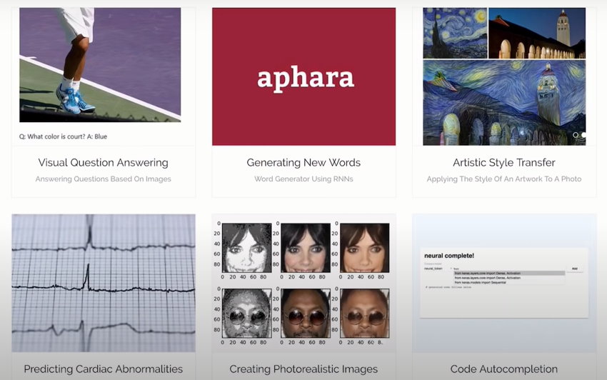
Why deep learning?
https://ml-showcase.com/

Slide 17
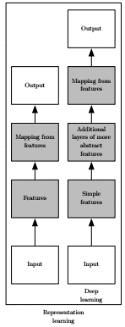


Why we care as developers

Slide 18



Good News!
Deep learning is not difficult
Linear algebra + probability + python
Many frameworks available
Unlimited study resources available

Slide 19
Frame works
PyTorch is a machine learning framework based on the Torch library, used for applications such as computer vision and natural language processing, originally developed by Meta AI
TensorFlow is a Google developed, free and open-source software library for machine learning and artificial intelligence. It can be used across a range of tasks but has a particular focus on training and inference of deep neural networks.
Apache MXNet is an open-source deep learning software framework, used to train and deploy deep neural networks.

Slide 20
Let’s start it
Linear Model
What will be the grade if I study 4 hours daily?
4
Hours
?
Grade points
Hours(x) | Points(y)
1 | 2
2 | 4
3 | 6
4 | ?
Prediction
Training dataset
Supervised Learning
Test dataset

Slide 21

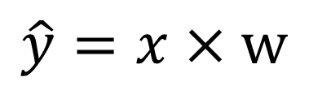


Model Design
What will be the best model for the data?
Linear Model?
$$\hat{y}=x×w$$
$$\hat{y}=x×w+b$$
Hours(x) | Points(y)
1 | 2
2 | 4
3 | 6
4 | ?
$$x$$
Linear
$$\hat{y}$$

Slide 22
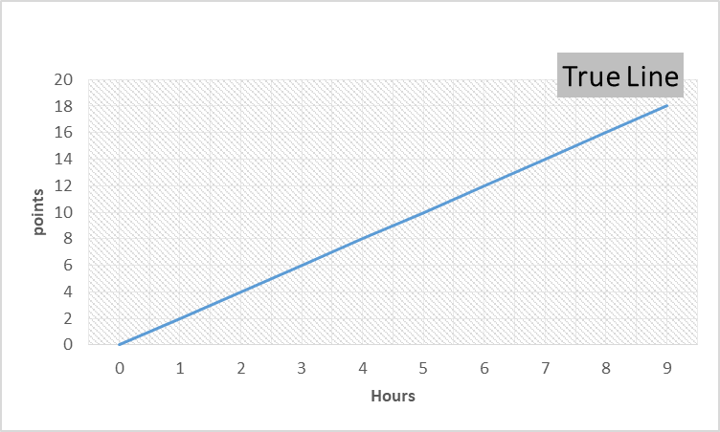
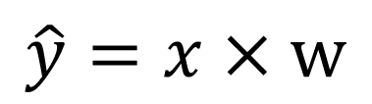
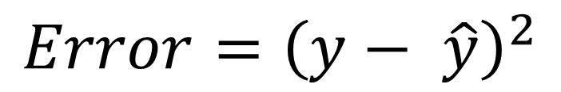


Linear Regression
$$\hat{y}=x×w$$
Machine starts with a random guess, w=random value
Distance from true line
$$\hat{y}$$
Hours(x) | Points(y)
1 | 2
2 | 4
3 | 6
$$y$$
$$Error={\left(y− \hat{y}\right)}^{2}$$

Slide 23
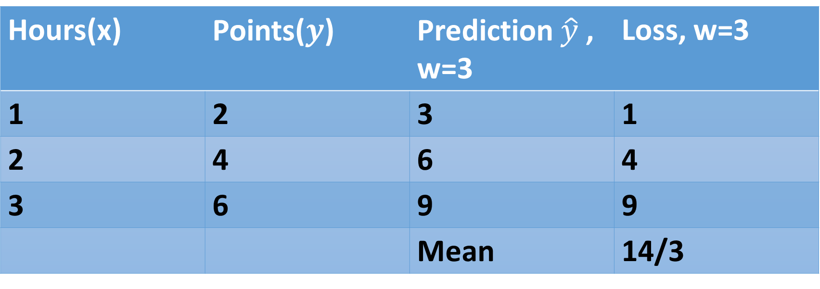
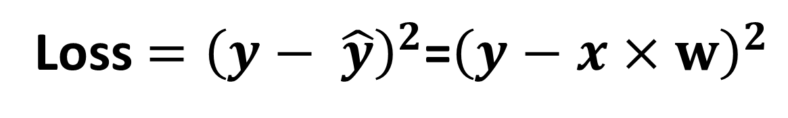
Training Loss (Error)
Loss $={\left(y− \hat{y}\right)}^{2}$=${\left(y−x×w\right)}^{2}$
Hours(x) | Points($y$) | Prediction $\hat{y}$ , w=3 | Loss, w=3
1 | 2 | 3 | 1
2 | 4 | 6 | 4
3 | 6 | 9 | 9
 |  | Mean | 14/3

Slide 24
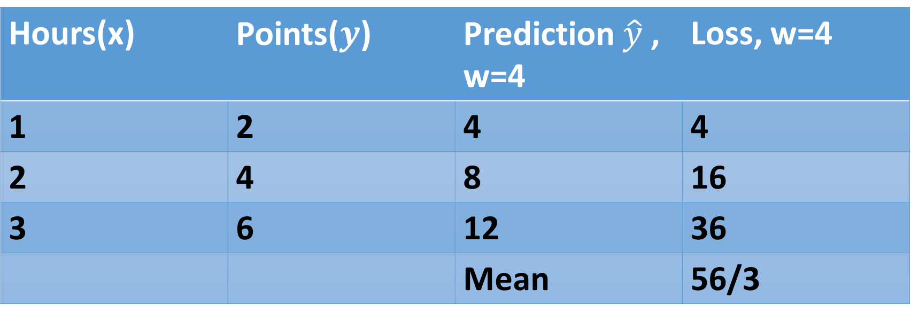
Training Loss (Error)
Loss $={\left(y− \hat{y}\right)}^{2}$=${\left(y−x×w\right)}^{2}$
Hours(x) | Points($y$) | Prediction $\hat{y}$ , w=4 | Loss, w=4
1 | 2 | 4 | 4
2 | 4 | 8 | 16
3 | 6 | 12 | 36
 |  | Mean | 56/3

Slide 25

Training Loss (Error)
Loss $={\left(y− \hat{y}\right)}^{2}$=${\left(y−x×w\right)}^{2}$
Hours(x) | Points($y$) | Prediction $\hat{y}$ , w=0 | Loss, w=0
1 | 2 | 0 | 4
2 | 4 | 0 | 16
3 | 6 | 0 | 36
 |  | Mean | 56/3

Slide 26

Training Loss (Error)
Loss $={\left(y− \hat{y}\right)}^{2}$=${\left(y−x×w\right)}^{2}$
Hours(x) | Points($y$) | Prediction $\hat{y}$ , w=1 | Loss, w=1
1 | 2 | 1 | 1
2 | 4 | 2 | 4
3 | 6 | 3 | 9
 |  | Mean | 14/3

Slide 27
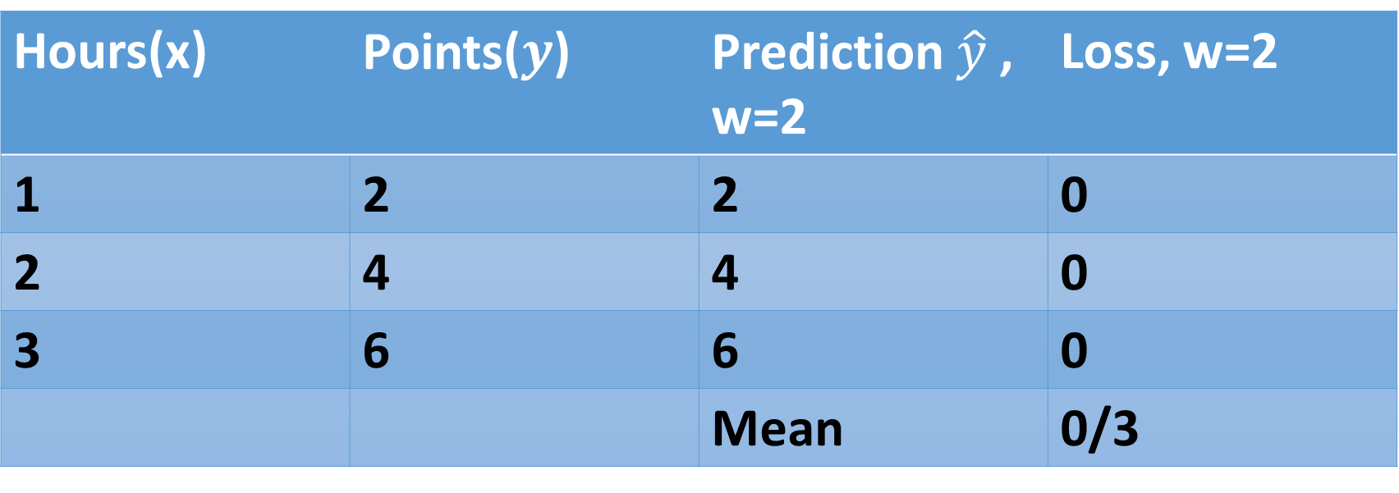
Training Loss (Error)
Loss $={\left(y− \hat{y}\right)}^{2}$=${\left(y−x×w\right)}^{2}$
Hours(x) | Points($y$) | Prediction $\hat{y}$ , w=2 | Loss, w=2
1 | 2 | 2 | 0
2 | 4 | 4 | 0
3 | 6 | 6 | 0
 |  | Mean | 0/3

Slide 28
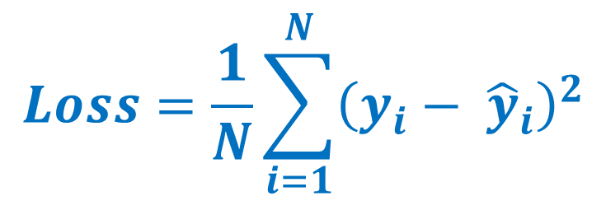
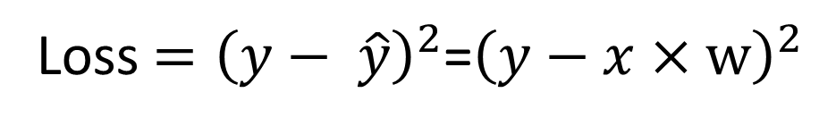
Training Loss (Error)
$$Loss=\frac{1}{N}\sum_{i=1}^{N}{{\left(y_{i}− {\hat{y}}_{i}\right)}^{2}}$$
Loss $={\left(y− \hat{y}\right)}^{2}$=${\left(y−x×w\right)}^{2}$
Hours(x) | Loss, w=0 | Loss, w=1 | Loss, w=2 | Loss, w=3 | Loss, w=4
1 | 4 | 1 | 0 | 1 | 4
2 | 16 | 4 | 0 | 4 | 16
3 | 36 | 9 | 0 | 9 | 36
MSE | 56/3=18.7 | 14/3=4.7 | 0/3=0 | 14/3=4.7 | 56/3=18.7

Slide 29
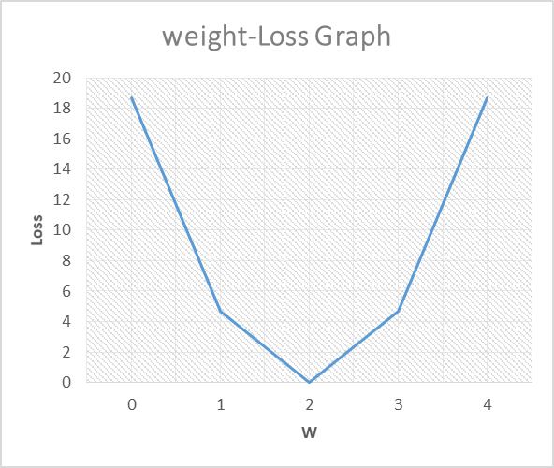
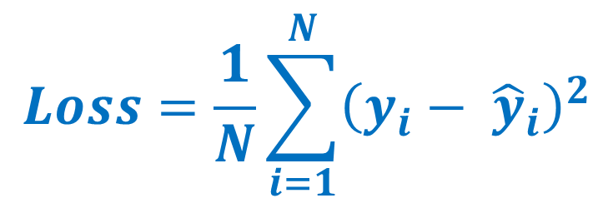
Loss Graph
$$Loss=\frac{1}{N}\sum_{i=1}^{N}{{\left(y_{i}− {\hat{y}}_{i}\right)}^{2}}$$

Slide 30
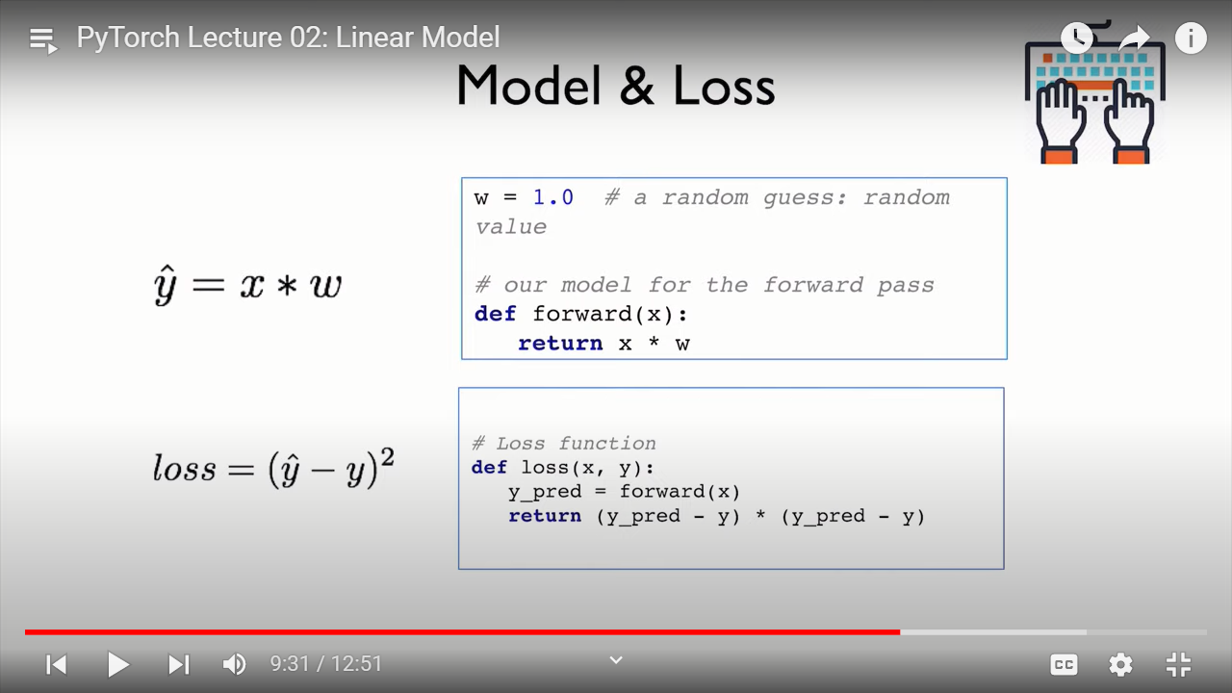
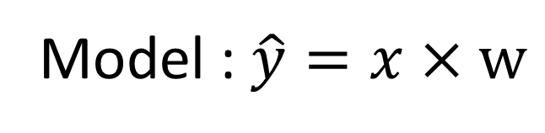
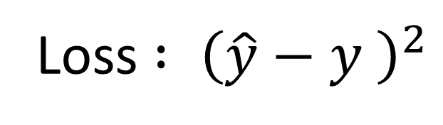
Model and Loss
Model : $\hat{y}=x×w$
Loss $: {\left(\hat{y}−y \right)}^{2}$

Slide 31
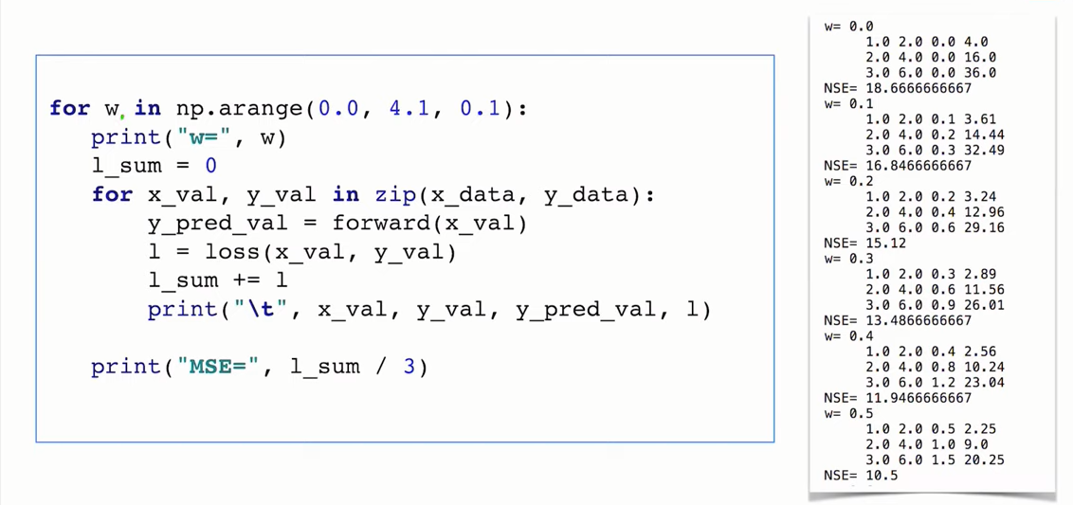
Compute Loss for w

Slide 32
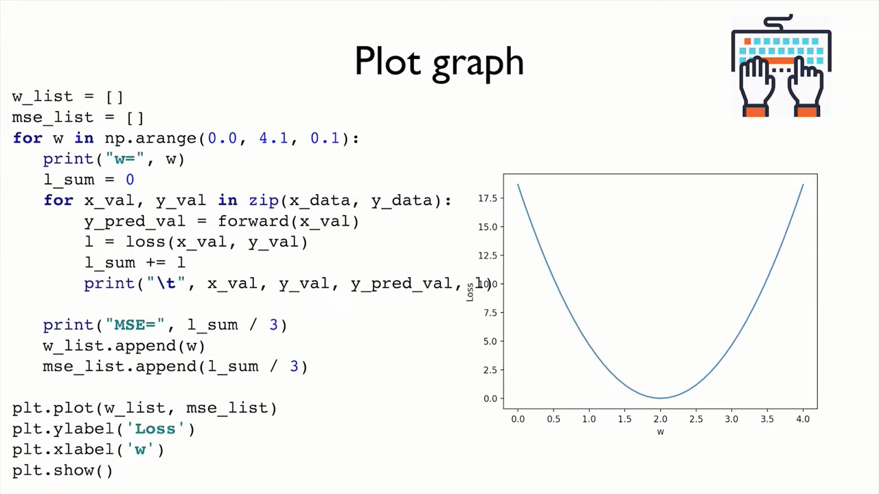

Slide 33
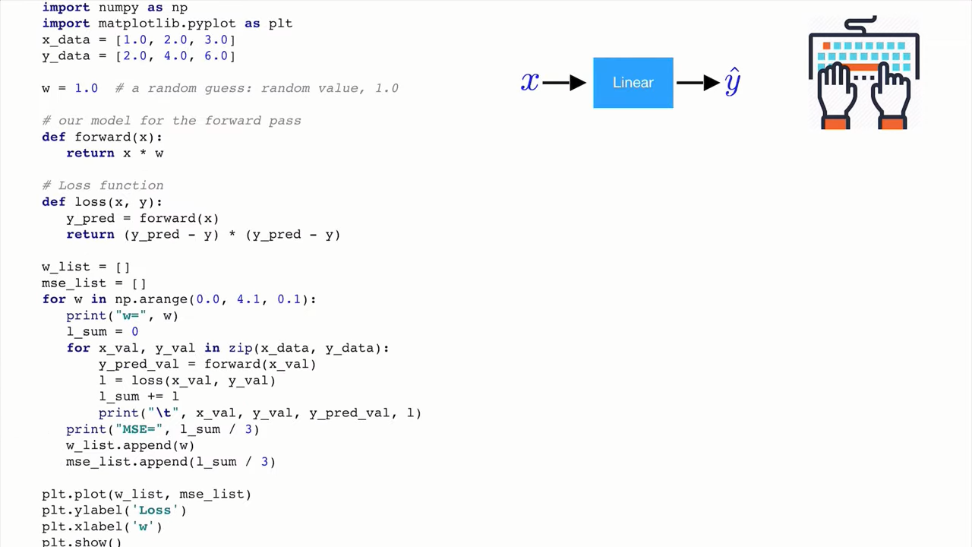

Slide 34
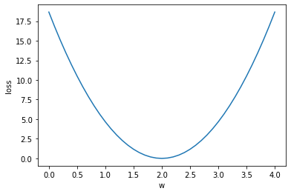
import numpy as np
import matplotlib.pyplot as plt
x_data=[1.0,2.0,3.0]
y_data=[2.0,4.0,6.0]
w=1.0 #random guess
def forward(x):
return x*w
def loss(x,y):
y_pred=forward(x)
return (y_pred-y)*(y_pred-y)
w_list=[]
mse_list=[]
for w in np.arange(0.0, 4.1, 0.1):
print("w=", w)
l_sum=0
for x_val,y_val in zip(x_data,y_data):
y_pred_val=forward(x_val)
l=loss(x_val,y_val)
l_sum=l_sum+l
print("\t",x_val,y_val,y_pred_val,l)
print("MSE=", l_sum/3)
w_list.append(w)
mse_list.append(l_sum/3)
plt.plot(w_list,mse_list)
plt.ylabel("loss")
plt.xlabel("w")
plt.show()

