Slide 1
Knowledge Representation and Reasoning:
Propositional and Predicate Logic

Slide 2
Intro..
Humans are best at understanding, reasoning, and interpreting knowledge.
Human knows things, which is knowledge and as per their knowledge they perform various actions in the real world.
But how machines do all these things comes under knowledge representation and reasoning

Slide 3
Intro..
Hence we can describe Knowledge representation as following:
  Knowledge representation and reasoning is the part of Artificial intelligence which concerned with AI agents thinking and how thinking contributes to intelligent behavior of agents.
  It is responsible for representing information about the real world so that a computer can understand and can utilize this knowledge to solve the complex real world problems such as
    diagnosis a medical condition or communicating with humans in natural language.
  It is also a way which describes how we can represent knowledge in artificial intelligence.
    Knowledge representation is not just storing data into some database,
    but it also enables an intelligent machine to learn from that knowledge and experiences so that it can behave intelligently like a human.

Slide 4
What to Represent?
Following are the kind of knowledge which needs to be represented in AI systems:
Object: All the facts about objects in our world domain. E.g., Guitars contains strings, trumpets are brass instruments.
Events: Events are the actions which occur in our world.
Performance: It describe behavior which involves knowledge about how to do things.
Meta-knowledge: It is knowledge about what we know.
Facts: Facts are the truths about the real world and what we represent.
Knowledge-Base: The central component of the knowledge-based agents is the knowledge base. It is represented as KB.
  The Knowledgebase is a group of the Sentences (Here, sentences are used as a technical term and not identical with the English language).

Slide 5
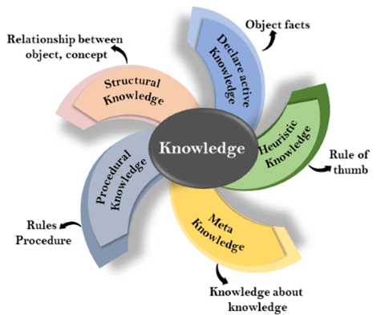
What is Knowledge?
Knowledge is awareness or familiarity gained by experiences of facts, data, and situations.
  Following are the types of knowledge in artificial intelligence:

Slide 6
…
1. Declarative Knowledge:
  Declarative knowledge is to know about something.
  It includes concepts, facts, and objects.
  It is also called descriptive knowledge and expressed in declarative sentences.
  It is simpler than procedural language.
2. Procedural Knowledge
  It is also known as imperative knowledge.
  Procedural knowledge is a type of knowledge which is responsible for knowing how to do something.
  It can be directly applied to any task.
  It includes rules, strategies, procedures, agendas, etc.
  Procedural knowledge depends on the task on which it can be applied.
Talking about actions

Slide 7
…
3. Meta-knowledge:
  Knowledge about the other types of knowledge is called Meta-knowledge.
4. Heuristic knowledge:
  Heuristic knowledge is representing knowledge of some experts in a filed or subject.
  Heuristic knowledge is rules of thumb based on previous experiences, awareness of approaches, and which are good to work but not guaranteed.
5. Structural knowledge:
  Structural knowledge is basic knowledge to problem-solving.
  It describes relationships between various concepts such as kind of, part of, and grouping of something.
  It describes the relationship that exists between concepts or objects.

Slide 8
The relation between knowledge and intelligence
Knowledge of real-worlds plays a vital role in intelligence and same for creating artificial intelligence.
  Knowledge plays an important role in demonstrating intelligent behavior in AI agents.
  An agent is only able to accurately act on some input when he has some knowledge or experience about that input.
Let's suppose if you met some person who is speaking in a language which you don't know, then how you will able to act on that.
  The same thing applies to the intelligent behavior of the agents.

Slide 9
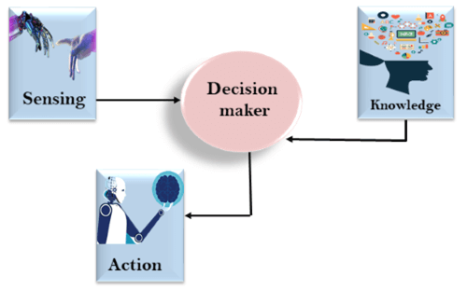
…
As we can see in below diagram, there is one decision maker which act by sensing the environment and using knowledge. But if the knowledge part will not present then, it cannot display intelligent behavior.

Slide 10
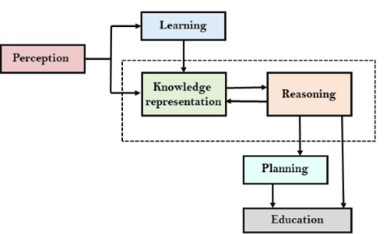
AI knowledge cycle
An Artificial intelligence system has the following components for displaying intelligent behavior:
  Perception, Learning, Knowledge Representation and Reasoning, Planning and Execution
The diagram is showing how an AI system can interact with the real world and what components help it to show intelligence. AI system has
  Perception component by which it retrieves information from its environment. It can be visual, audio or another form of sensory input.
  The learning component is responsible for learning from data captured by Perception comportment.
  In the complete cycle, the main components are knowledge representation and Reasoning. These two components are involved in showing the intelligence in machine-like humans. These two components are independent with each other but also coupled together. The planning and execution depend on analysis of Knowledge representation and reasoning.

Slide 11
Approaches to knowledge representation
There are mainly four approaches to knowledge representation, which are given below:
1. Simple relational knowledge:
  It is the simplest way of storing facts which uses the relational method, and each fact about a set of the object is set out systematically in columns.
  This approach of knowledge representation is famous in database systems where the relationship between different entities is represented.
  This approach has little opportunity for inference.
a conclusion reached on the basis of evidence and reasoning.

Slide 12
2. Inheritable knowledge:
In the inheritable knowledge approach, all data must be stored into a hierarchy of classes.
All classes should be arranged in a generalized form or a hierarchal manner.
In this approach, we apply inheritance property.
Elements inherit values from other members of a class.
This approach contains inheritable knowledge which shows a relation between instance and class, and it is called instance relation.
Every individual frame can represent the collection of attributes and its value.
In this approach, objects and values are represented in Boxed nodes.
We use Arrows which point from objects to their values.

Slide 13
3. Inferential knowledge
Inferential knowledge approach represents knowledge in the form of formal logics.
This approach can be used to derive more facts.
It guaranteed correctness.
  Example: Let's suppose there are two statements:
  1. Marcus is a man
  2. All men are mortal
  Then it can represent as;
  man(Marcus)
  ∀x = man (x) ----------> mortal (x)s

Slide 14
4. Procedural knowledge
Procedural knowledge approach uses small programs and codes which describes how to do specific things, and how to proceed.
In this approach, one important rule is used which is If-Then rule.
In this knowledge, we can use various coding languages such as LISP language and Prolog language.
We can easily represent heuristic or domain-specific knowledge using this approach.
But it is not necessary that we can represent all cases in this approach.

Slide 15
Requirements for knowledge Representation system
A good knowledge representation system must possess the following properties.
  1. Representational Accuracy:
  system should have the ability to represent all kind of required knowledge.
  2. Inferential Adequacy:
    system should have ability to manipulate the representational structures to produce new knowledge corresponding to existing structure.
  3. Inferential Efficiency:
    The ability to direct the inferential knowledge mechanism into the most productive directions by storing appropriate guides.
  4. Acquisitional efficiency:
    The ability to acquire the new knowledge easily using automatic methods.

Slide 16
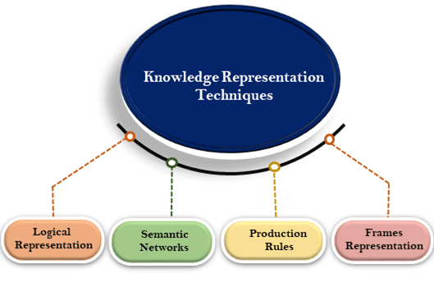

Slide 17
1. Logical Representation
Logical representation is a language with some concrete rules which deals with propositions and has no ambiguity in representation.
  Logical representation means drawing a conclusion based on various conditions. This representation lays down some important communication rules. It consists of precisely defined syntax and semantics which supports the sound inference. Each sentence can be translated into logics using syntax and semantics.
  Syntax: Syntaxes are the rules which decide how we can construct legal sentences in the logic.
    It determines which symbol we can use in knowledge representation.
    How to write those symbols.
  Semantics:
    Semantics are the rules by which we can interpret the sentence in the logic.
    Semantic also involves assigning a meaning to each sentence.
Logical representation can be categorized into mainly two logics:
  Propositional Logics: representation in terms of T and F
  Predicate logics: In terms of quantifiers like There Exist, For All

Slide 18
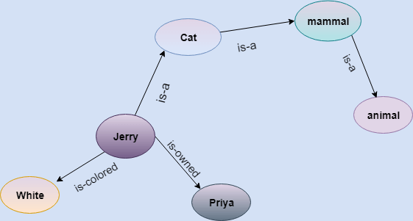
2. Semantic Network Representation
Semantic networks are alternative of predicate logic for knowledge representation.
In Semantic networks, we can represent our knowledge in the form of graphical networks.
This network consists of nodes representing objects and arcs which describe the relationship between those objects.

Slide 19
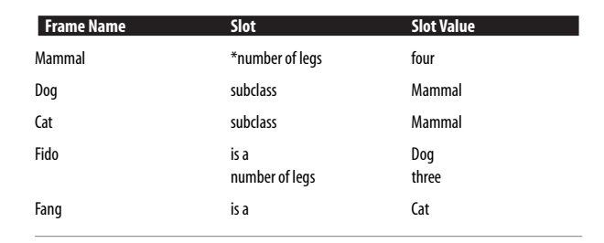
3. Frame Representation
A frame is a record like structure which consists of a collection of attributes and its values to describe an entity in the world.
  Frames are the AI data structure which divides knowledge into substructures by representing stereotypes situations.

Slide 20
4. Production Rules
Production rules system consist of (condition, action) pairs which mean, "If condition then action". It has mainly three parts:
The set of production rules
Working Memory
The recognize-act-cycle
In production rules agent checks for the condition and if the condition exists then production rule fires and corresponding action is carried out. The condition part of the rule determines which rule may be applied to a problem. And the action part carries out the associated problem-solving steps. This complete process is called a recognize-act cycle.
The working memory contains the description of the current state of problems-solving and rule can write knowledge to the working memory. This knowledge match and may fire other rules.
If there is a new situation (state) generates, then multiple production rules will be fired together, this is called conflict set. In this situation, the agent needs to select a rule from these sets, and it is called a conflict resolution.

Slide 21
Propositional logic
a statement or assertion that expresses a judgment or opinion.
Propositional logic is the simplest form of logic where all the statements are made by propositions.
  A proposition is a declarative statement which is either true or false.
  It is a technique of knowledge representation in logical and mathematical forma) It is Sunday.
  Examples:
    a) The Sun rises from West (False proposition)
    b) 3+3= 7(False proposition)
    c) 5 is a prime number (True proposition)

Slide 22
Following are some basic facts about propositional logic
Propositional logic is also called Boolean logic as it works on 0 and 1.
In propositional logic, we use symbolic variables to represent the logic, and we can use any symbol for a representing a proposition, such A, B, C, P, Q, R, etc.
Propositions can be either true or false, but it cannot be both.
Propositional logic consists of an object, relations or function, and logical connectives.
These connectives are also called logical operators.
The propositions and connectives are the basic elements of the propositional logic.
Connectives can be said as a logical operator which connects two sentences.
A proposition formula which is always true is called tautology, and it is also called a valid sentence.
A proposition formula which is always false is called Contradiction.
A proposition formula which has both true and false values is called Contingency.
Statements which are questions, commands, or opinions are not propositions such as "Where is Osama", "How are you", "What is your name", are not propositions.

Slide 23
Syntax of propositional logic
The syntax of propositional logic defines the allowable sentences for the knowledge representation. There are two types of Propositions:
Atomic Proposition: Atomic propositions are the simple propositions. It consists of a single proposition symbol. These are the sentences which must be either true or false.
  Example:
    a) 2+2 is 4, it is an atomic proposition as it is a true fact.
    b) "The Sun is cold" is also a proposition as it is a false fact.
Compound proposition: Compound propositions are constructed by combining simpler or atomic propositions, using parenthesis and logical connectives.
    a) "It is raining today, and street is wet."
    b) “Sajid is a doctor, and his clinic is in Attock."

Slide 24
Logical Connectives
Logical connectives are used to connect two simpler propositions or representing a sentence logically. We can create compound propositions with the help of logical connectives. There are mainly five connectives, which are given as follows:
Negation: A sentence such as ¬ P is called negation of P. A literal can be either Positive literal or negative literal.
Conjunction: A sentence which has ∧ connective such as, P ∧ Q is called a conjunction. Example: Rashid is intelligent and hardworking. It can be written as, P= Rashid is intelligent, Q= Rashid is hardworking. → P∧ Q.
Disjunction: A sentence which has ∨ connective, such as P ∨ Q. is called disjunction, where P and Q are the propositions. Example: “Ahmad is a doctor or Engineer", Here P= Ahmad is Doctor. Q= Ahmad is Engineer, so we can write it as P ∨ Q.
Implication: A sentence such as P → Q, is called an implication. Implications are also known as if-then rules. It can be represented as If it is raining, then the street is wet. Let P= It is raining, and Q= Street is wet, so it is represented as P → Q
  If you try hard for your exam then you will succeed. If you get 100% marks then you will get a trophy
Bi-conditional: A sentence such as P⇔ Q is a Bi-conditional sentence, example If I am breathing, then I am alive P= I am breathing, Q= I am alive, it can be represented as P ⇔ Q.

Slide 25
Limitations of Propositional logic
We cannot represent relations like ALL, some, or none with propositional logic. Example:
  All the humans are intelligent.
  Some apples are sweet.
Propositional logic has limited expressive power.
In propositional logic, we cannot describe statements in terms of their properties or logical relationships.

Slide 26
Rules of Inference in Artificial intelligence
Inference:
  In artificial intelligence, we need intelligent computers which can create new logic from old logic or by evidence, so generating the conclusions from evidence and facts is termed as Inference.
Inference rules:
  Inference rules are the templates for generating valid arguments. Inference rules are applied to derive proofs in artificial intelligence, and the proof is a sequence of the conclusion that leads to the desired goal.

Slide 27
In inference rules, the implication among all the connectives plays an important role. Following are some terminologies related to inference rules:
Implication: It is one of the logical connectives which can be represented as P → Q. It is a Boolean expression.
Converse: The converse of implication, which means the right-hand side proposition goes to the left-hand side and vice-versa. It can be written as Q → P.
Contrapositive: The negation of converse is termed as contrapositive, and it can be represented as ¬ Q → ¬ P.
Inverse: The negation of implication is called inverse. It can be represented as ¬ P → ¬ Q.

Slide 28
Example
Implication: If it rains today then I will stay at home
Converse: If I will stay at home then it rains today
Contrapositive: If I will not stay at home then it does not rain today
Inverse: If it does not rain today then I will not stay at home
FACTS: implication and contrapositive both are equivalent
Converse and inverse both are equivalent

Slide 29
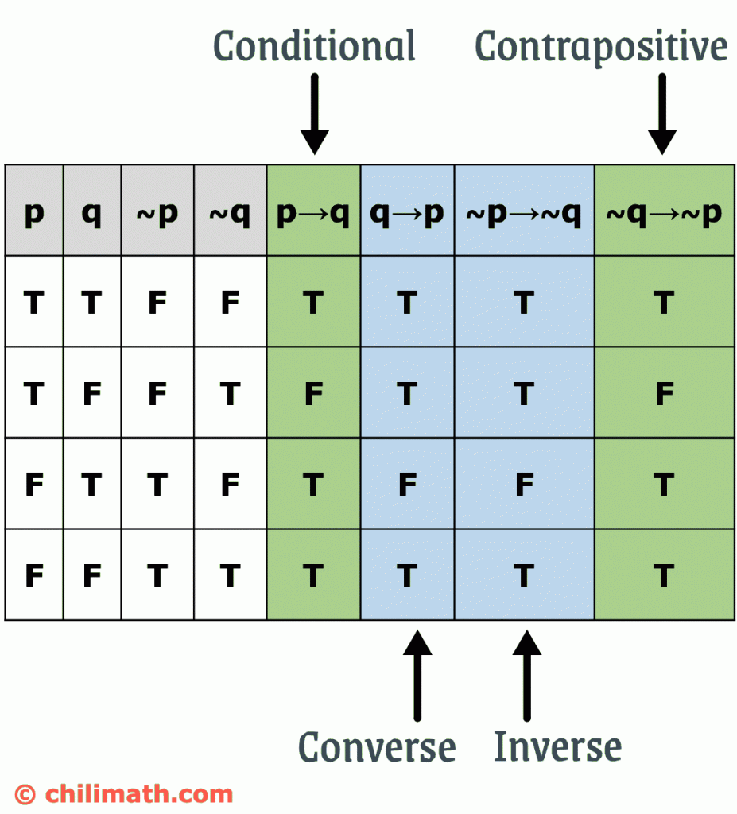

Slide 30
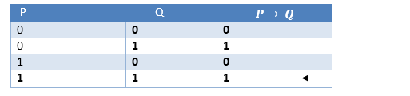
Types of Inference rules
1. Modus Ponens:
  The Modus Ponens rule is one of the most important rules of inference, and it states that if P and P → Q is true, then we can infer that Q will be true. It can be represented as:
Example:
Statement-1: "If I am sleepy then I go to bed" ==> P→ Q
Statement-2: "I am sleepy" ==> P
Conclusion: "I go to bed." ==> Q.
Hence, we can say that, if P→ Q is true and P is true then Q will be true.

Slide 31
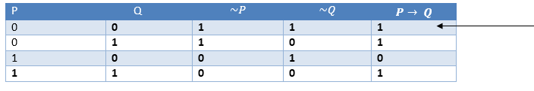
2. Modus Tollens
The Modus Tollens rule state that if P→ Q is true and ¬ Q is true, then ¬ P will also true. It can be represented as:
Statement-1: "If I am sleepy then I go to bed" ==> P→ Q
Statement-2: "I do not go to the bed."==> ~Q
Statement-3: Which infers that "I am not sleepy" => ~P

Slide 32
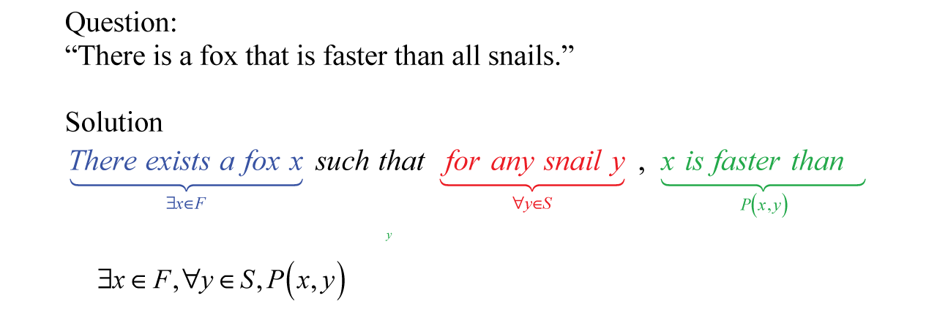
What is predicate logic?
Predicate logic is a mathematical model that is used for reasoning with predicates.
  Predicates are functions that map variables to truth values. They are essentially boolean functions whose value could be true or false, depending on the arguments to the predicate.

Slide 33
Existential Quantifier
If p(x) is a proposition over the universe U. Then it is denoted as ∃x p(x) and read as "There exists at least one value in the universe of variable x such that p(x) is true. The quantifier ∃ is called the existential quantifier.
There are several ways to write a proposition, with an existential quantifier, i.e.,
(∃x∈A)p(x) or ∃x∈A such that p (x) or (∃x)p(x) or p(x) is true for some x ∈A.

Slide 34
Universal Quantifier
If p(x) is a proposition over the universe U. Then it is denoted as ∀x, p(x) and read as "For every x∈U, p(x) is true." The quantifier ∀ is called the Universal Quantifier.
There are several ways to write a proposition, with a universal quantifier.
∀x∈A,p(x) or p(x), ∀x ∈A Or ∀x,p(x) or p(x) is true for all x ∈A.

Slide 35
What is first-order predicate logic? And its example?
First-order logic refers to the symbolized reasoning in which the sentences and statements are divided into a subject & a predicate in the predicate logic model. The predicate modifies or defines the properties of the subject in the logic statement.
In first-order logic, a predicate can only refer to a single subject. First-order logic is also called first-order predicate calculus or first-order functional calculus.
A sentence in first-order logic is written in the below format:
Px or P(x);
Where P is the predicate; and
x as the subject represented as a variable.

Slide 36
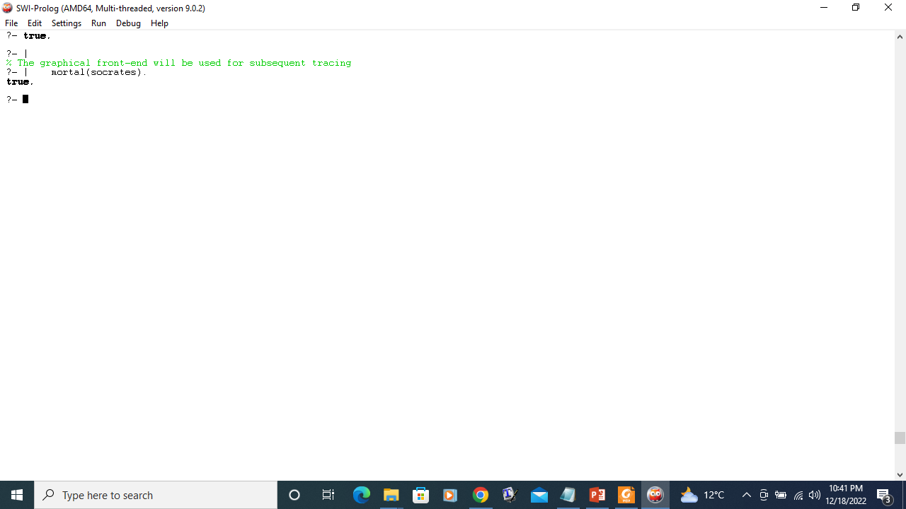
Predicate Logic using Prolog
Prolog (``PROgramming in LOGic'') is a programming language based on the predicate calculus, reformatted in such a style.
Here is a quick example. Recall the classic example: ``all humans are mortal; Socrates is human; therefore, Socrates is mortal.'' Here is how the first two clauses are written in predicate logic:
∀X(human(X) —> mortal(X))
human(socrates)
The two propositions look like this when written as Prolog code:
mortal(X) :- human(X).
human(socrates).
(The ∀ is deleted, and —> is ``flipped'' into :-.)
The Prolog interpreter (theorem prover) reads and saves the above program. We ask the interpreter to prove `` Socrates is mortal'' like this:
?- mortal(socrates).
The prover builds the proof (using the resolution technique from the last chapter) and prints
true
meaning that it found a proof.

Slide 37
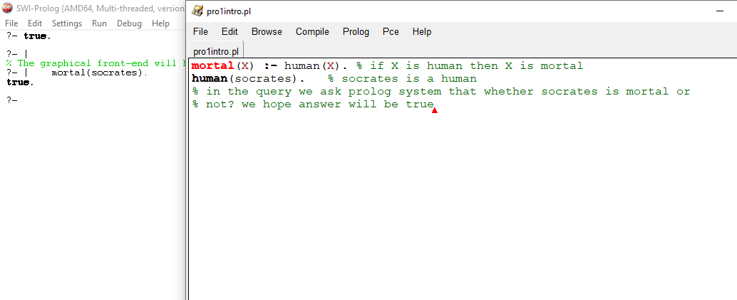

Slide 38
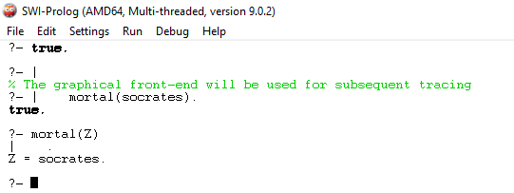
We can even ask the Prolog interpreter to discover who it is that is mortal, like this:
?- mortal(Z).
(That is, we ask to prove the proposition, ∃Z mortal(Z)). The interpreter replies with
Z = socrates
showing that it built the proof, using socrates as the ``witness'' for Z.

