Slide 1
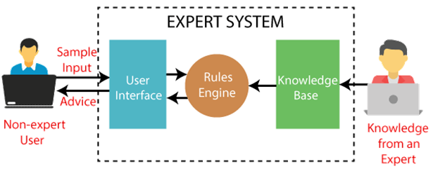
Expert System

Slide 2
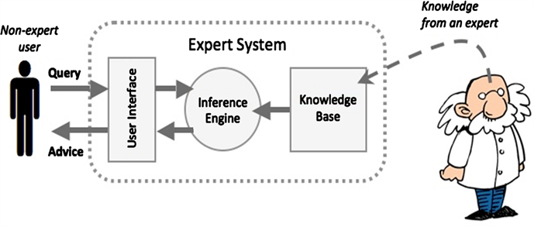
The Concept of Expert System

Slide 3
What is Expert System
An expert system is a computer program that is designed to solve complex problems and to provide decision-making ability like a human expert.

Slide 4
Intro…
Expert systems are computer applications which embody some non-algorithmic expertise for solving certain types of problems.
For example, expert systems are used in diagnostic applications servicing both people and machinery.
They also play chess, make financial planning decisions, configure computers, monitor real time systems, underwrite insurance policies, and perform many other services which previously required human expertise.

Slide 5
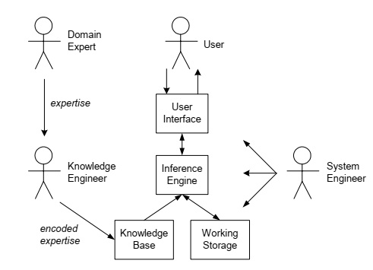
Expert System Components and Human Interfaces

Slide 6
ES components
Knowledge base – a declarative representation of the expertise, often in IF THEN rules;
Working storage – the data that is specific to a problem being solved;
Inference engine – the code at the core of the system, which derives recommendations from the knowledge base and problem-specific data in working storage;
User interface – the code that controls the dialog between the user and the system.

Slide 7
Major roles of individuals who interact with the system
Domain expert – the individual or individuals who currently are experts solving the problems the system is intended to solve;
Knowledge engineer – the individual who encodes the expert's knowledge in a declarative form that can be used by the expert system;
User – the individual who will be consulting with the system to get advice that would have been provided by the domain expert.

Slide 8
Expert System shells
Many expert systems are built with products called expert system shells.
The shell is a piece of software which contains the user interface, a format for declarative knowledge in the knowledge base, and an inference engine.
The knowledge engineer uses the shell to build a system for a particular problem domain.

Slide 9
When System Engineer is required?
When the shell does not provide the user interface, a format for declarative knowledge in the knowledge base, and an inference engine, then an expert is required to build these components.
System engineer – the individual who builds the user interface, designs the declarative format of the knowledge base, and implements the inference engine.

Slide 10
Expert System Features
Goal driven reasoning or backward chaining – an inference technique which uses IF THEN rules to repetitively break a goal into smaller sub-goals, which are easier to prove;
Coping with uncertainty – the ability of the system to reason with rules and data that are not precisely known;
Data driven reasoning or forward chaining – an inference technique that uses IF THEN rules to deduce a problem solution from initial data;
Data representation – the way in which the problem specific data in the system is stored and accessed;
User interface – that portion of the code that creates an easy-to-use system;
Explanations – the ability of the system to explain the reasoning process that it used to reach a recommendation.

Slide 11
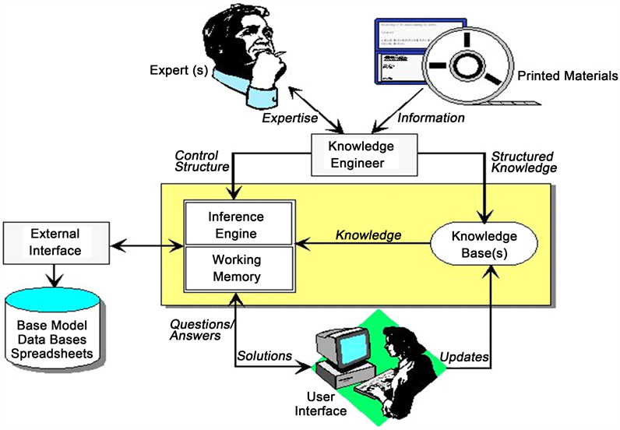
A typical architecture of an expert system

Slide 12
MYCIN Expert System – The First AI Medical Diagnosis
MYCIN was advanced for its time and had a competence level comparable to blood infection specialists and greater accuracy than general practitioners. The thought processes that it used were similar to human thought.
Researchers wrote this system in Lisp, a set of multiple programming languages designed to work with artificial intelligence. This system was the first system of its kind invented for medical usage.
MYCIN’s foundations came from another framework developed at Stanford called DENDRAL. This system helped find new chemical compounds in the organic chemistry field.

Slide 13
MYCIN Expert System History
Edward Shortliffe, the developer, was with the Department of Medicine and Computer Science at Stanford University School of Medicine.
During its usage, this expert system provided recommendations about antibiotics to use for patients with meningitis.
Advantages of this system included a high degree of accuracy; however,
disadvantages included not exceeding human competency levels to that high a degree.

Slide 14
MYCIN Expert System: How It Worked
MYCIN was an expert system using backward chaining, a form of artificial intelligence.
In this context, backward chaining helped determine that the patient had an infection and worked back through several steps to determine the type of bacteria and which antibiotics to use.
Advantages included making it easier to find out the causes because of the known endpoint.

Slide 15
Prolog Syntax
There are just five symbols or things that you have to remember which covers a lot of Prolog Syntax:
:- means this arrow → (meaning “it implies that”)
, which means AND
; represents OR
A any word written with a capital letter is a variable
. represents end
() for enclosing data/information

Slide 16
Facts and Rules
A FACT is basically a thing that is known or proved to be true. For example, Alex is a Male, Tweety is a Bird, A Bicycle has two tires.
Based on the facts we make RULES.
Example 1:
Facts: The bathroom is dry. The hall is wet. There is a leak in the kitchen.
Rule: IF the bathroom is dry AND the hall is wet THEN there is a leak in the kitchen.

Slide 17
Example 2
If Alex is the father of Matt, and Matt is the father of Quinn that means Alex is the grandfather of Quinn.
Let generalize it: If X is the father of Y, and Y is the father of Z that implies X is the grandfather of Z.
father(alex,matt).
father(matt,quinn).
grandfather(X,Y):-father(X,Z),father(Z,Y).
Ask Now
Who is the father of matt? father(K,matt).
Who is the grandfather of Quinn? grandfather(V,quinn).
Is Alex is the grandfather of Quinn? grandfather(alex,quinn).

Slide 18
Factor Table
A factor table is a simple table that can be made using an excel sheet and is a part of Knowledge Representation.
Knowledge representation is a brief note of the expert system.
In the factor table, we just represent the knowledge we have and this makes it easy for us to write rules and facts.

Slide 19
Steps to design Expert System in Prolog
So here are the steps of how our expert system will be created:
Write a brief description of the knowledge we have for the system and from that knowledge, we’ll make the factor table
From the factor table, we’ll write rules (production rules)
Write those rules in the prolog

Slide 20
An expert system that suggests a song to you based on your personality type and mood.
For our expert system we are considering 2 types of moods. We are categorizing moods generally in these two types:
Happy
Sad

Slide 21
We just need to ask the person these questions:
Are you an Introvert or Extrovert?
Are you Intuitive or Observant?
Are you Thinking or Feeling?
Are you Judging or Prospecting?
(we will just ask the user to enter their personality type)
How is your mood?
So the top two questions will suggest a song link to the user. Let’s create a factor table which will simplify the knowledge for us.
Shy
Social
perceive beyond the workings of consciousness
flexible
planned

Slide 22
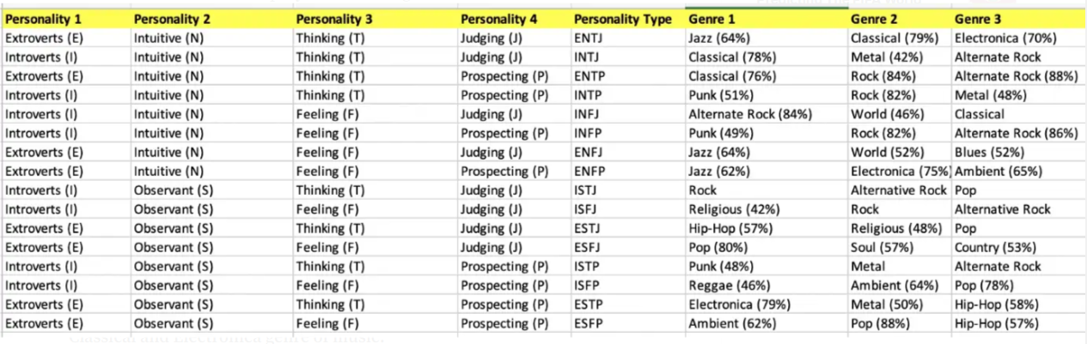
Factor Table
This is a factor table that we have made using the brief note above:

Slide 23
Usable Factor Table
We can write the facts and rules using this but
first, let’s make another factor table because we can make a simplified version of the above table.
And this table will work as the main table based on which we’ll be writing our logic.

Slide 24
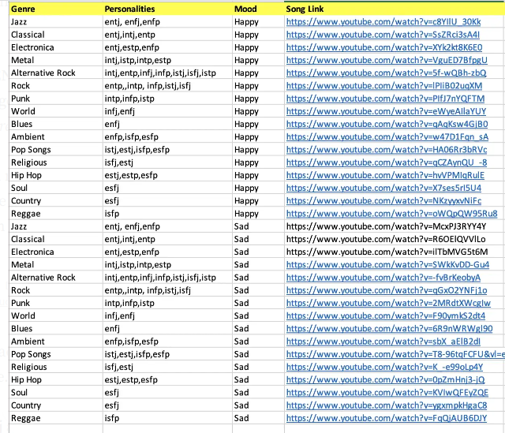

Slide 25
Why second table?
It’s all about creating the factor table that makes it easier for you to understand and write code. This second/main factor table indicates that:
Personalities entj and enfj and enfp when happy listen to jazz so here is a link that we can suggest.

Slide 26
Production Rules & Predicate Logic
Let’s define some facts and rules along with that we write the predicate logic. So some facts would be:
ENTJ is a personality
P(x) means x is a personality
Happy/Sad is a mood.
M(x) means x is a mood.
https://www.youtube.com/watch?v=c8YIlU_30Kk song is of Jazz Genre.
S(x,y) means song x is of y genre

Slide 27
So these are the basic facts that we’ll use for all of our logic. For example, if we have to write:
Suggest song link https://www.youtube.com/watch?v=c8YIlU_30Kk of jazz genre implies that the person’s mood is happy and he is of entj or enfj or enfp personality type.
In predicate logic, it’ll be:
∀x: S(x,y) → M(x) ∧ P(x) ∨ P(x) ∨ P(x)

Slide 28
Let’s code Prolog!
Remember the Prolog Syntax discussed in the start. Let’s use that to write a rule-based on our factor table.
song('https://www.youtube.com/watch?v=c8YIlU_30Kk',jazz,M,P):- M = happy ,(P= (entj) ; P=(enfj) ; P=(enfp)),!.
This line of code when translated to English becomes:
Song ‘https://www.youtube.com/watch?v=c8YIlU_30Kk' of jazz genre implies that mood is happy and personality is entj or enfj or enfp.

Slide 29
Explanation
The code indicates that for a song we’ll have song link and genre which are the known variables in this rule because we know it's a fact that this song is of which genre.
M which stands for Mood and P which stands for Personality are the unknown variables and will require the user’s input. Remember everything that is written with a capital letter at the start considered as a variable.
You can also see the usage of , and ; which represents AND and OR in prolog syntax. We used () to keep the OR conditions together.
! at the end of the line is called cut and is used to reduce backtracking. It’s optional you can remove ,! if you want and it’ll not affect the output.

Slide 30
song('https://www.youtube.com/watch?v=c8YIlU_30Kk',jazz,M,P):- M = happy ,(P= (entj) ; P=(enfj) ; P=(enfp)),!.
song('https://www.youtube.com/watch?v=SsZRci3sA4I',classical,M,P):- M = happy ,(P= (entj) ; P=(intj) ; P=(entp) ; P=(infj)),!.
song('https://www.youtube.com/watch?v=XYk2kt8K6E0',electronica,M,P):- M = happy ,(P= (entj) ; P=(estp) ; P=(enfp)),!.
song('https://www.youtube.com/watch?v=VguED7BfpgU',metal,M,P):- M = happy ,(P= (intj) ; P=(istp) ; P=(intp) ; P=(estp)),!.
song('https://www.youtube.com/watch?v=5f-wQBh-zbQ',alternative_rock,M,P):- M = happy ,(P= (intj) ; P=(entp) ; P=(infj) ; P=(infp) ; P=(istj) ; P=(isfj) ; P=(istp)),!.
song('https://www.youtube.com/watch?v=lPIiB02uqXM',rock,M,P):- M = happy ,(P= (entp) ; P=(intp) ; P=(infp) ; P=(istj) ; P=(isfj)),!.
song('https://www.youtube.com/watch?v=PIfJ7nYQFTM',punk,M,P):- M = happy ,(P= (intp) ; P=(infp) ; P=(istp)),!.
song('https://www.youtube.com/watch?v=eWyeAIlaYUY',world,M,P):- M = happy ,(P= (infj) ; P=(enfj)),!.
song('https://www.youtube.com/watch?v=qAqKsw4GjB0',blues,M,P):- M = happy ,(P= (enfj)),!.
song('https://www.youtube.com/watch?v=w47D1Fqn_sA',ambient,M,P):- M = happy ,(P= (enfp) ; P=(isfp) ; P=(esfp)),!.
song('https://www.youtube.com/watch?v=HA06Rr3bRVc',pop_songs,M,P):- M = happy ,(P= (istj) ; P=(estj) ; P=(isfp) ; P=(esfp)),!.
song('https://www.youtube.com/watch?v=qCZAynQU_-8',religious,M,P):- M = happy ,(P= (isfj) ; P=(estj)),!.
song('https://www.youtube.com/watch?v=hvVPMIqRulE',hip_hop,M,P):- M = happy ,(P= (estj) ; P=(estp) ; P=(esfp)),!.
song('https://www.youtube.com/watch?v=X7ses5rI5U4',soul,M,P):- M = happy ,(P= (esfj)),!.
song('https://www.youtube.com/watch?v=NKzyyxvNiFc',country,M,P):- M = happy ,(P= (esfj)),!.
song('https://www.youtube.com/watch?v=oWQpQW95Ru8',reggae,M,P):- M = happy ,(P= (isfp)),!.
song('https://www.youtube.com/watch?v=McxPJ3RYY4Y',jazz,M,P):- M = sad ,(P= (entj) ; P=(enfj) ; P=(enfp)),!.
song('https://www.youtube.com/watch?v=R6OElQVVlLo',classical,M,P):- M = sad ,(P= (entj) ; P=(intj) ; P=(entp) ; P=(infj)),!.
song('https://www.youtube.com/watch?v=ilTbMVG5t6M',electronica,M,P):- M = sad ,(P= (entj) ; P=(estp) ; P=(enfp)),!.
song('https://www.youtube.com/watch?v=SWkKvDD-Gu4',metal,M,P):- M = sad ,(P= (intj) ; P=(istp) ; P=(intp) ; P=(estp)),!.
The CODE
song('https://www.youtube.com/watch?v=-fvBrKeobyA',alternative_rock,M,P):- M = sad ,(P= (intj) ; P=(entp) ; P=(infj) ; P=(infp) ; P=(istj) ; P=(isfj) ; P=(istp)),!.
song('https://www.youtube.com/watch?v=qGxO2YNFj1o',rock,M,P):- M = sad ,(P= (entp) ; P=(intp) ; P=(infp) ; P=(istj) ; P=(isfj)),!.
song('https://www.youtube.com/watch?v=2MRdtXWcgIw',punk,M,P):- M = sad ,(P= (intp) ; P=(infp) ; P=(istp)),!.
song('https://www.youtube.com/watch?v=F90ymkS2dt4',world,M,P):- M = sad ,(P= (infj) ; P=(enfj)),!.
song('https://www.youtube.com/watch?v=6R9nWRWgl90',blues,M,P):- M = sad ,(P= (enfj)),!.
song('https://www.youtube.com/watch?v=sbX_aElB2dI',ambient,M,P):- M = sad ,(P= (enfp) ; P=(isfp) ; P=(esfp)),!.
song('https://www.youtube.com/watch?v=T8-96tqFCFU&vl=en',pop_songs,M,P):- M = sad ,(P= (istj) ; P=(estj) ; P=(isfp) ; P=(esfp)),!.
song('https://www.youtube.com/watch?v=K_-e99oLp4Y',religious,M,P):- M = sad ,(P= (isfj) ; P=(estj)),!.
song('https://www.youtube.com/watch?v=0pZmHnj3-jQ',hip_hop,M,P):- M = sad ,(P= (estj) ; P=(estp) ; P=(esfp)),!.
song('https://www.youtube.com/watch?v=KVIwQFEyZQE',soul,M,P):- M = sad ,(P= (esfj)),!.
song('https://www.youtube.com/watch?v=ygxmpkHgaC8',country,M,P):- M = sad ,(P= (esfj)),!.
song('https://www.youtube.com/watch?v=FqQjAUB6DJY',reggae,M,P):- M = sad ,(P= (isfp)),!.

Slide 31
The above messy code requires a lot of concentration to know if you have written down every rule correctly. It’s the same song(_,_,_,_) that I’ve defined above but for every personality type and for all moods and genres as per my factor table.
We use _ when we don’t want to give a variable value. _ is just used to fill the space but not to print anything.
So now we have the rules in place. The last thing is to ask users about their personality type and their mood so that we can fill the M and P variable.
There is a built-in predicate in prolog called read() and write() that we’ll use to take user input. So here’s the code for that:
suggest(S) :- write('What is your personality type?: '),read(P),write('How is your mood?: '),read(M), song(S,_,M,P).
We have a simple predicate, named suggest(S) where S symbolizes as a song. Then we say write(what is your personality type?) and then wait to read(P) and then write(How is your mood?) and then again wait to read(M) and then call song(S,_,M,P)
As our song requires 4 variables and we only have three right now. So just to ignore genre, as it’s not important for the end-user to know, we are using _ as a replacement of genre.

Slide 32
That’s it! Let’s RUN IT!!!
Open SWI-Prolog and from the menu select File > Consult then in the console write:
suggest(Song).
and it’ll ask you the two questions and based on your answers it’ll print out the suggestion for you.

Slide 33
